Slide 1
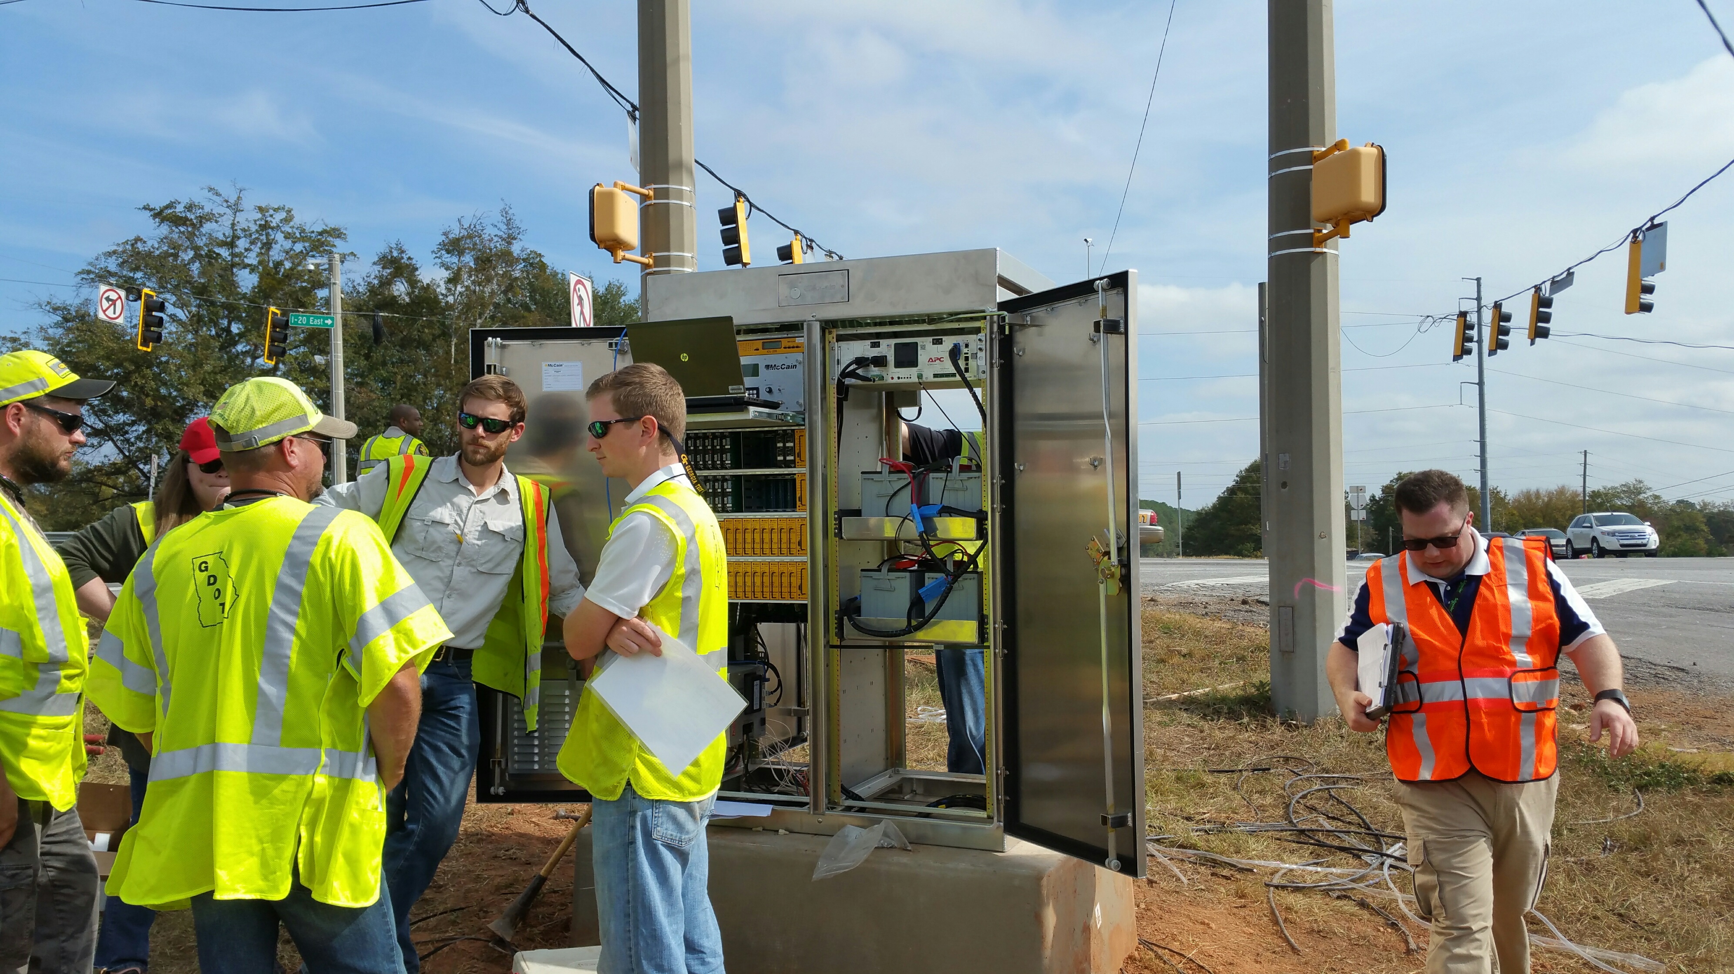
Cabinet trouble shooting
Eric Itzel
Jeff Pearson
Mccain, Inc.

Slide 2
AGENDA
WHAT’S UP FOR DISCUSSION
RECAP – KEY ASSEMBLIES AND COMponents
Atcc product and news updates
Troubleshooting atcc components
Troubleshooting atcc from within omni
Troubleshooting edi components
Other cases and scenarios

Slide 3
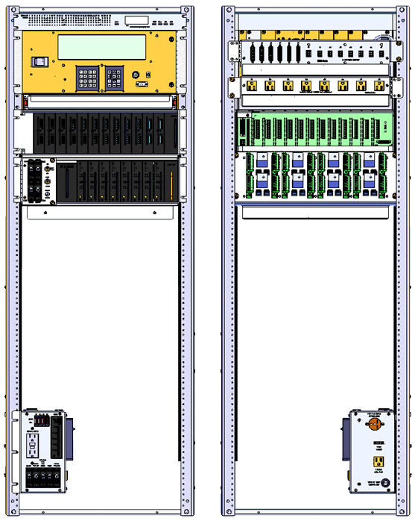
Key assemblies & components
ADU
Aux display unit
Cabinet power supply*
ATC-CU
2070 ATC controller
Power bus assembly*
SB1/SB2
Drawer
AC clean power bus*
Input assembly
24-channel
Output assembly
16-channel
Field output termination assembly
Front
Back
Service assembly
Service assembly

Slide 4
Atc cabinet serial bus system
Controller Unit
Input Assembly #1-5
SIU
Serial Bus 1 & 2
Output Assembly
Serial Bus 3
CMU
SIU
Auxiliary Display Unit
Service Assembly
HDFU

Slide 5
Troubleshooting I sb1 failure
ADU Shows
“Serial Bus 1 Fail”
Verify if the SB1 LED’s of the High-Density Switch Packs (HDSPs) and CMU are blinking
Make a direct connection using a SB1/SB2 cable between the Output Assembly and Controller
yes
Are the SB1 LED’s Blinking?
Replace Bus Assembly
Verify the SIUs/CMU configuration in the Controller Unit
yes
no
Are the SB1 LED’s Blinking?
yes
no
Is the SB1/SB2 Cable Connected?
no
Replace SB1/SB2 Cables
Verify if the SIU’s and CMU are Inserted Properly
Insert the SIUs and CMU Properly
no
Verify if the SB1/SB2 cable is connected between the Bus Assembly and the Output Assembly
Are the Devices Well Inserted?
yes
yes
Verify if the SB1/SB2 cable is connected between the Controller and Bus Assembly
Is the SB1/SB2 Cable Connected?
no
Connect SB1/SB2 Cable Properly

Slide 6
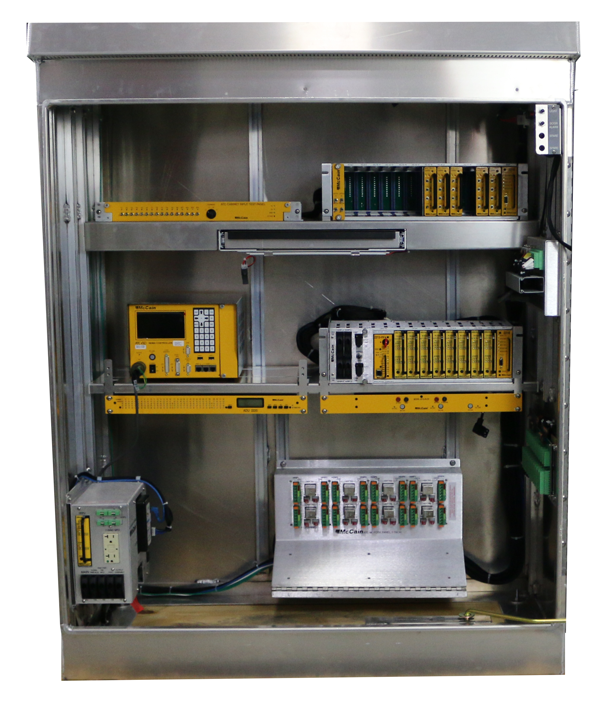
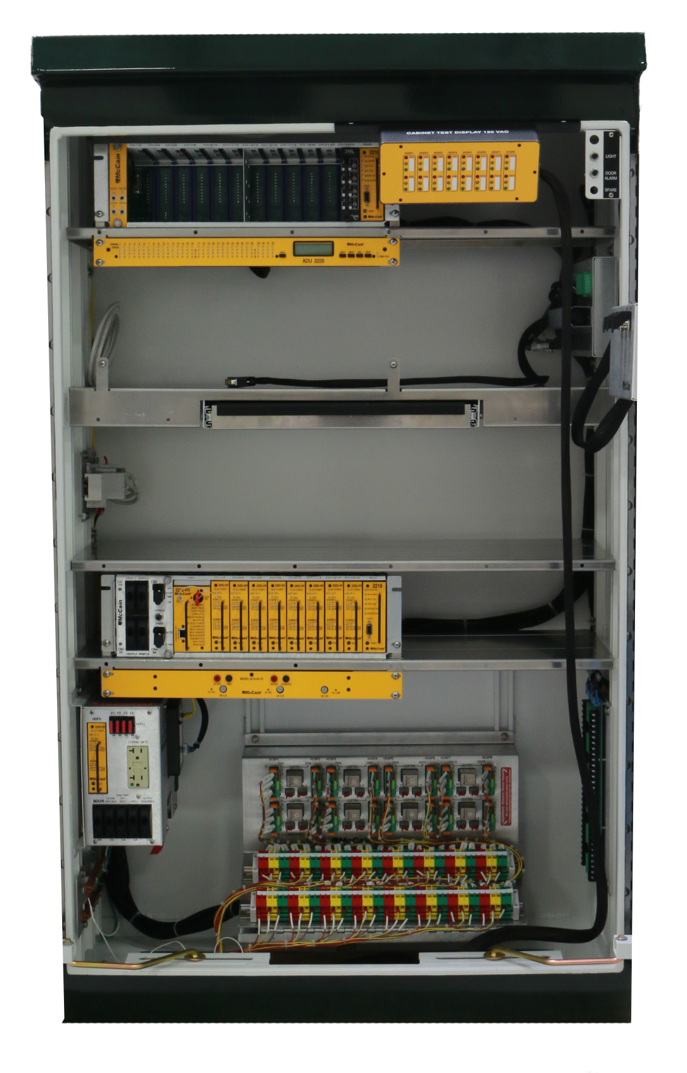
New atcc cabinet types

Slide 7
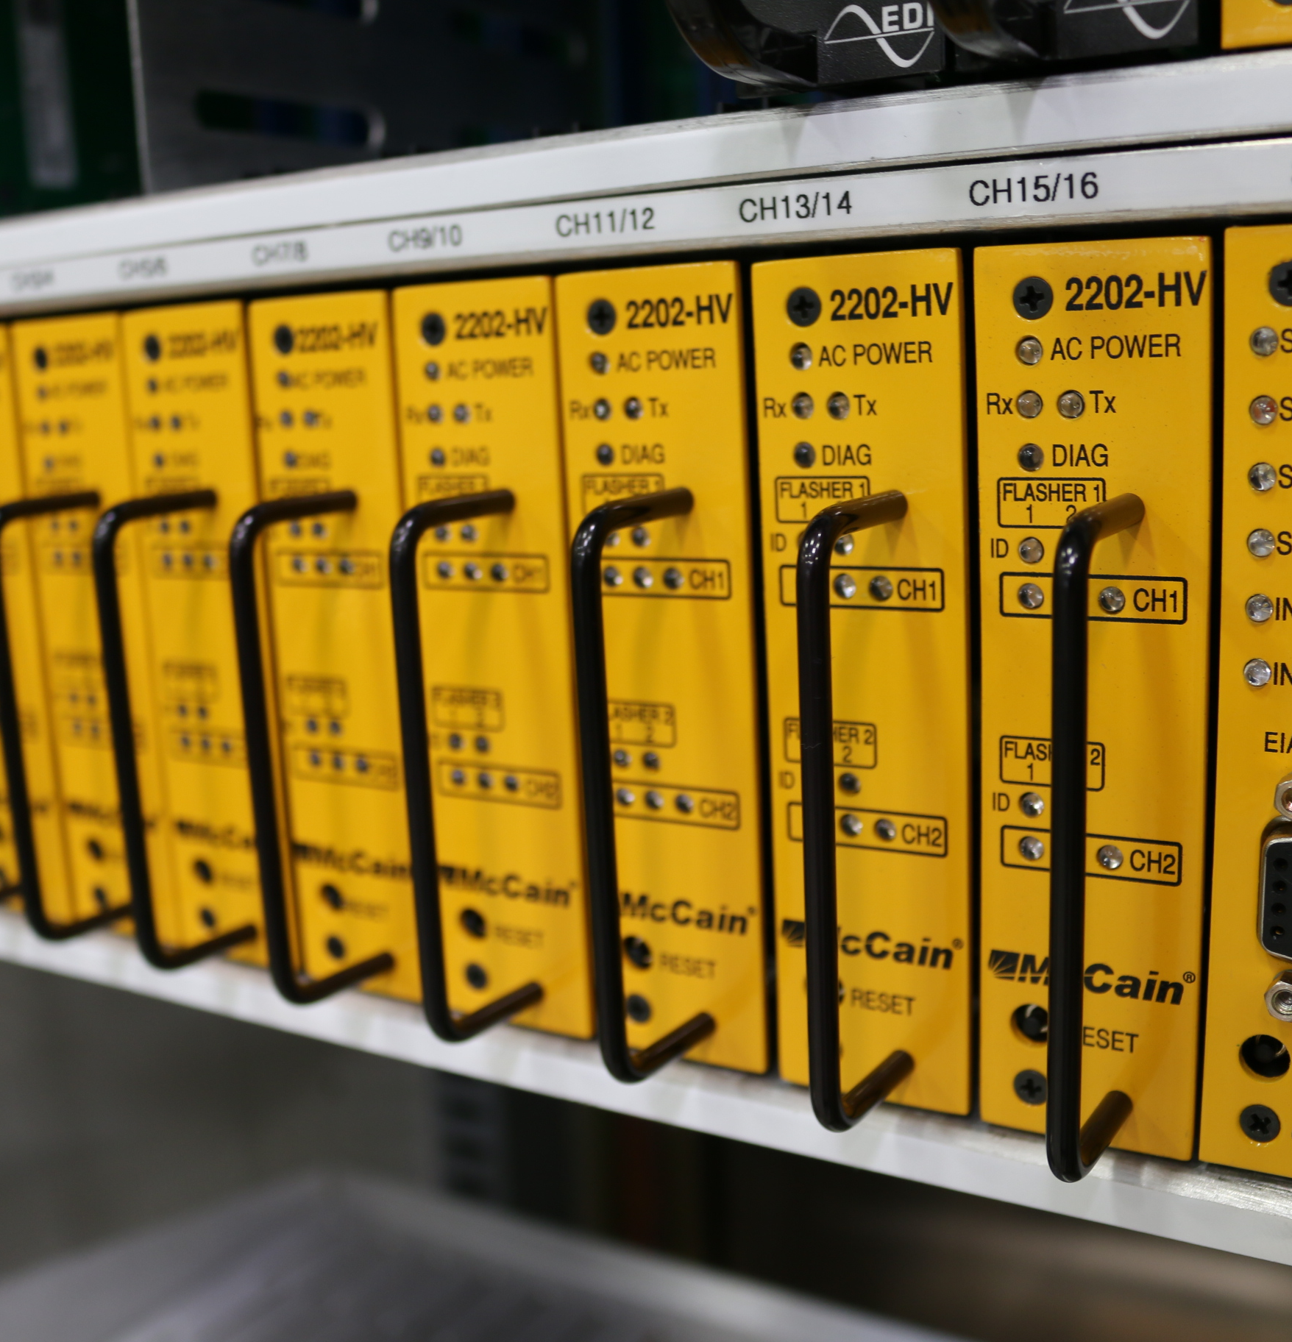

New ATCC Components
FITA
Output Assembly
Horizontal rackmounted FITA with Phoenix blocks now available to replace panel mounted FITA​
CMU can now monitor 48vdc
FOTA
CMU
Spring clip phoenix blocks now available in place of screw terminal phoenix blocks​
Switchpack Improvements

Slide 8
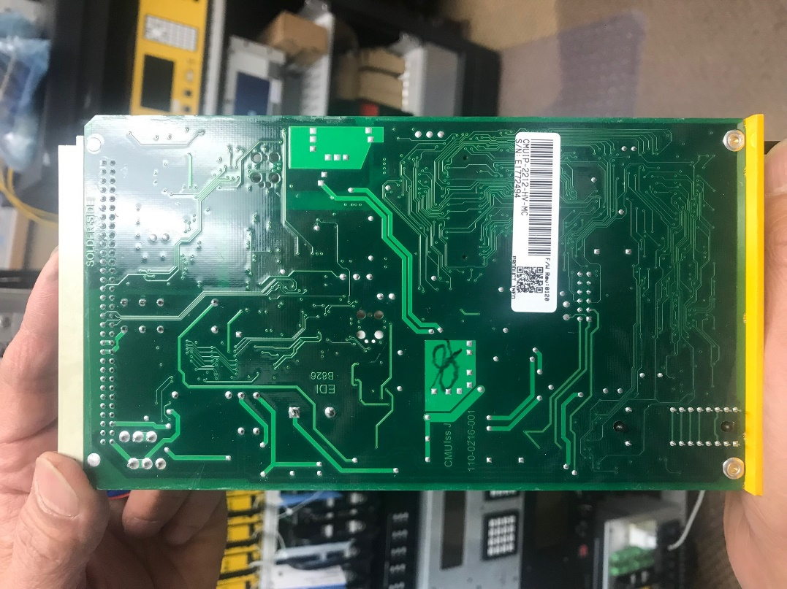
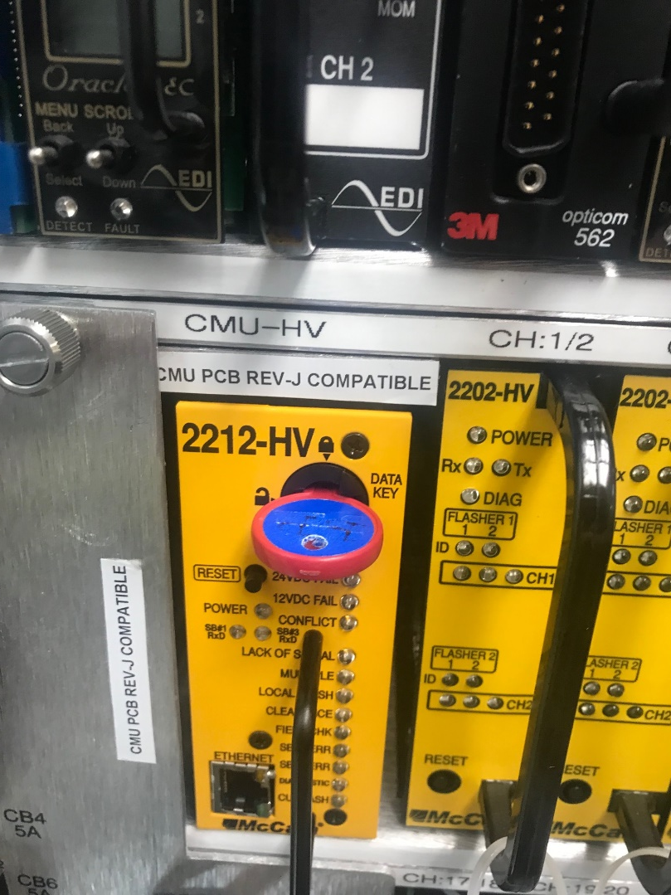
Atcc cmu update
Is your ATC Cabinet "CMU PCB Rev-J"Compatible? *​ | Is your CMU "Rev JPCB"?**​ | Datakey: 48VDCMonitor​
No​ | No​ | Disabled​
No​ | Yes​ | Disabled​
Yes​ | No​ | Disabled​
Yes​ | Yes​ | Enabled​
​ | ​ | ​
* Labeled on the Output Assembly above CMU housing​ |  | ​
** Stamped on the back of CMU PCB​ |  | ​
Atcc cmu known issues

Slide 9
Cabinet switches
Switch​ | Location​ | Default position​ | Opposite position​
Stop Time​ | Output Assembly ​ | OFF- CU Stop Time input is off and CU is in normal operation​ | ON- CU Stop time input is on and CU has stopped time​
Cabinet Control​ | Output Assembly​ | AUTO- CU will run cabinet preprogrammed operation​ | FLASH- CU local flash input is active and HDSPs are flashing outputs​
24 vdc bypass button​ | Output Assembly​ | N/A​ | HDSPs will display 24vdc input status​
Manual Control Enable​ | Police Panel​ | OFF- CU MCE input is off and CU is in normal operation​ | ON- CU MCE input is on and CU timing is in manual control​
Signal Power​ | Police Panel​ | ON- MC Coil is active and signal power is provided to the output assembly​ | OFF- MC Coil has been de-energized and signal power has been disconnected from field outputs​
Stop Time (or Flash?)​ | Police Panel​ | OFF- CU Stop Time input is off and CU is in normal operation​ | ON- CU Stop time input is on and CU has stopped time​ ​
The above outlines what each cabinet toggle switch controls
Please refer to atc cabinet test & diagnostics document for additional information

Slide 10
Circuit breaker guide
Circuit Breaker​ | Controlled Part​
Service Assembly (SA) MAIN Circuit Breaker (CB)​ | Entire ATC cabinet ​
SA CLEAN POWER CB​ | Clean power bus​
SA RAW PWR/GFCI/FAN/LIGHTS CB controls ​ | Outlets, GFCI, fan(s) and light(s)​
SA HDFU CB​ | SA HDSP-FU​
SA OUTPUT ASSEMBLY (OA) CB​ | Output Assembly​
OA CB1 ​ | HDSP 1 & 2​
OA CB2​ | HDSP 3 & 4​
OA CB3 ​ | HDSP 5 & 6​
OA CB4​ | HDSP 7 & 8​
The above outlines what each cabinet circuit breaker controls
Manual control enable (mce) switch places call into the cu and activates stop time
Advance switch advances the cu when MCE is on

Slide 11
Result of removing componenets
Scenario​ | CMU​ | ADU-2220​ | Signals​
RemovingDatakeywith front door open​ | Diagnostic Blink​ | No Fault​ | Auto​
RemovingDatakeywith front door closed​ | Diagnostic ON​ | Datakeynot present​ | Flash​
Removing Output assembly (OA) SIU ​ | CU/Local Flash​ | CU Non-latched flash​ | Flash​
Removinga HDSP-FU from OA​ | SB#3Error​ | Serial Bus 3 Fail​ | Flash​
Removing a HDSP-FU from SA​ | No Fault​ | Flasher Alarm Active​ | Auto​
Removing SA HDSP-FU Fuse​ | No Fault​ | Flasher Alarm Active​ | Auto​
Removing Flash Program Block ​ | Lack of Signal​ | Lack of Signal​ | Flash​
Removing HDFTR​ | Lack of Signal​ | Lack of Signal​ | Flash​
Removing CMU​ | N/A​ | No SB# COMM from CMU​ | Flash​
Removing SA SHA-1250 Suppressor​ | CU/Local Flash​ | OFF​ | Flash​
Removing CU SB1/SB2 cable​ | SB#1 Fail​ | Serial Bus 1 Error​ | Flash​
The above outlines what will happen if components are removed

