Slide 1
This ATC Cabinet presentation has been created by McCain for use by McCain Distributors.
We invite you to co-brand this presentation, it’s as easy as 1-2-3!
  Update the presenter’s name, title, and company on the first and last slide.
  Add company logo to the first and last slide.
  Remove this slide.
If you have any questions, please contact marketing@mccain-inc.com.
Copyright © 2018 McCain, Inc. May not be distributed or reproduced without the written consent of McCain.

Slide 2


Presenter’s Full Name
Presenter’s Title
Company
Copyright © 2018 McCain, Inc. May not be distributed or reproduced without the written consent of McCain.

Slide 3

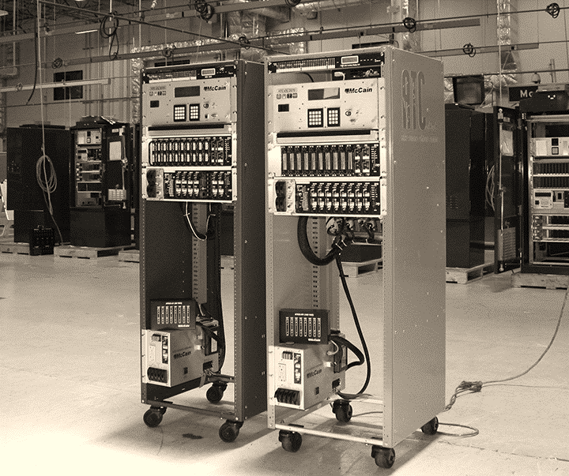

Brief history and ATCC objectives
Features & benefits
Key assemblies & components
Advantages & disadvantages of available power options
Deployments
Key takeaways

Slide 4
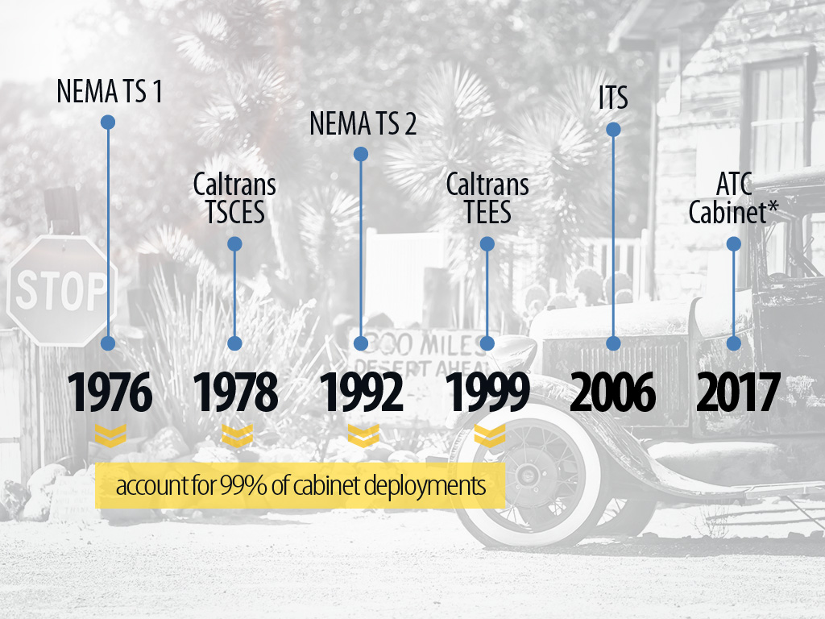

Notes:
First standards came out in 1976
Specs have not changed in nearly 40 years
99% of cabinet deployments across the US are using these standards

Slide 5

Notes:
Think of everything that has changed in our industry, including the different technology, and things that haven’t changed, such as hardware specs
Example: it’s common to see in the field advanced technology (rugged com, network, CCTV equipment) used in cabinets from the 1970s

Slide 6
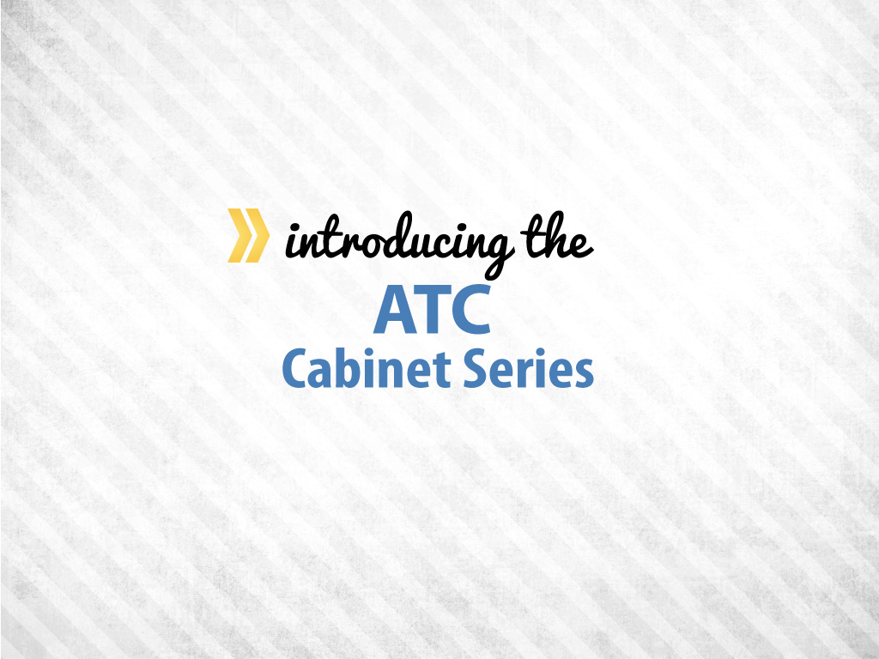

Slide 7
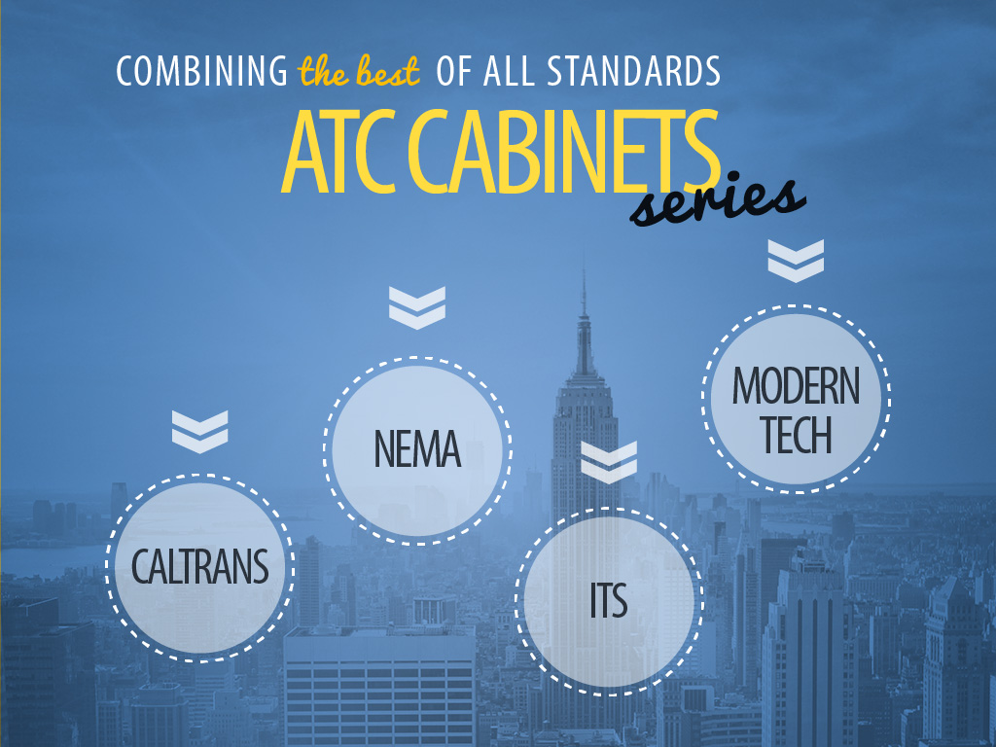
Notes:
The ATC cabinet series combines the best of all standards
Caltrans – rack mounted; adheres to the standard EIA measurements which is in every industry
NEMA – instead of using parallel communications, it uses the latest TS 2 standard – SDLC or serial communications
ITS – modular configurations
Example: an intersection with 16 phases can be expanded to include a 17th phase by adding a new assembly/module
Modern technology – designed to use LED technology

Slide 8
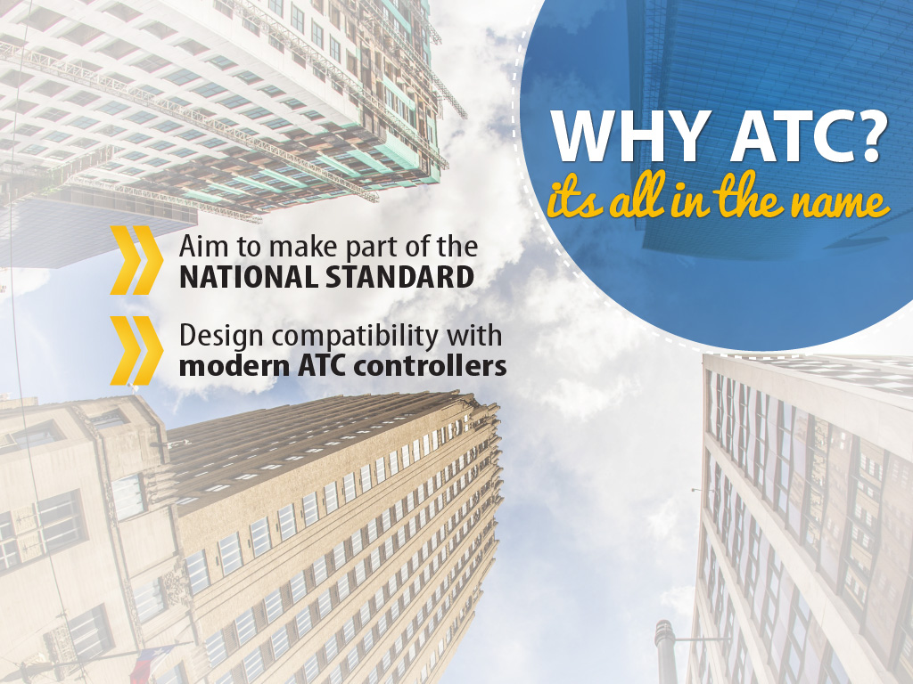
Notes:
It’s all in the name – Advanced Transportation Controller cabinet
Aimed to be part of a national standard
On this note – ITE has officially rekindled the ITE working group; FHWA re-funded the project
Designed for compatibility with ATC controllers
It’s a power PC not just a traffic controller

Slide 9


Boost Safety
for technicians and motorists
  Reduce accidental contact
  Ensure equipment works
  Protect technicians & motorists
Notes:
Boost safety through intelligence
Reduce accidental contact
Ensure equipment works through smarter technology
Intelligence helps protect technicians and motorists by actively monitoring the load, some of the breakers, fuses, as well as the flasher

Slide 10

Boost Safety
for technicians and motorists
  Reduce accidental contact
  Ensure equipment works
  Protect technicians & motorists
Increase Operational Efficiencies
with built-in features
  Expedite troubleshooting
  Reduce training and inventory
  Modularity
Notes:
Increase operational efficiencies with built-in features
Expedite troubleshooting is a key element for traffic technicians
Requires less training and less inventory with compact HD components
Modular configurations meet different needs

Slide 11

Achieve great results and peace of mind with the ATC cabinet.
Boost Safety
for technicians and motorists
  Reduce accidental contact
  Ensure equipment works
  Protect technicians & motorists
Increase Operational Efficiencies
with built-in features
  Expedite troubleshooting
  Reduce training and inventory
Save Money
and gain peace of mind
  Reduce liability
  Save energy
  Adapt to meet future demand
Notes:
Save Money
Reduce liability
Every single intersection in the US is a liability to an agency; an ATC cabinet reduces liability with the preventive accidental contact features
Energy savings is possible because there’s the ability to run more energy-efficient intersections
Adaptive to future demand
An ATC cabinet can be used for many different applications
Example: if an additional 17th or 18th channel is needed beyond a 16-channel output, an additional output assembly can be bolted on to meet future demands, saving money in the long run

Slide 12


Slide 13

Notes:
Feature: an important feature is its compact, smart, HD components

Slide 14

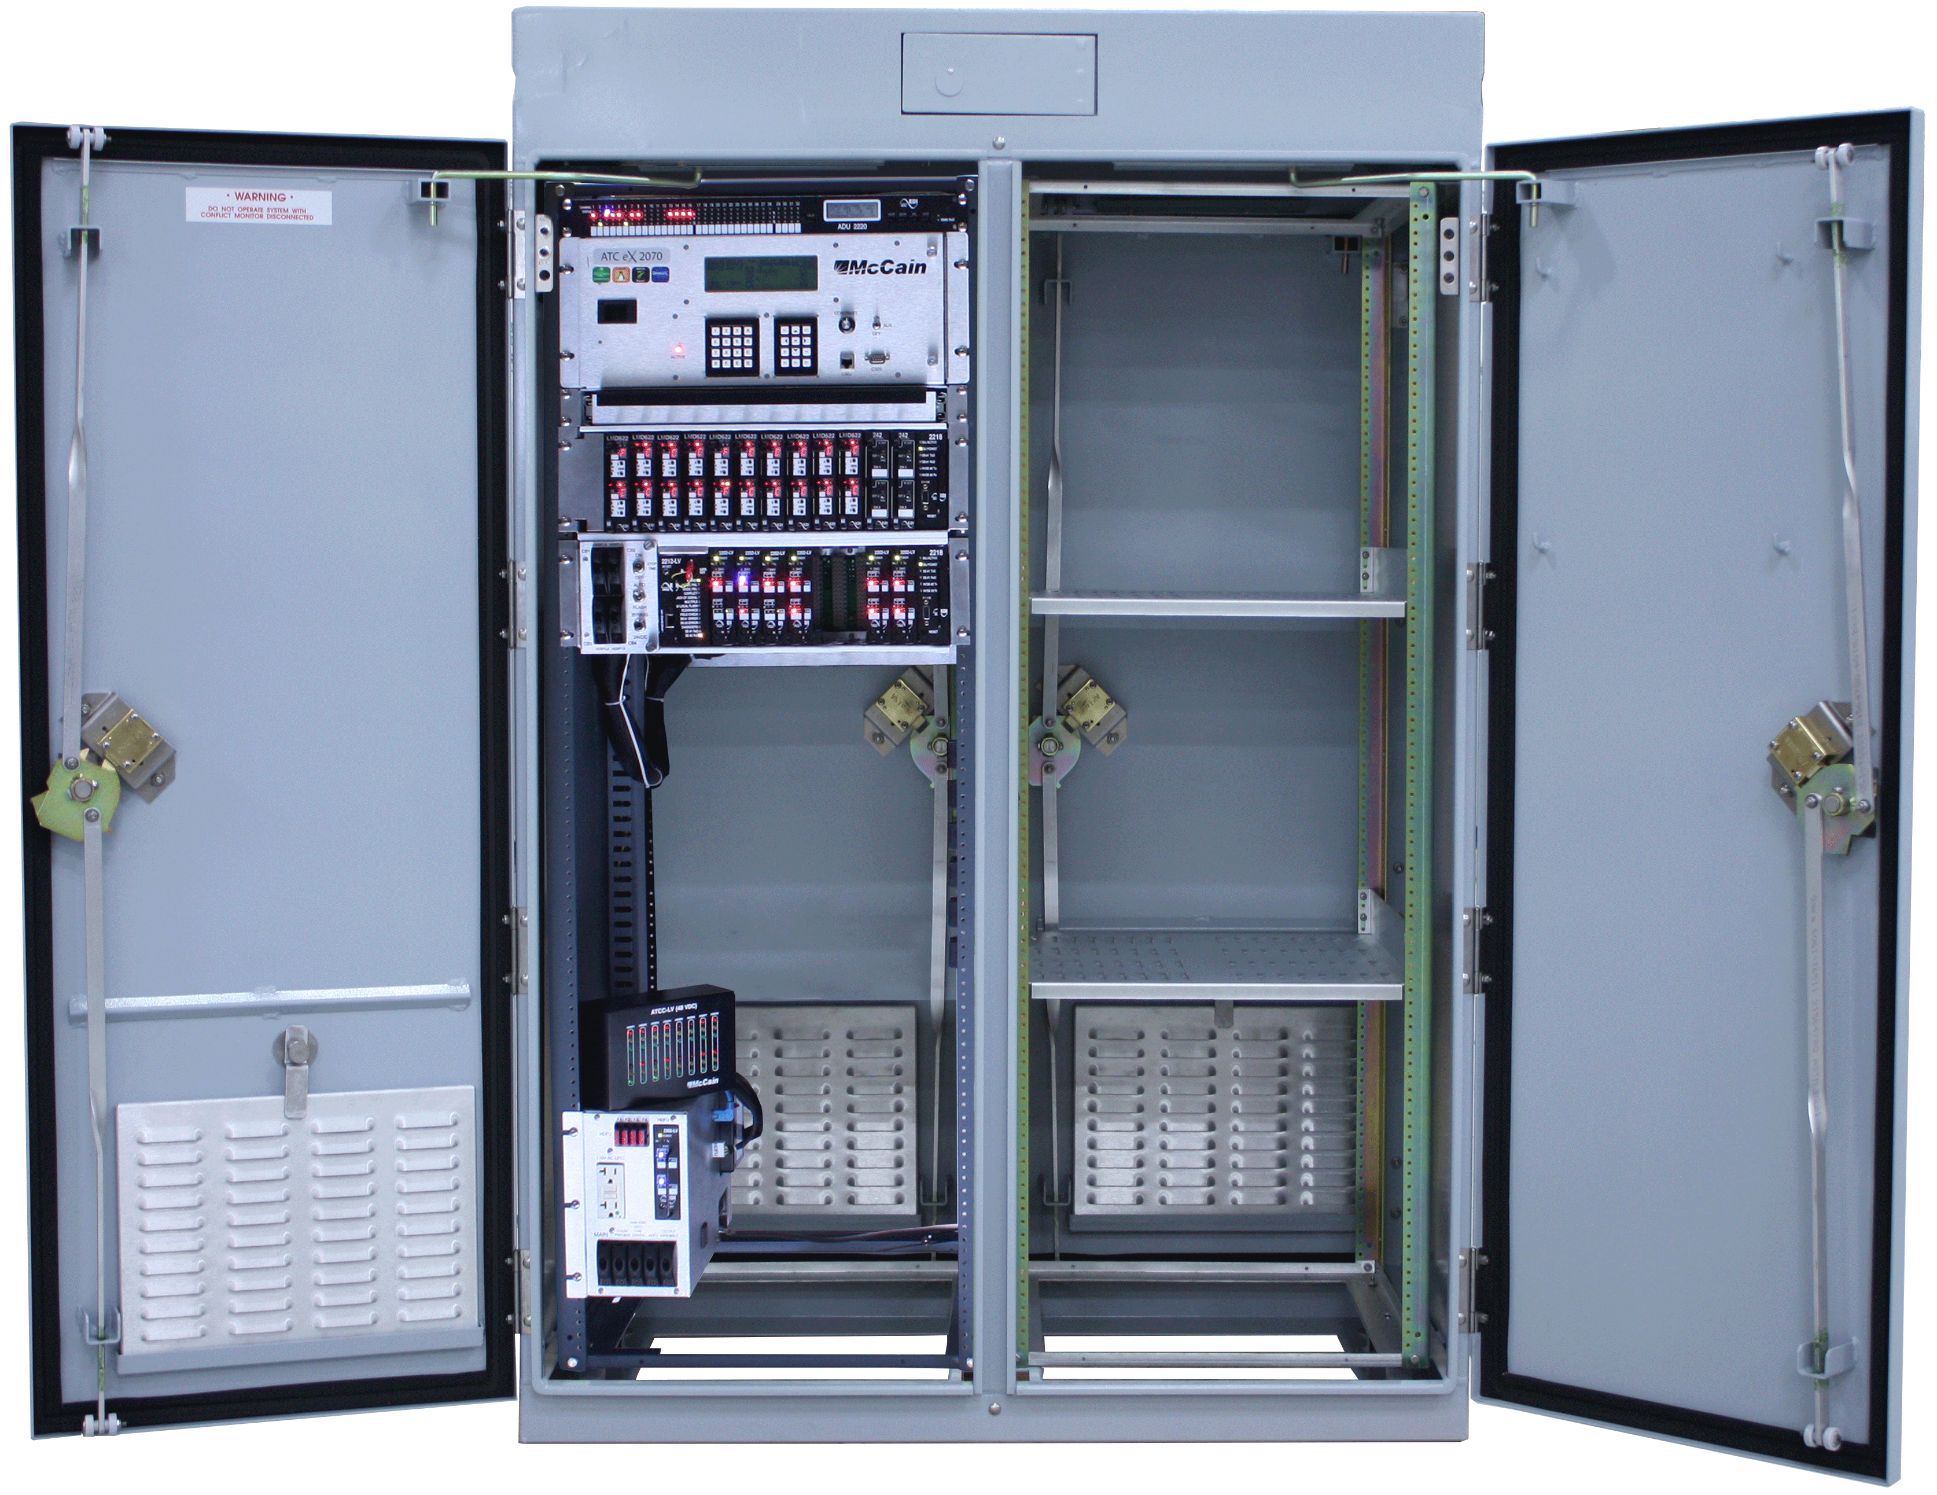
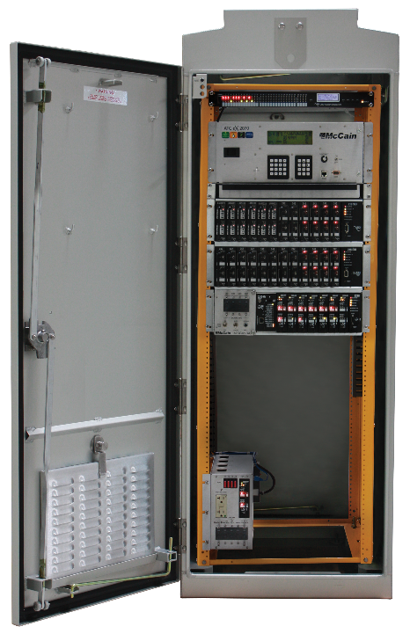
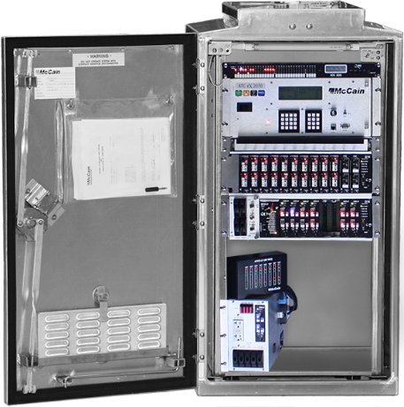
series
350i ATC cabinet
352i ATC cabinet
356i ATC cabinet
Notes:
Benefit: able to do more with less
More equipment capacity and flexibility
Rely on high-density (HD) components
Switch pack
Flasher
Flash transfer relay (FTR)
Ability to optimize cabinet space or acquire smaller cabinets
With compact equipment, they use ½ the space
Advanced technology allows expansion for different applications, from a very small pole-mount cabinet to a huge quad cabinet

Slide 15
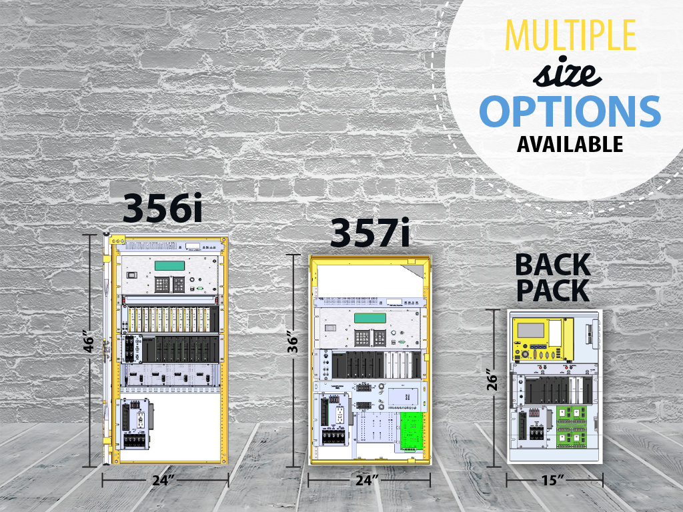
Notes:
Benefit: meets the needs of any agency
ATC cabinet series suite has multiple cabinet size and power options
350i
352i
356i
357i
Back pack
DC power option is available

Slide 16
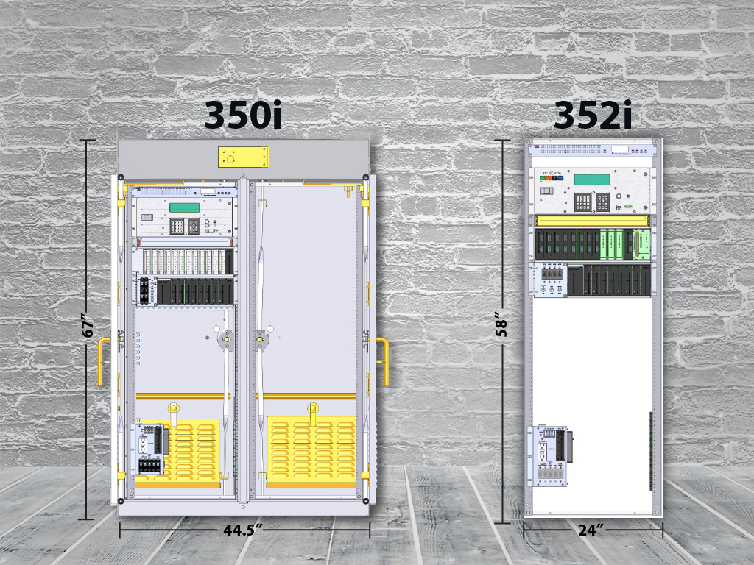
Notes:
Benefit: meets the needs of any agency
ATC cabinet series suite has multiple cabinet size and power options
350i
352i
356i
357i
Back pack
DC power option is available

Slide 17

Notes:
Consider this: what are your needs?
Start a brief conversation of what agency’s needs are.

Slide 18

Notes:
Feature: decoupled service assembly
The service assembly is separate from the output assembly, which differentiates us from the competition

Slide 19

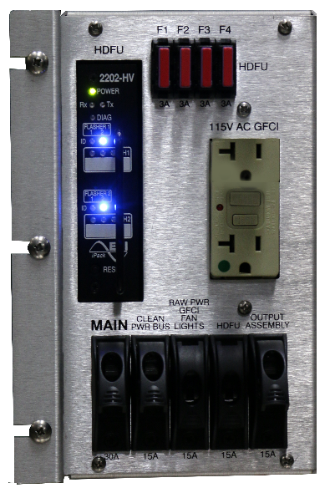
Notes:
Benefit: it leaves an intersection in flash while troubleshooting
Competition such as Intelight deviated from specifications and Econolite does not do it, that we’re aware of

Slide 20

Notes:
Feature: built for today’s LED technology and lighting standards

Slide 21

Notes:
Benefit: use of low wattage leads to savings
It’s designed for LED technology
Pushes LED manufactures to create low voltage LEDs
Could save up to 80% in energy savings

Slide 22

Notes:
Feature: enables migration to low-voltage operations

Slide 23

Notes:
Benefit: migration eliminates high voltage in the field
Cabinet can migrate to low-voltage operations
Makes for safer technology during knock downs, provides safer access to cabinet
Available migration path to 48 VDC
Migration is about safety
Example: if a pole is knocked down, migration occurs, therefore no more high energy exposed
With LED low wattage usage –smaller conductors are used, saving on copper

Slide 24

Notes:
Feature: actively monitors current load
Detects dark signals

Slide 25

Notes:
Benefit: proactively detects dark signals, puts intersection into flash, and sends an alarm/notification
In the future, technology will allow us to have a viable path to see not only when a phase/leg load goes out, but will able to monitor the consumption and tell when it’s not working to its full potential
Agency will be able to actively do maintenance on a signal
Once the standard comes out, agencies will be able to monitor loads per intersection, per leg
By sending a technician to replace a bulb before it goes out, agencies will drastically reduce liability

Slide 26

Notes:
Feature: constant flasher monitoring

Slide 27

Notes:
Benefit: receive instant fault and failure notifications
Detects a dark approach immediately
CMU load current monitoring provides instant notification of no-load situations
Monitor flasher and fuses constantly
Flasher output failures are identified daily, not when the flasher function is most needed after a malfunction has occurred.
If a flasher fails, it’s not put into a fail state, instead an alarm/notification is sent to the customer so they can go and replace the flasher
Example: The alarm goes to the controller, then to a central if the central supports the custom NTCIP objects. So in other words in order to get the full benefits of the cabinet notifications such as this, you would have to pair it with Transparity where we are looking at grabbing the data/ information and sharing through Transparity (i.e. log data, alarms by email, etc.).

Slide 28

Notes:
Feature: protected parts

Slide 29

Notes:
Benefits: live parts are guarded to prevent accidental contact
Personnel safety is increased
NFPA 70/NEC guidelines are used by OSHA as guideline for their requirements
Benefits both markets – Caltrans & NEMA

Slide 30

Notes:
Features: 32 channel outputs and 120 detector inputs

Slide 31
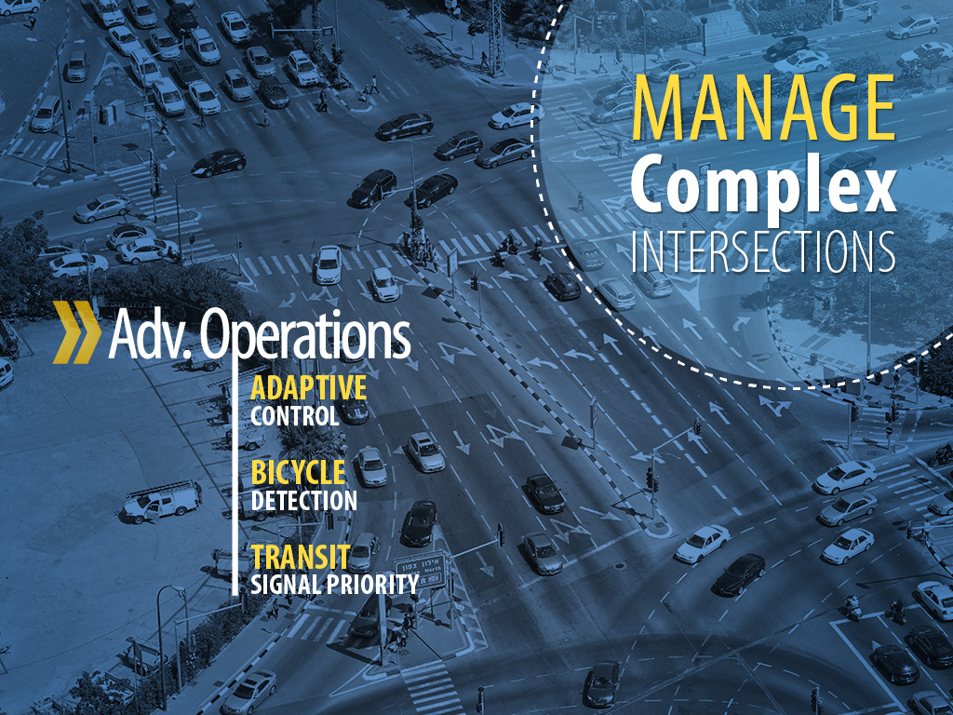
Notes:
Benefit: manages complex intersections
32 channel outputs
120 detector inputs
Ability to handle advanced operations
Adaptive control
Bicycle detection
Transit signal priority with dedicated BRT lanes

Slide 32
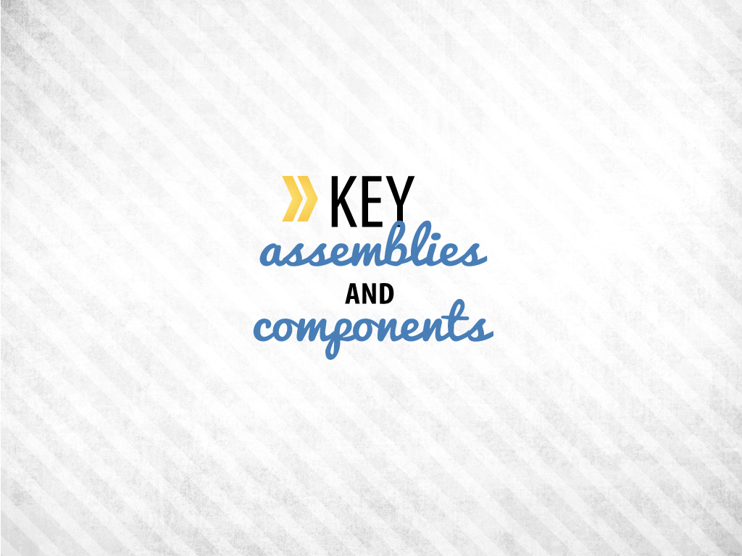
Notes:
Provide brief insight to assemblies and components

Slide 33

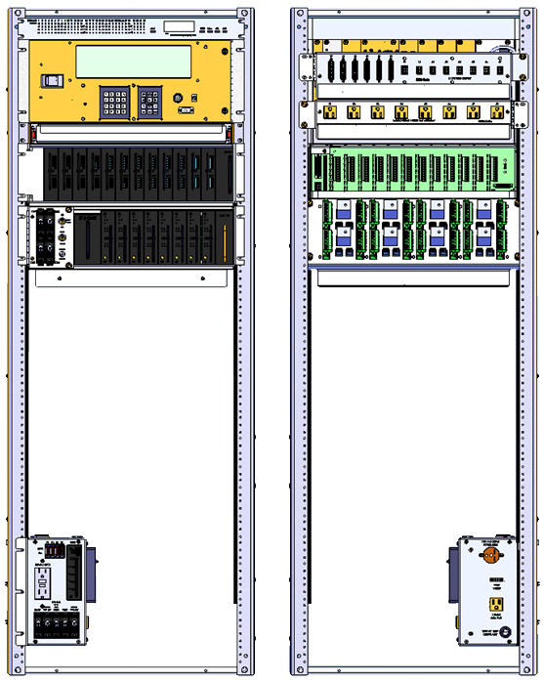
ADU
Aux display unit
Cabinet power supply*
ATC-CU
2070 ATC controller
Power bus assembly*
SB1/SB2
Drawer
AC clean power bus*
Input assembly
24-channel
Output assembly
16-channel
Field output termination assembly
Front
Back
Service assembly
Service assembly
*Swing Out

Slide 34

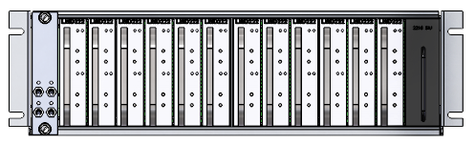
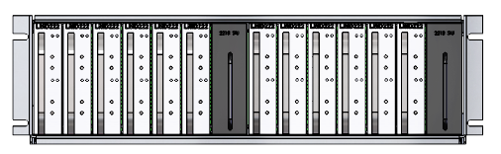
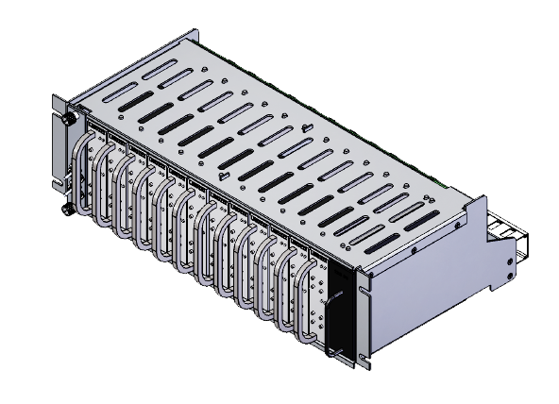
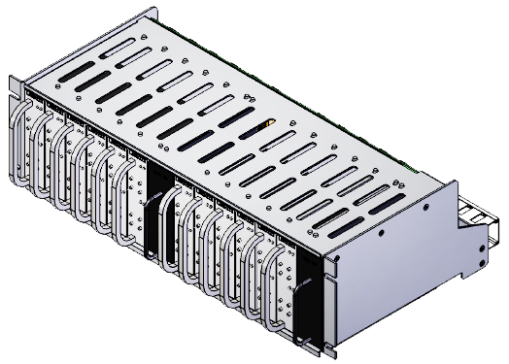
24-channel
48-channel HD
Notes:
Input Assembly
Has 24-channel and 48-channel capabilities

Slide 35
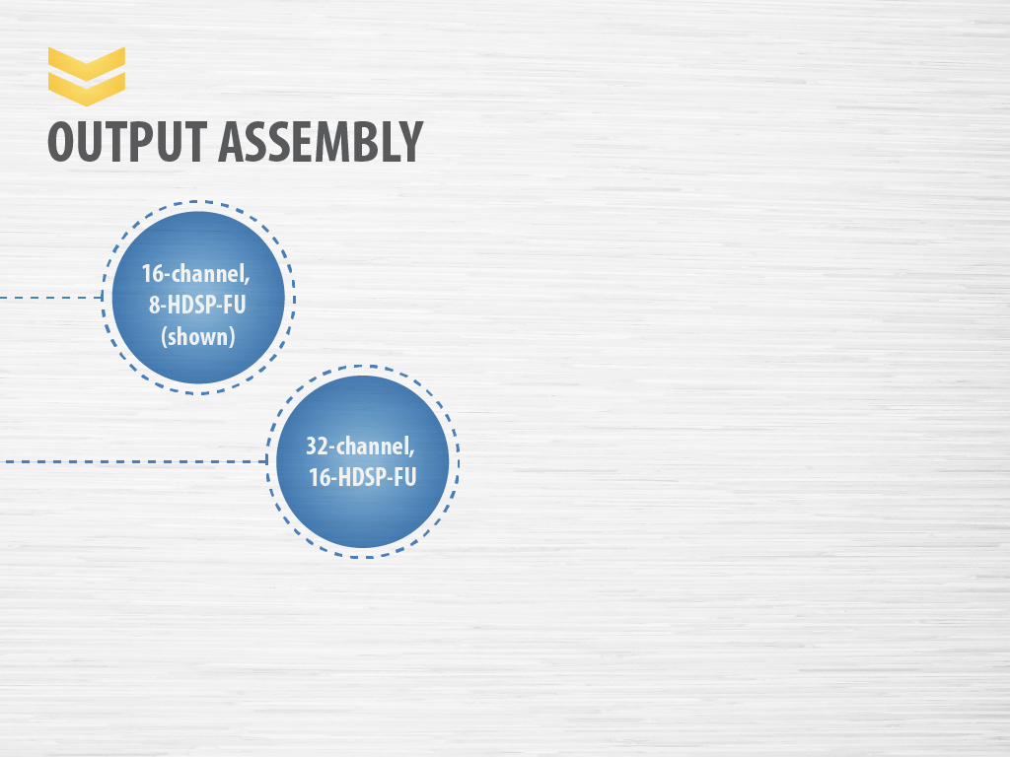
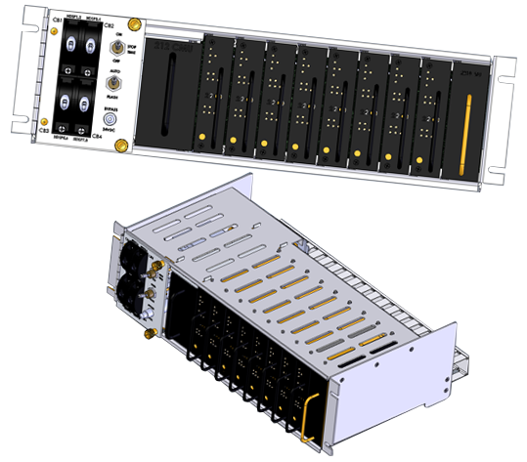
Notes:
Output Assembly
Two versions available
16-channel, 8-HDSP-FU (shown)
32-channel, 16-HDSP-FU

Slide 36
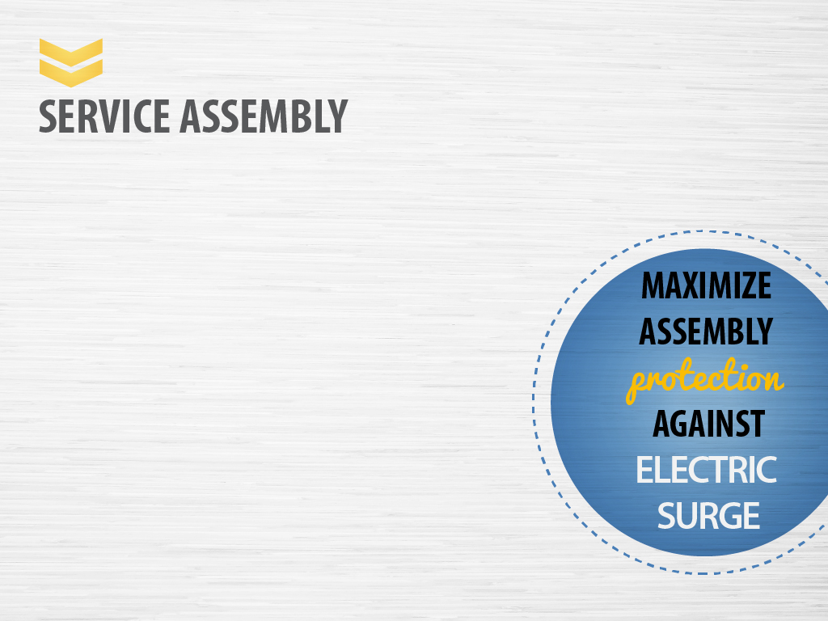
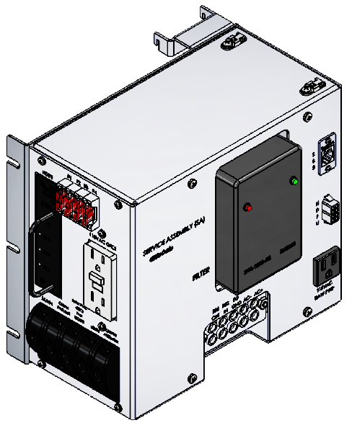
Notes:
Service Assembly
Service assembly is different for a 32 channel
Has more breakers, fuses, and flashers
Pluggable filtering surge protector and main circuit breaker located at the point of utility service entry
Maximizes cabinet assembly protection against electric surge
Complies with NEC experts recommendation respectively
Advantages pluggable filtering surge protector:
Has health indicators
Easier to replace and maintain
BBS terminal ready

Slide 37

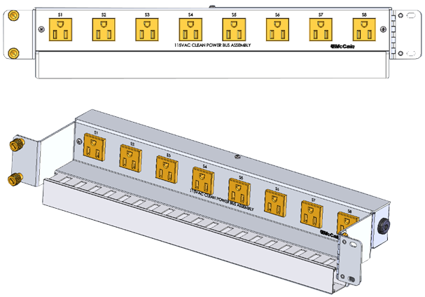
Notes:
AC Clean Power Bus
Provides clean power (filtered) through (8) 120 VAC NEMA 5-15 outlets
As more cabinets are deployed, more network equipment such as CCTV are added
Clean power is requested; it’s standard for McCain cabinets
This is unique to the ATC cabinet

Slide 38

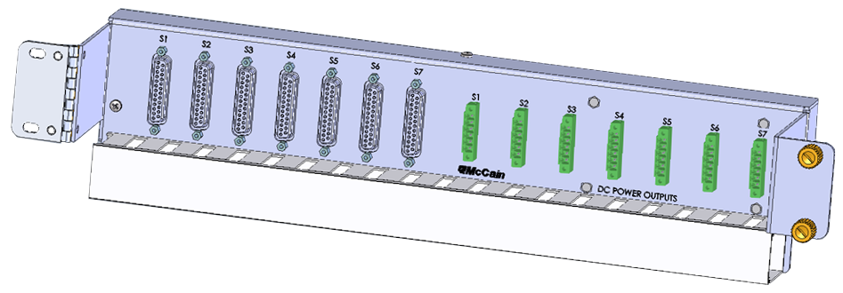
Notes:
DC Power/Communication Assembly
Controller, output assembly, CMU all ties into this location
Hosts the serial bus 1 & 2 interface by means of (7) DB25 connectors
Distributes the 12/24/48 VDC power to assemblies by means of (7) Phoenix connectors
SB3 is between the CMU to /HDSP/FU and ADU

Slide 39
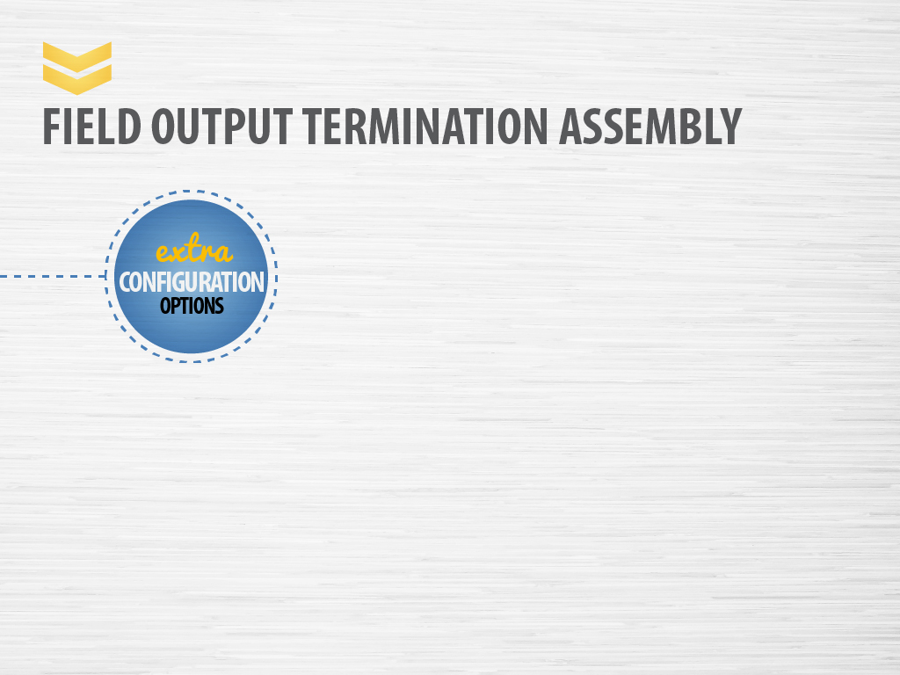
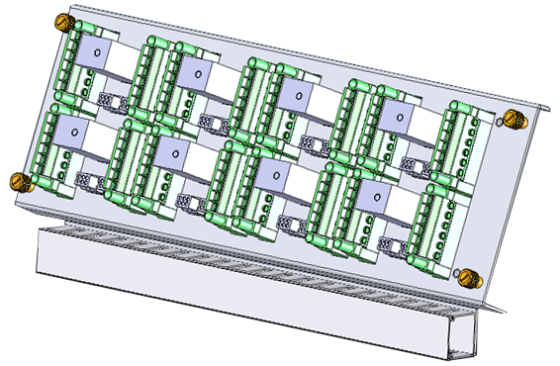
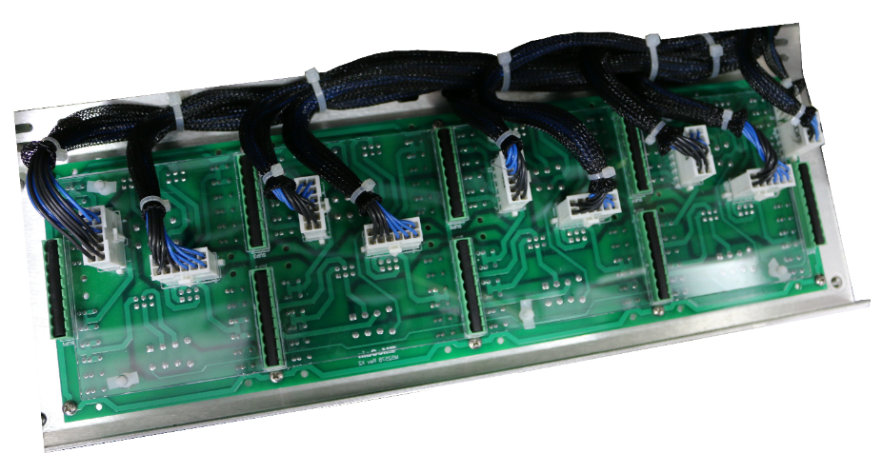
16-channel
Photo of the back of the FOTA showing where the MOV suppression plugs in
Notes:
Field Output Termination Assembly (FOTA)
Shown is a 16-channel field output termination assembly
For a 32 channel, will need two of these
Houses all FTRs, flash blocks, MOVs

Slide 40
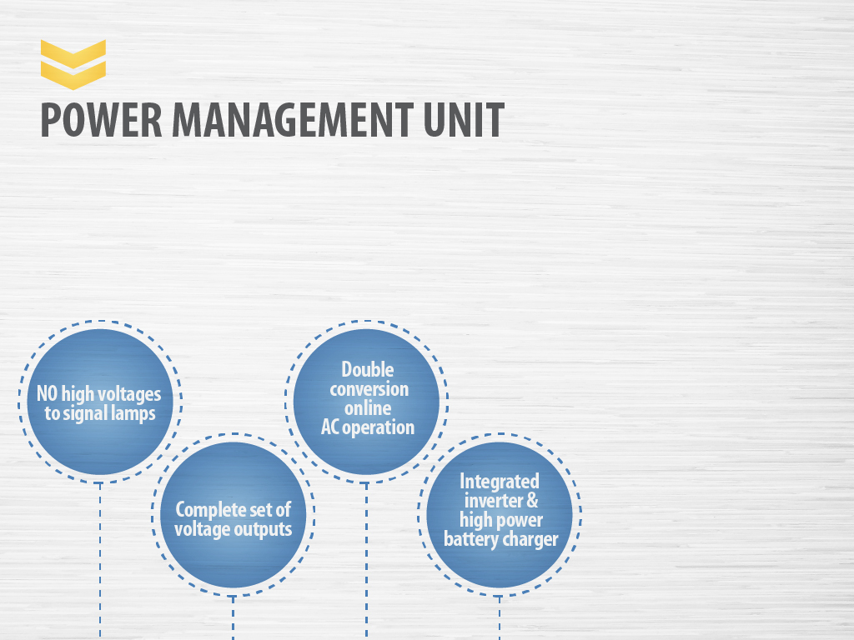
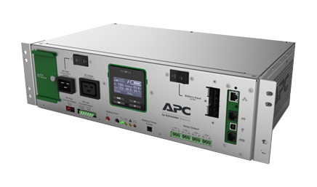
Photo courtesy Schneider Electric.
Notes:
Power Management Unit
This takes 120 volts and converts it to 48volts to feed the cabinet and signal heads
Additionally integrated inverter and battery charger can take 48 volts and convert it to 120 volts
The PMU is for the DC version only

Slide 41



Slide 42
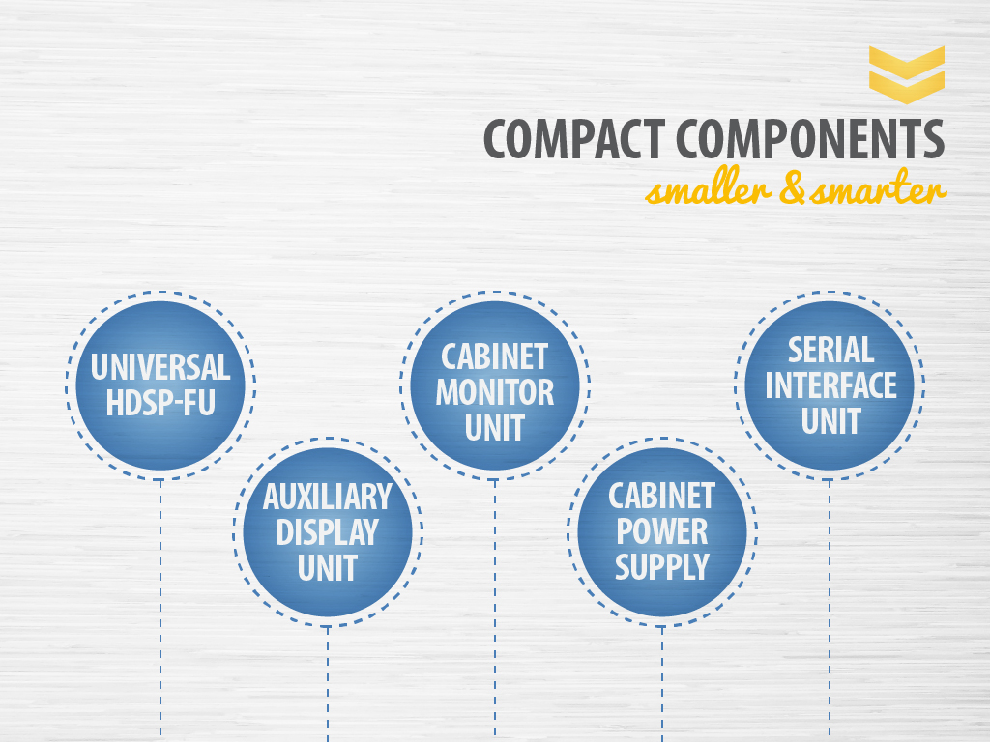
Notes:
Other compact components that make the ATC cabinet smarter
Universal HDSP-FU
Interchangeable between switch pack and flasher function
Auxiliary Display Unit (ADU2)
Built-in Diagnostic Wizard provides concise view of signal states involved in fault, pinpoints faulty signal inputs, and provides guidance on how technicians should isolate the cause of the malfunction
Cabinet Monitor Unit (CMU2)
Compact plug-in modular format with 32-channel capability
Programmed with datakey
Built-in diagnostic wizard, isolates cause of malfunction
Provides guidance on how technician should isolate the cause of malfunction
Cabinet Power Supply
Provides dual 24VDC power to the input and output assembly and 48VDC to the FTRs and main contactor
HV version is power factor corrected and high efficiency (86%)
Serial Interface Unit (SIU2)
Provides 2070-2A field IO function on an individual rack mounted card

Slide 43

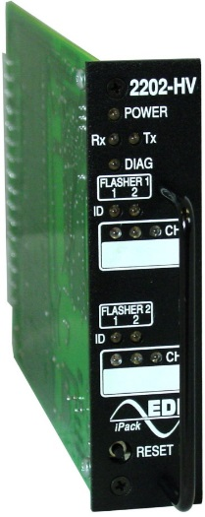
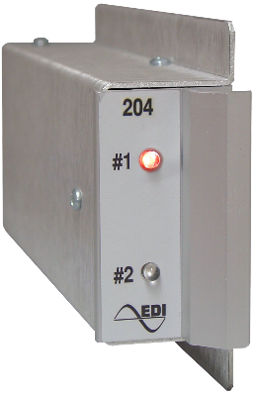
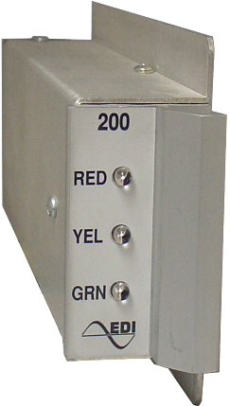
Notes:
This is a twofer
A HD switch pack is equal to two older switch packs or flashers
You have to use two different inventories
Switch packs
Flashers

Slide 44
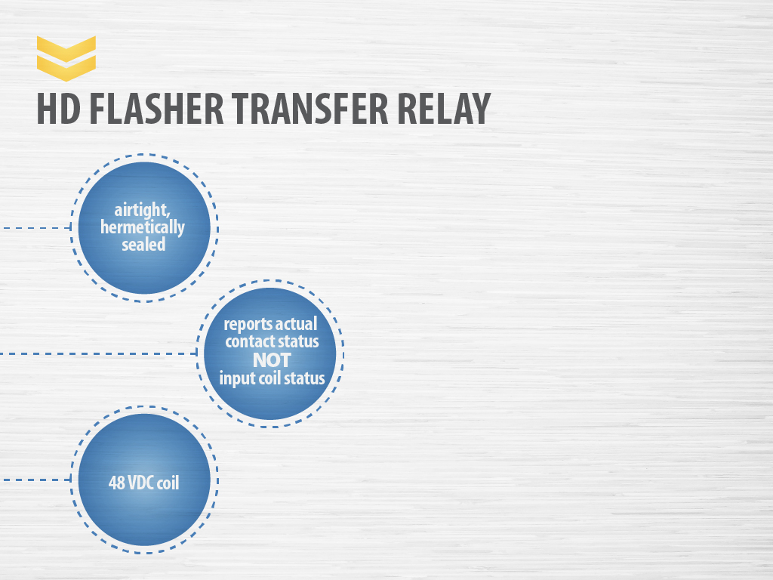
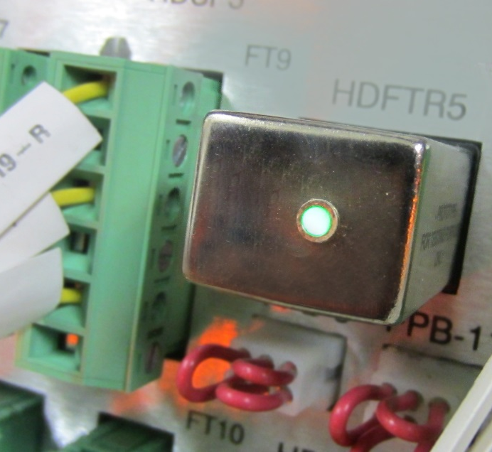
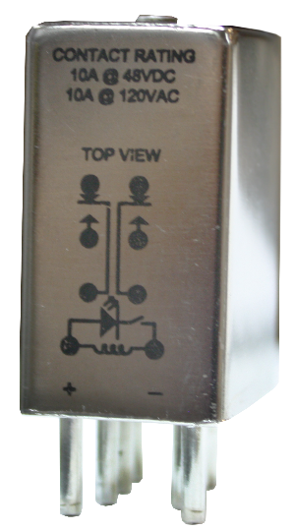
Model 2205
Notes:
HD Flasher Transfer Relay
Top coil is active and gives a true status
These cabinets run cooler which means components will last longer
No longer uses 120v; instead uses a 48v coil and is cool to the touch

Slide 45


Slide 46
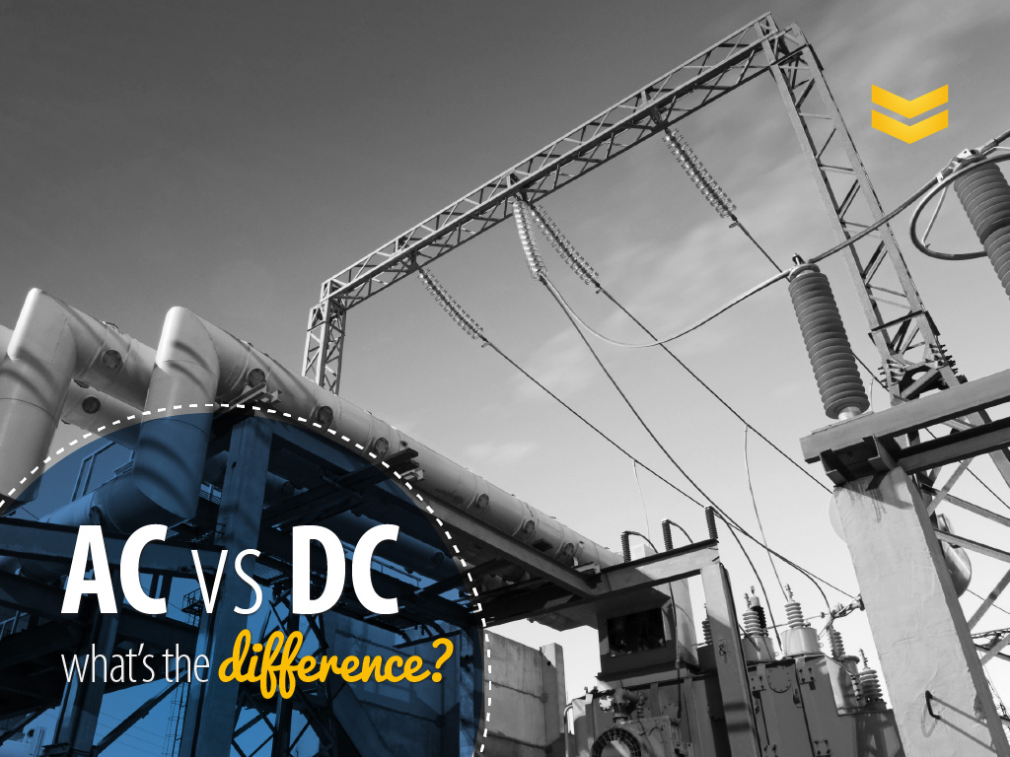
Notes:
The difference between AC and DC power
Looking at it from an ATC cabinet perspective, AC and DC plays into the type of infrastructure that is needed
When using AC in an ATC cabinet, the benefit of doing so is that you are able to use your current infrastructure, including LEDs
In addition, AC power is alternating current that can go longer distances without power loss
An ATC cabinet that uses DC power will require changes to infrastructure, including LEDs
Example: The service pedestals are all for AC, there are none available for DC?
Why is it that there is no DC in the field? It just hasn’t been adopted, perhaps it’s because there is more line loss with DC power than AC power

Slide 47

Notes:
Advantages to using the high-voltage ATC cabinet
Direct replacement of existing cabinet – BBS stays the same
Can keep existing infrastructure, except for incandescent lamps and can put it on same foundation
Make sure that your intersections do not have incandescent lamps
Field loads (heads) stay the same

Slide 48

Notes:
Disadvantages to using the high-voltage power
Subjects technicians/public (if pole gets knocked down) to shock hazard
Shock hazard is a disadvantage of any high power
New equipment means a learning curve for the agency, regardless of power type

Slide 49
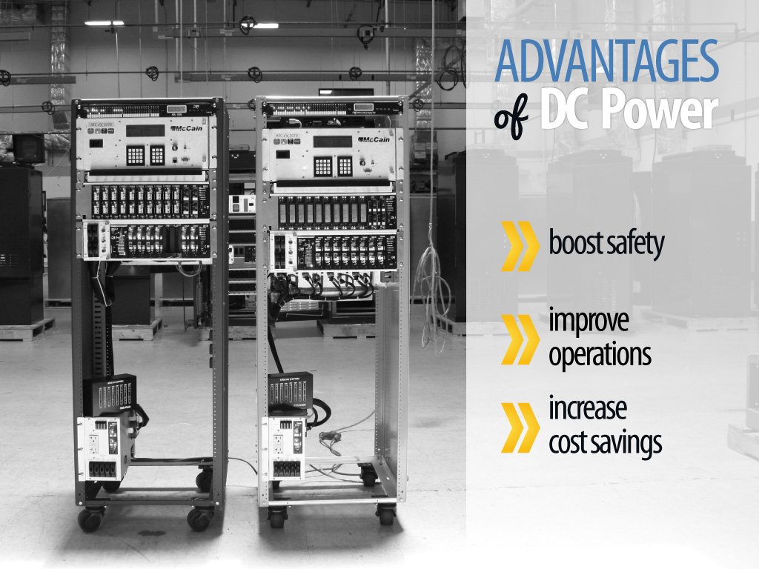
Notes:
Advantages of DC Power
There is no AC exposed in the field
It’s a huge advantage because a lot of these agencies have consultants who are not certified electricians
Improve operations
Intersections can run longer
Components are cooler to the touch – it has longer efficiency
Have real path to off-grid intersections tied to solar
Can be powered by solar panels
LEDs consume less power, extending the effectiveness of backup power in an event of an outage

Slide 50

Notes:
Disadvantage of DC Power
People misunderstand what DC means; they think DC is low power but it’s not the case
If power supply fails in a DC cabinet, the intersection goes dark
Migration will require two inventories if DC and AC are kept in the field
There are no published standards for DC at this time, but as technology and industry advances, we will see more and more involvement published for DC standards

Slide 51

Notes:
Deployments Coast to Coast

Slide 52


Slide 53

Notes:
Cedar Park, TX is home to McCain’s 1st ATC cabinet deployment

Slide 54


Slide 55

Notes:
Tuner-Fairbank Highway Research Center
Outside of DC
Adopted ATC cabinet series
They are adopting our technology

Slide 56


Slide 57
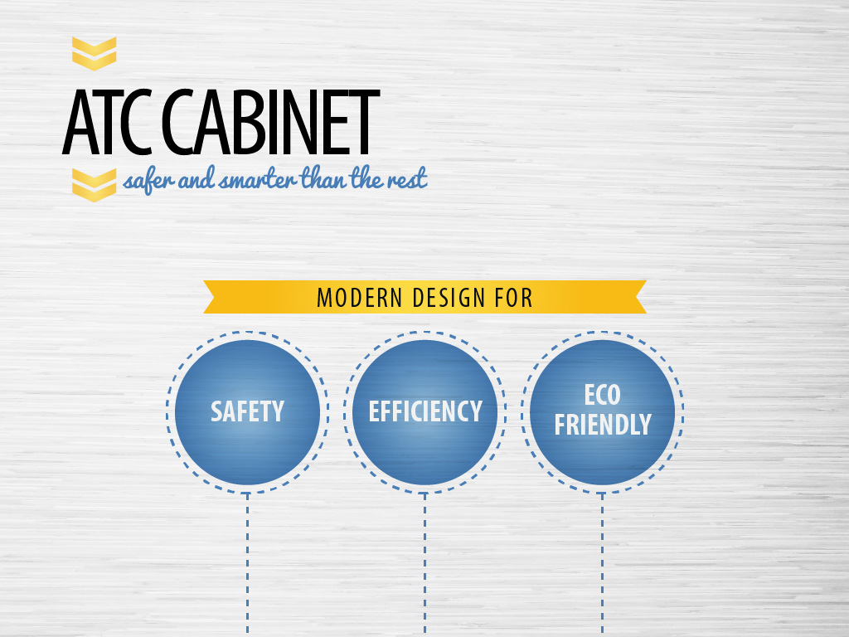
Notes:
Safer than other cabinets
Protected parts prevent accidental contact
Efficient
Expedites trouble shooting
Uses half the space with compact HD components
Eco-friendly
Saves energy
Adapts to future needs by using existing infrastructures

Slide 58

presented by
Presenter’s Full Name
Presenter’s Title
Company
Phone Number
email
website
Copyright © 2018 McCain, Inc. May not be distributed or reproduced without the written consent of McCain.

