Slide 1
LX Cabinet Series
January 15, 2013
An introduction to the latest cabinet focused on personal safety
presented by
Nathan Welch
National Sales Manager
McCain, Inc.

Slide 2
Agenda
Personal safety rules & regulations
Where do the 50 volts comes from?
LX series assemblies
Recap
Q&A

Slide 3
Personal Safety
Rules & Regulations

Slide 4

Personal Safety Rules & Regulations
NFPA 70 requires:
  Guarding of the Live Parts (Article 110-27):
    Live parts of electrical equipment operating at 50 volts or more shall be guarded against accidental contact….
  Arcing Parts (Article 110.18):
    Parts of electrical equipment that in ordinary operation produce arcs, sparks, flames, or molten metal shall be enclosed….

Slide 5

Personal Safety Rules & Regulations
Occupational Safety and Health Act (OSHA) has similar requirements to NFPA.
Current traffic standards do not address guarding of live and arcing parts:
  NEMA
  TSCES
  ITS Cabinet Standard
  TEES

Slide 6
Personal Safety Solutions
Design and build equipment less than 50 volts: cabinet, controller, CMU, cabinet plug-ins, BBS inverter, signal head, ped-count module, preemption equipment, etc.
    While this may occur in near-term, it is not an immediate solution.
Provide Personal Protective Equipment (PPE) for all employees working with high voltage equipment.
    PPE is not cheap and requires continual training on proper use.
Design your cabinet assembly to guard against accidental contact and arc flash.
    The TEES 2009 Errata #2 LX Series Cabinet offers a solution.

Slide 7
Old vs. New Thinking
Old Thinking
  This is the way we have always done it.
New Thinking
  New guidelines by OSHA and NFPA 70.

Slide 8
Where do the 50 volts come from?

Slide 9
Where do the 50 volts come from?
6 mA-16 mA is known as “let-go” current range for human body.
Definitions:
Resistance of human body
  R (total) = R (skin-in) + R (internal) + R (skin-out) + R (point of contact)
  R (total) = 1,000 + 300 + 1,000 + 3,000 = 5,300 Ohm*
  * The 5300 Ohm may vary depending on a person size, humidity, etc.
Term | Abbreviation | Measurement
Resistance | R | Ohm
Voltage | V | Volt
Current | I | Ampere

Slide 10
Where do the 50 volts come from?
Ohm’s Law: I=V/R
For a 120 volt system:
  120 V / (5300 Ohm) = 0.022A or 22mA
For a 50 volt system:
  50 V / (5300 Ohm) = 0.009A or 9mA
9 mA falls between 6 mA-16 mA “let-go” range.

Slide 11
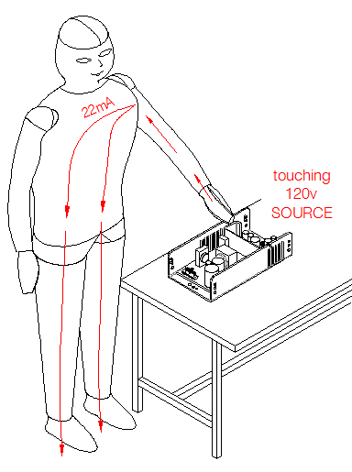
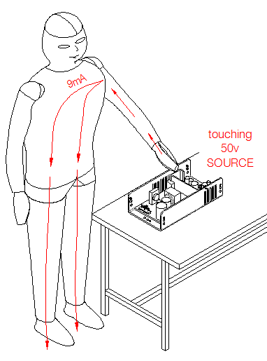
Human Touching 50 volts vs. 120 volts
9 mA falls between 6 mA-16 mA “let-go” current range.

Slide 12
LX Series Assemblies

Slide 13
LX Series Assemblies
Forward thinking – proactive approach
Addresses NFPA 70E/ OSHA
The LX Series Assemblies will continue to utilize the 170/2070 controller, firmware and standard plug-ins.

Slide 14
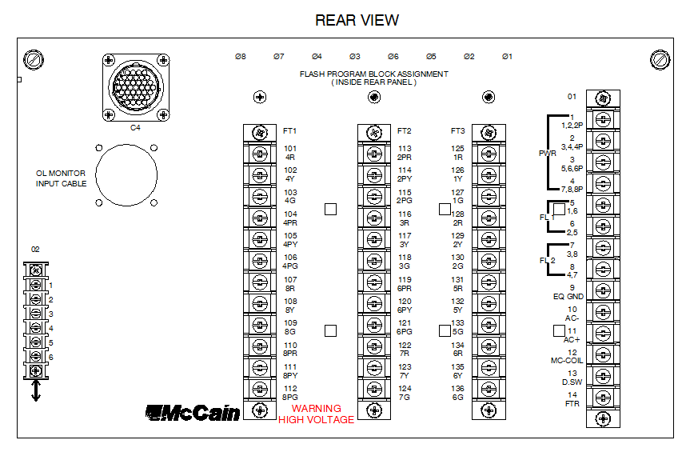
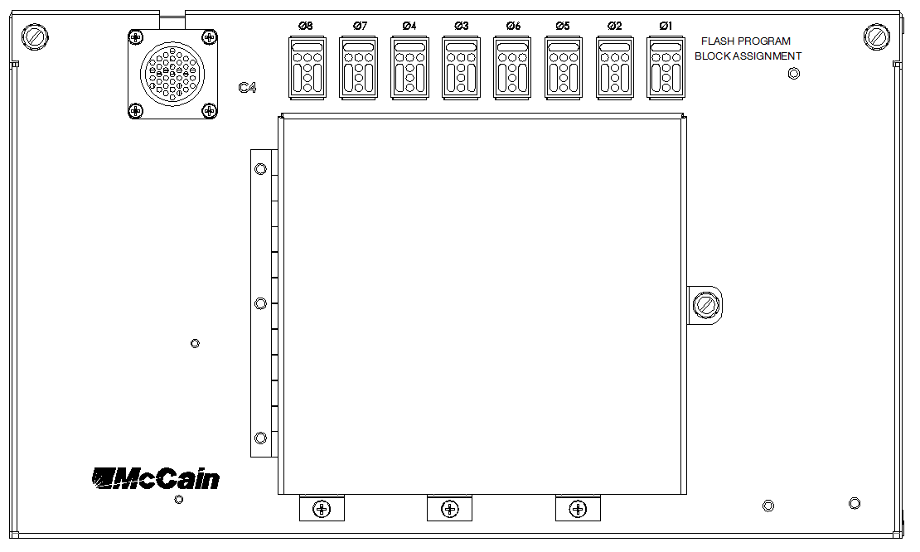
Output File
Existing
LX Series

Slide 15
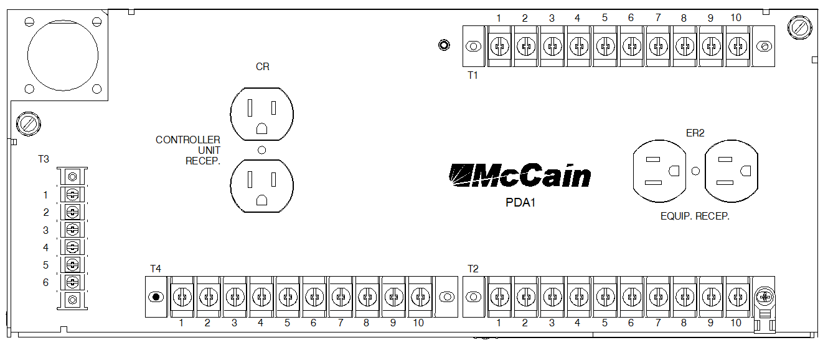
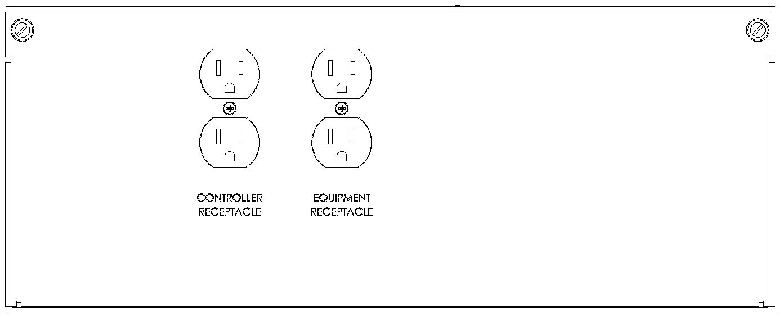
PDA
Existing
LX Series

Slide 16
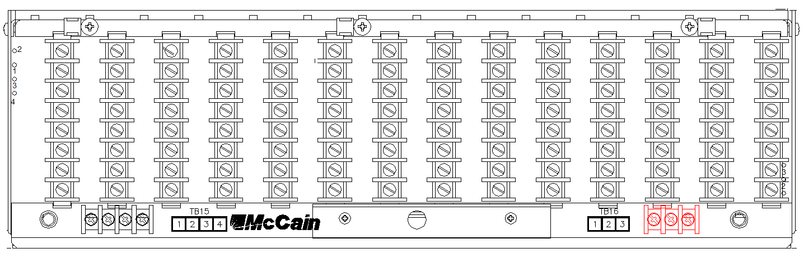
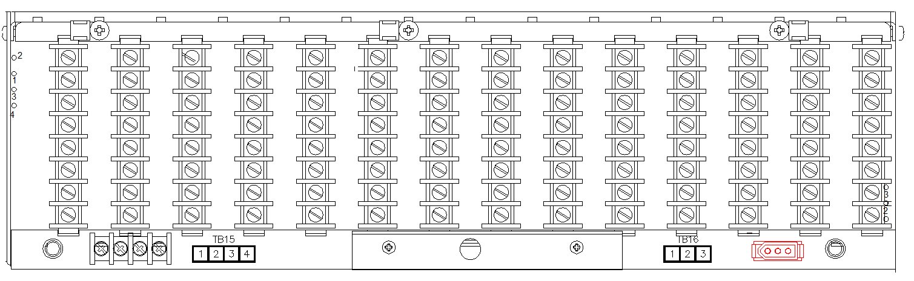
Input File
Existing
LX Series

Slide 17
Recap

Slide 18
Recap
The traffic signal cabinet standards and specifications do not cover the personal safety of the personnel. It has always been assumed that the people who have access to cabinets are qualified, trained and experienced.
Other groups – such as the ITS group and consultants – may have access and may not have proper training or knowledge of the risk of working around high voltage equipment.
The TEES 2009 Errata #2 LX Series Cabinet offers a solution.

Slide 19
Questions?
Thank You!
McCain, Inc.
(888) 262-2246
info@mccain-inc.com

