Slide 1
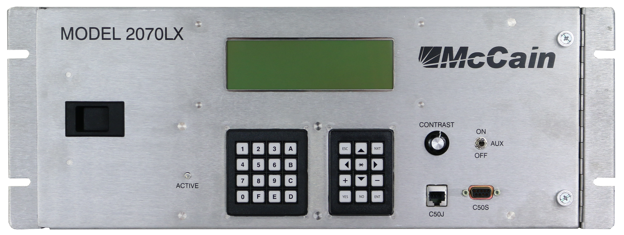
McCain 2070LX Controller
Overview
Presented by:
Douglas Acker
Hardware Engineering Manager
McCain, Inc.
November 16, 2017

Slide 2
Contents
History
Hardware
Software
Standards and testing
Advantages and disadvantages

Slide 3
History
The road to the 2070LX
More powerful replacement for 170 and NEMA controllers
Established open architecture
Non application specific
Version – Caltrans ATC 1C standard

Slide 4
Hardware
Open architecture
  Interchangeable components
  Defined interfaces
  Compatible with existing equipment
Common operating system software: (Linux)
Hardware specification only; no application software

Slide 5
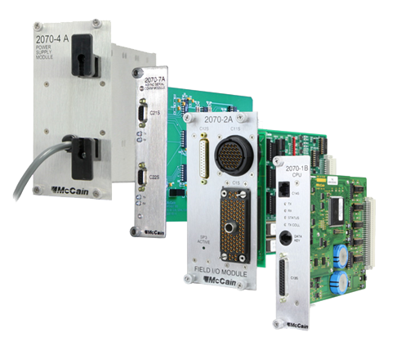
Hardware Components
Chassis
CPU
Field I/O
Serial and modem
Power supplies
Front panels
NEMA modules

Slide 6
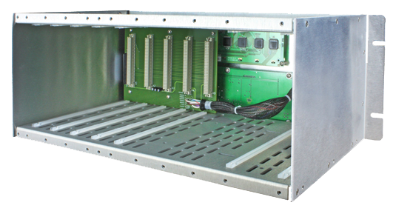
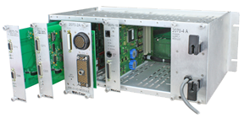
Chassis
Same 2070 chassis for any configuration

Slide 7
CPU
Based on Freescale 8360 PowerQUICC II Pro processor
16 MB NOR Flash and 256 MB NAND Flash
2 MB SRAM
256 MB DRAM
7 Serial ports
4 Ethernet ports (10/100 Base T)
2 USB

Slide 8
Engine Board Comparison Table
 | ATC 5.2b | ATC 6.24 | Caltrans 2070-1C | Specifications
CPU | Freescale MPC8360E @ 400 MHz | Freescale MPC8360E @ 400 MHz | Freescale MPC8360E @ 400 MHz | 60MIPS
DRAM | 128 MB (256 MB optional) | 256 MB | 256 MB | 16MB
SRAM | 2 MB | 2 MB | 2MB | 1MB
FLASH | 16 MB (8 MB available to user) | 256 MB | 256MB | 6MB
Ethernet | 10/100 Mbps | 10/100 Mbps | 10/100 Mbps | 10/100 Mbps
SD Card | No | No | Yes (on CPU module host board) | No
Linux kernel | 2.6.22 | 2.6.22 | 2.6.39 | 2.6.22
Flash file system | JFFS2 | JFFS2 | JFFS2 | JFFS2

Slide 9
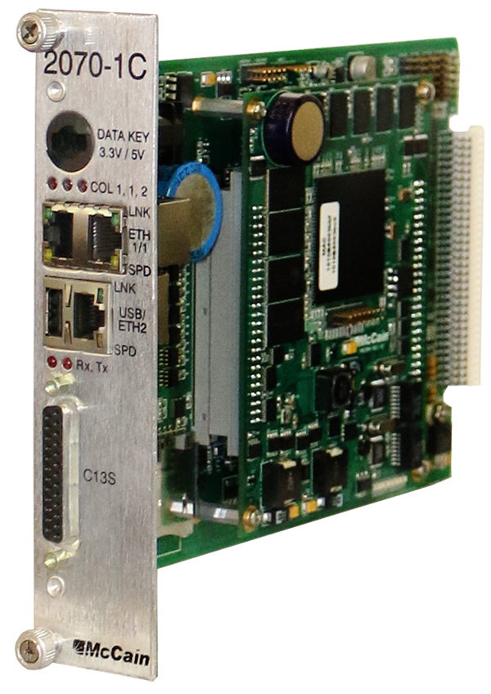
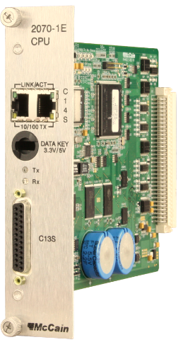
Hardware Migration
From legacy 2070 controller
Replace CPU module
2070 1E CPU module -> 2070 1C CPU module
2070 1B/1E
CPU module
ATC eX 2070 CPU module

Slide 10
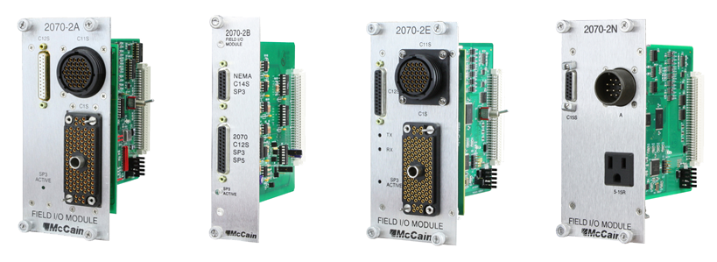
Field I/O unit
2070-2E for Caltrans type cabinets
2070-2B connects to 2070-8 NEMA base
2070-2N for NEMA TS2 type 1 cabinets

Slide 11
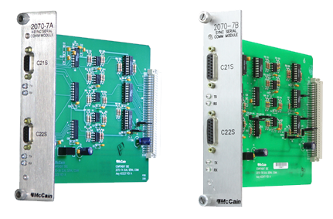
Serial Comms Modules
Async serial port and GPS modules (2070-7(x))
Modem modules (2070-6(x))
Fiber optic modules (2070-F(x))
Other communication modules (2070-9(x))
Notes:
There are 6A, B, AE, BE, D, W
There are 7A, B
There are FX
There are 9A, B, D, E

Slide 12
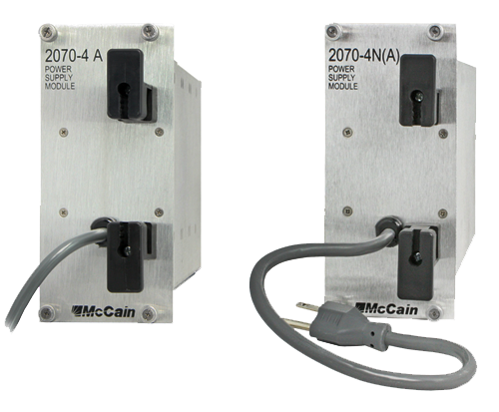
Power Supplies
Standard version (2070-4A)
NEMA version (2070-4NA)

Slide 13
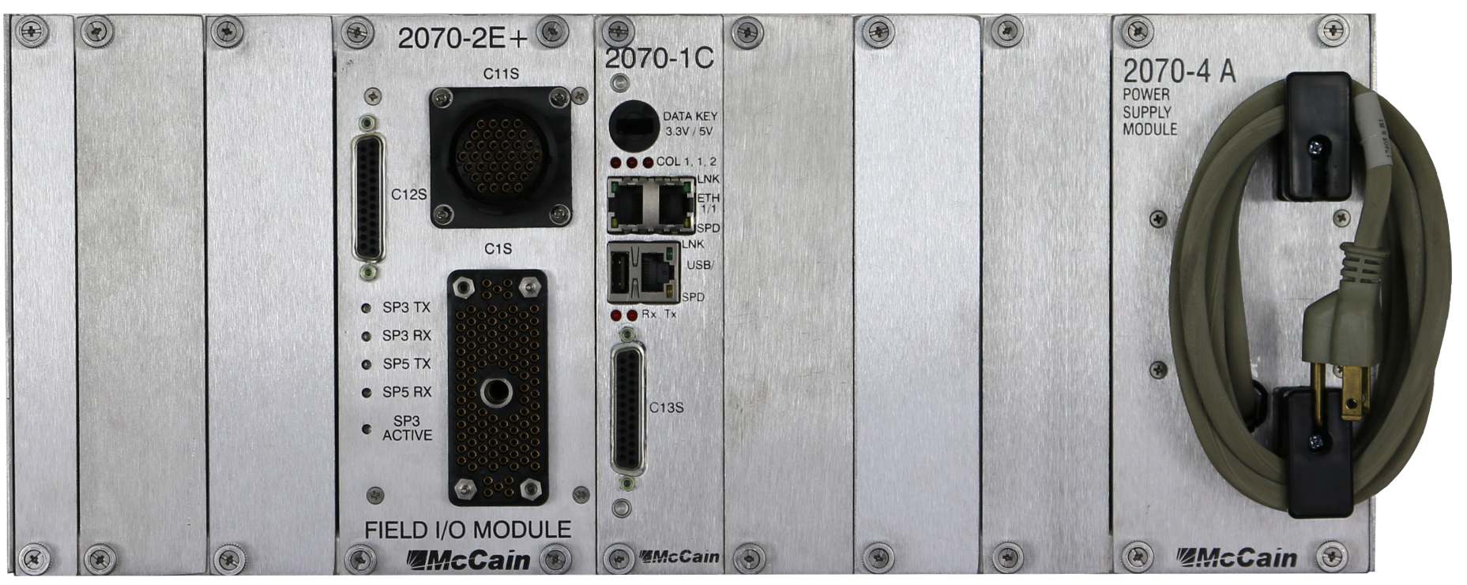
Front Panels
Emulates VT-100 terminal
8 x 40 display (2070-3B)
No display or keypad (2070-3C)

Slide 14
2070ATC
Chassis
2070-ATC cpu board
2070-2E+ field I/O module
2070-3B front panel
2070-4A power supply module
Comms modules as specified

Slide 15
Software
Linus operating system
API’s
Application software packages
NTCIP (software interoperability)

Slide 16
Standards and Specifications
Caltrans ATC 1C Standard
ITS Cabinet Standard
ATC Controller Standard
API

Slide 17
Testing
Testing to standards is more difficult than testing to specifications
No industry-wide testing program is available
Caltrans maintains a Qualified Products List
Agency specific requirements

Slide 18
Advantages
Open architecture eases maintenance and ensures future compatibility
Multiple application software vendors
Simple, competitive hardware purchasing
Compatible with all cabinets, existing and future
Upgradeable (hardware or software)
Fairly mature specification

Slide 19
Disadvantages
Agencies usually must purchase software by separate agreement
Careful specifications are a must to assure proper configuration of modular components

Slide 20
Questions?
info@mccain-inc.com

