Slide 1

Advance Transportation Controllers

Slide 2
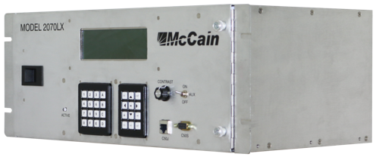
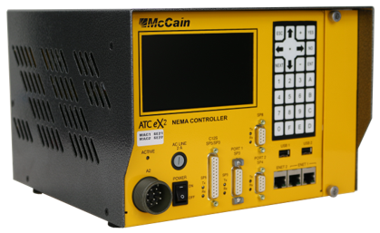
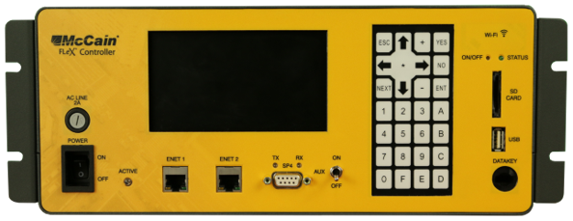
mccain ATC controllers
ATC 2070 lx
ATC Nema ts2-1
ATC Flex
Our controller line covers Caltrans, nema, and atc standards and they all use the same engine board and omni ex local control software.

Slide 3
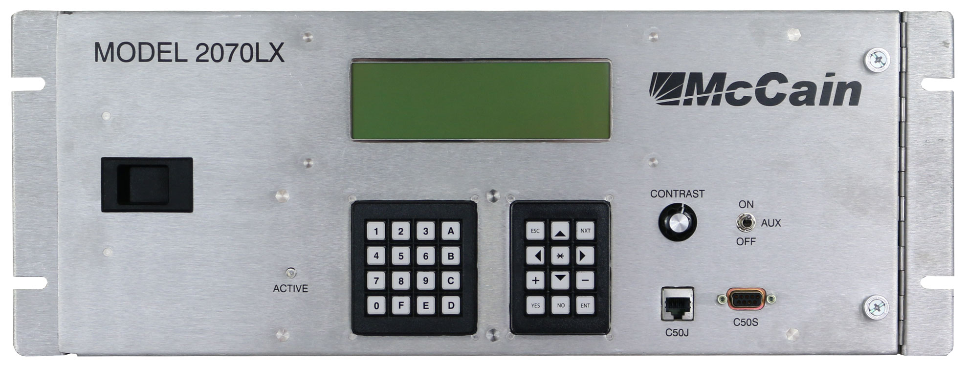
2070LX front view
Meets and exceeds the latest Caltrans tees 2009 errata 3 and Ite standard v6.25
Standard keypad that you are used to with the 170e
8-line display
Serial ports (C50J & C50S)

Slide 4
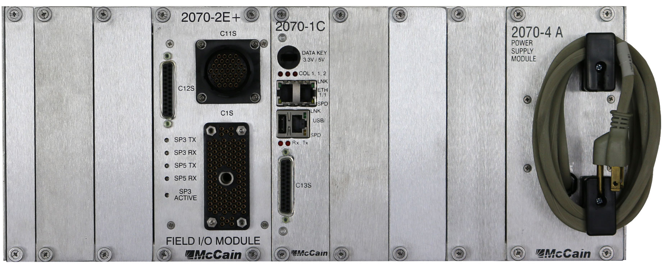
2070LX rear view
Meets and exceeds the latest Caltrans tees 2009 errata 3 and ite standard v6.25
2070-2E+ (Field I/O module)
2070-1C (CPU) – sd card, 1 USB port
2070-4a (power supply)

Slide 5
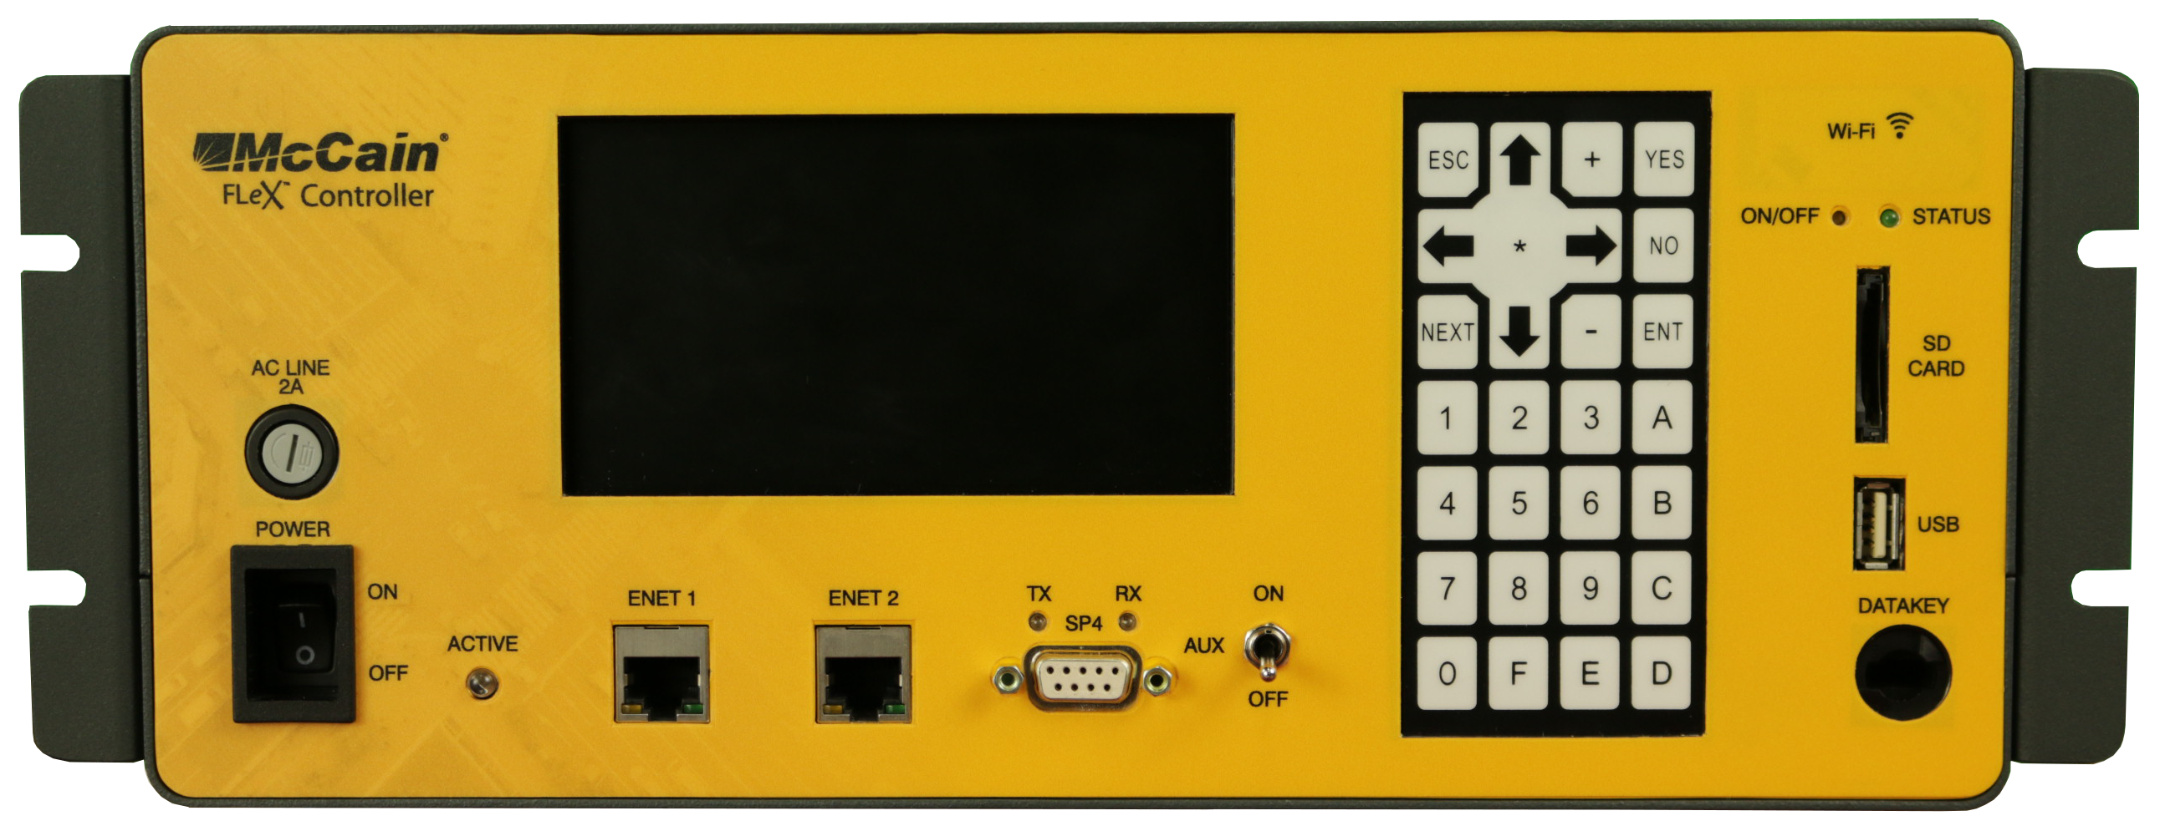
flex front view
Meets and exceeds the engine board requirements of Caltrans tees 2009 and all requirements of Ite standard v6.25
Membrane style keypad
2 Ethernet
Front access sd card
Front access usb
native wifi

Slide 6
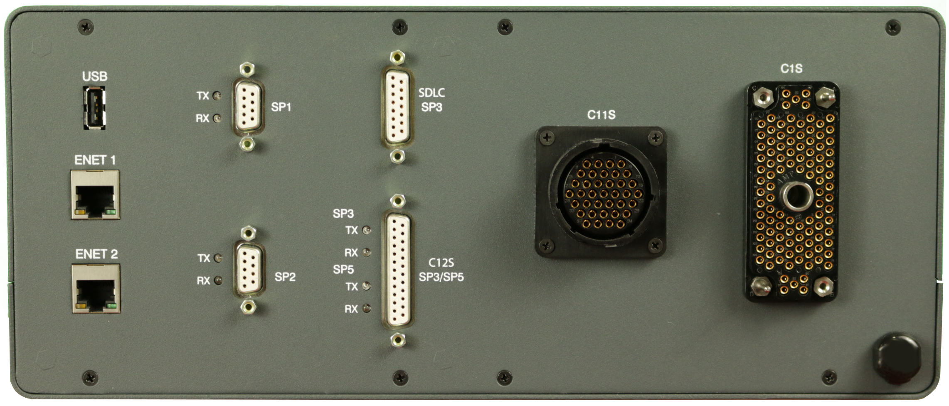
flex rear view
Meets and exceeds the engine board requirements of Caltrans tees 2009 and all requirements of Ite standard v6.25
2 Ethernet
High speed usb 2.0
Serial com support (2070-7A equivalent)
Module style c11 and c1 for legacy cabinets

Slide 7
Omni ex software
All inclusive approach

Slide 8

Omni ex functions
Powerful software platform for today’s needs yet foundation for future requirements.
What cabinets does the omni ex support?
What communication protocols does omni ex support?
What features does the omni ex have?
What differences should I be aware of?
What are some of the basic operations in omni ex?
What are some of the advance operations in omni ex?

Slide 9



Slide 10
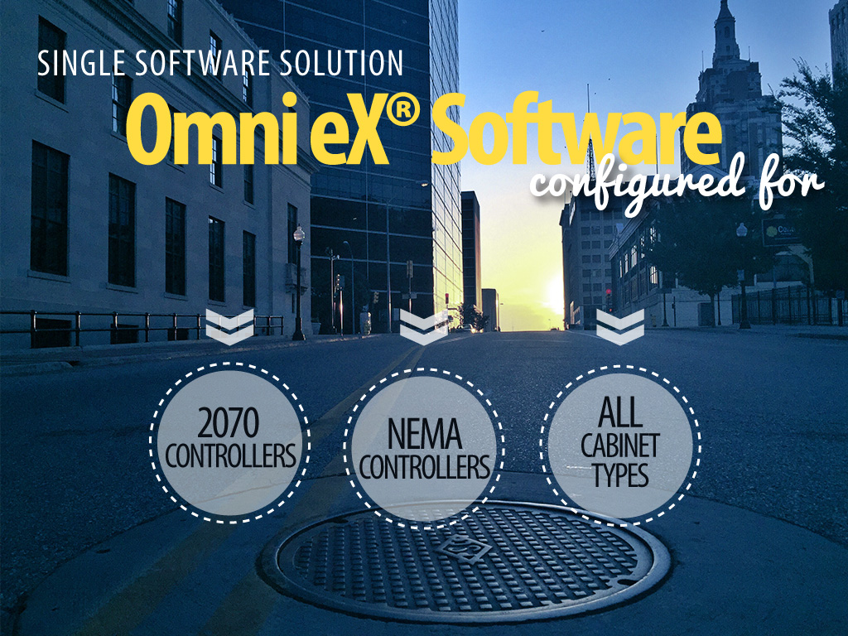
Notes:
Flex Controllers as well

Slide 11


Slide 12
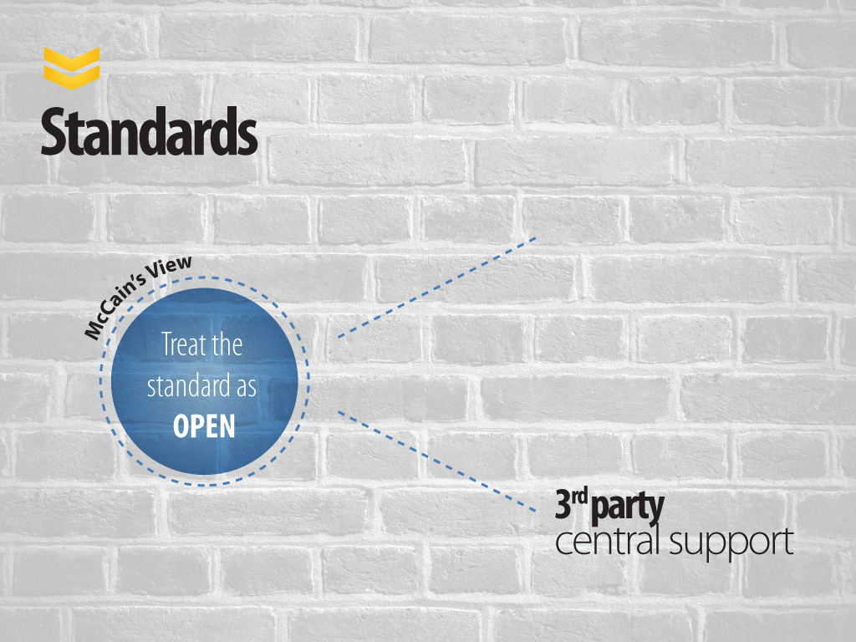


Slide 13

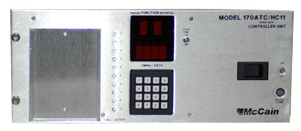
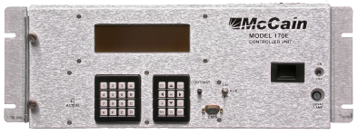
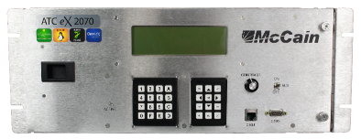
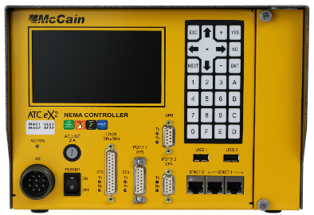
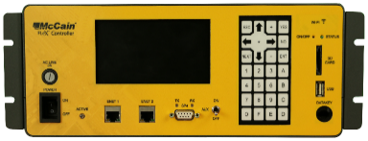
170
PROGRAMS
2070
PROGRAMS
ATC
PROGRAMS
COMMUNICATION
PROTOCOLS
C8
200
223
233 RV2
233 MC1
210/245 FM
2033
OMNI EX
STANDARD NTCIP
ECONOLITE
INTELIGHT
PEEK
D4
SERIAL
AB3418E
NTCIP
QUICCOMM
ETHERNET
Notes:
Omni can work with these other programs and protocols on the same network.

Slide 14

More of Everything
More Phases (16 Veh, 16 Ped)
More Overlaps (16)
More Patterns (253)
More Schedules (64)
Additional Features
Pedestrian Overlaps
Dynamic Max
Advance Transit Signal Priority
Peer to Peer
Copyright © 2013 McCain, Inc. All Rights Reserved. No part of this document may be reproduced without written consent from McCain, Inc.
Notes:
Dynamic Max – If a phase maxes out twice in a row – increase max time

Slide 15

Fundamental Differences
Splits Instead of Force-offs
No Inherent Ring/Barrier Structure
You program concurrency & sequence
Defaults to Standard 8 Phase
I/O Completely Customizable
Patterns Instead of Plan/Offset
Additional Functions
Transaction Error Checking
Failsafe Modes – Coord Fail – Cycle Fail
Copyright © 2013 McCain, Inc. All Rights Reserved. No part of this document may be reproduced without written consent from McCain, Inc.
Notes:
Most of you are familiar with our Legacy firmware – Bitran 200, 233. Here I highlight some fundamental differences. For the sake of avoiding information overload I will only highlight some major fundamental differences here:
OMNI is based on NEMA and NTCIP standards so in that sense it is a departure from what you are used to
I/O – you can assign any function to any “pin”
Error Checking – won’t let you put in “bad” timing. I.E. “Splits Exceed Cycle Time”
Coord Fail – when in coord phase with call is skipped 2 times – revert to free Cycle fail – phase 2 times skipped in free, revert to flash

Slide 16


Slide 17

Controller
Router
Server

Slide 18


Slide 19
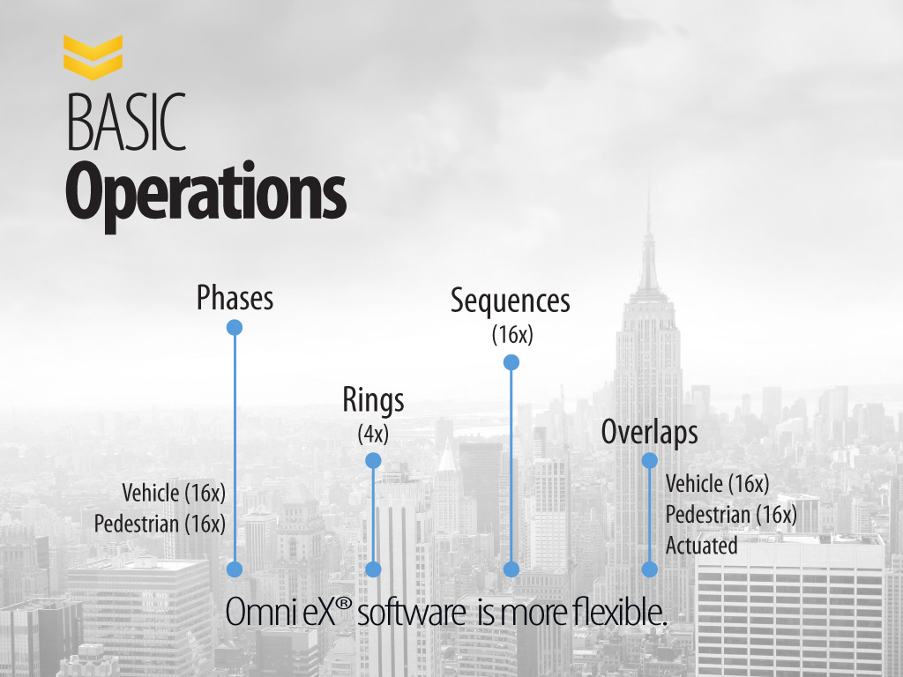

Slide 20













Notes:
Center Running BRT project in Chula Vista uses phases 9&10 as transit phases on its own ring.

Slide 22
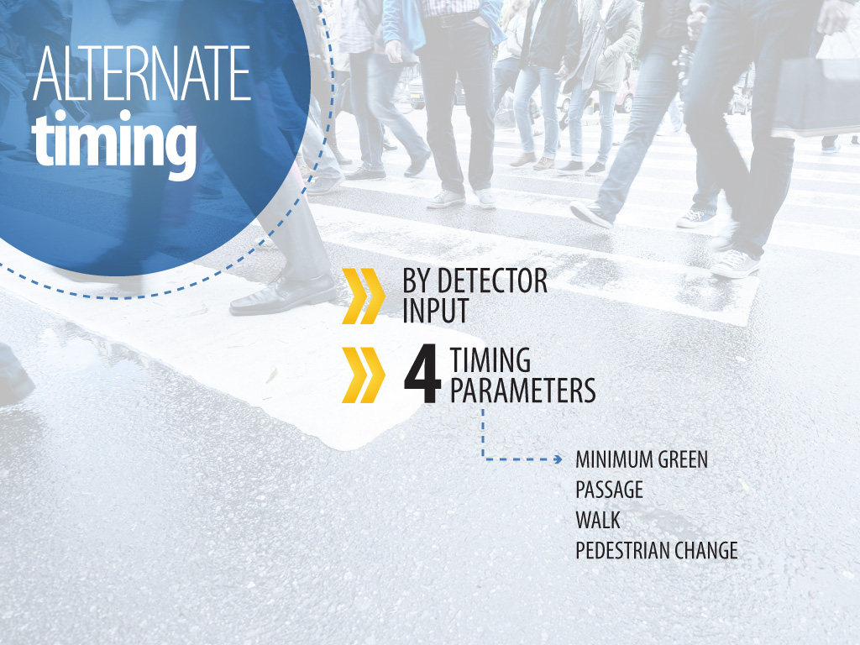
Notes:
Alternative bike timing ped crossing times.

Slide 23
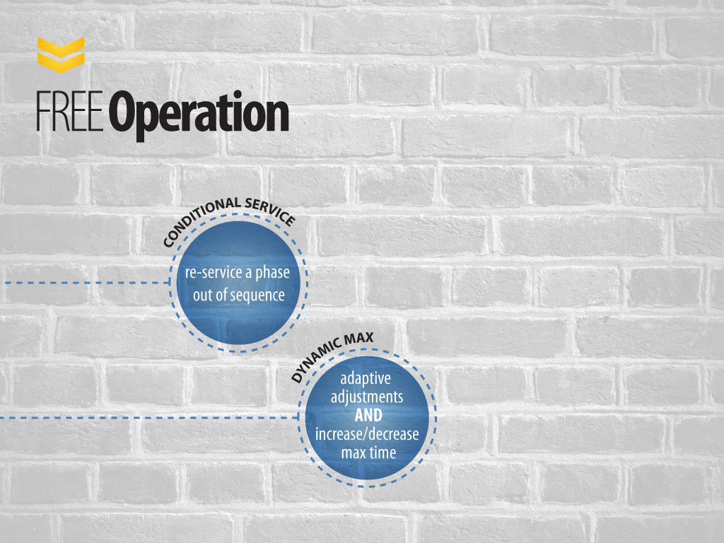
Notes:
When operating in Free mode, consecutive max out will increase the mat time by a user specified value up to a dynamic max limit.

Slide 24
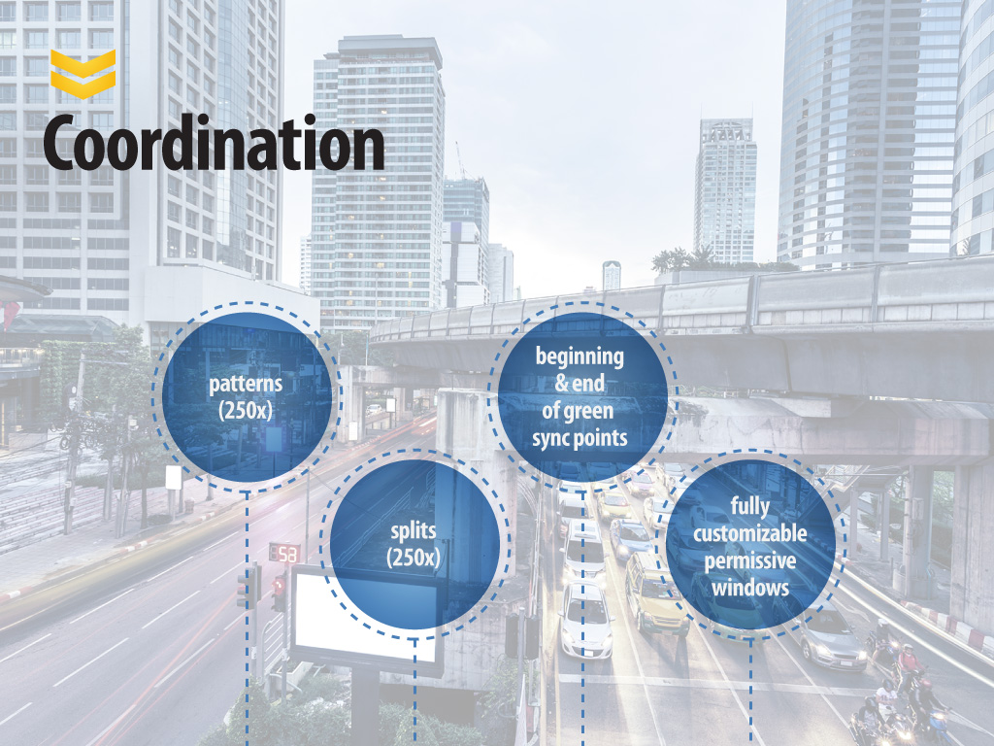
Notes:
Jewish high holidays with ped recall, Friday football games, junior college exams, surf competions,

Slide 25
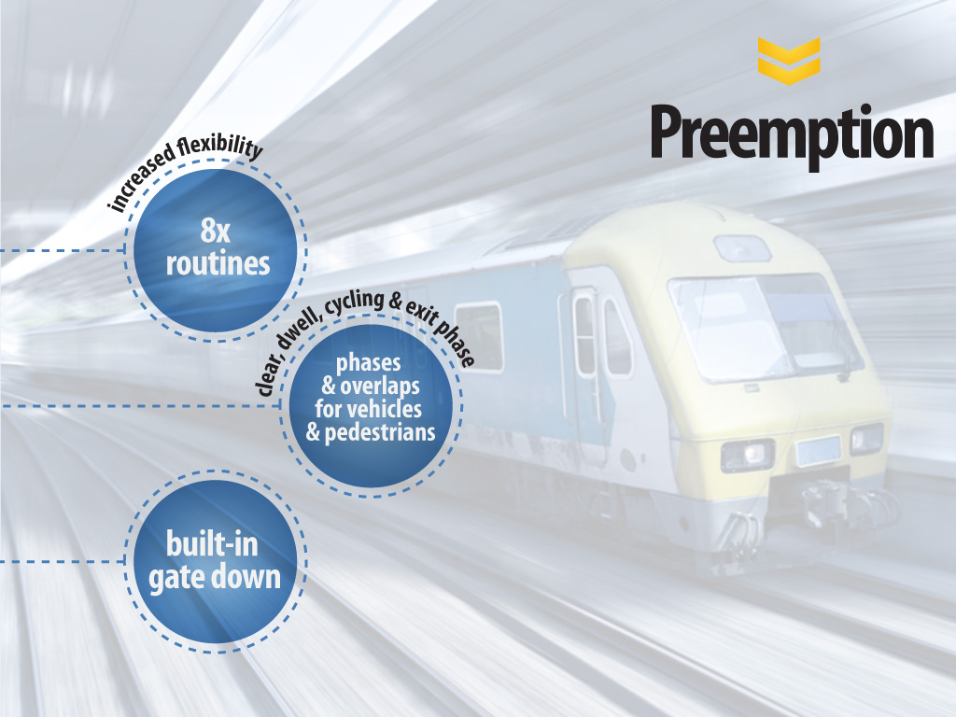
Notes:
Built in gate down - Allows the track clearance phase to be truncated when a crossing gate comes down.

Slide 26
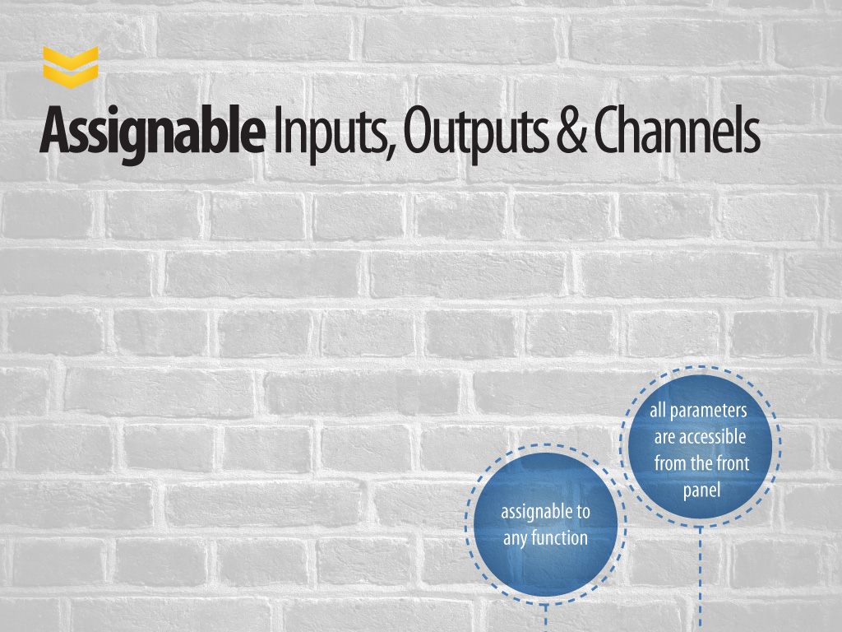
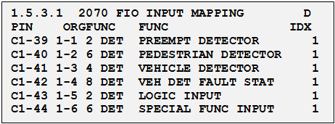
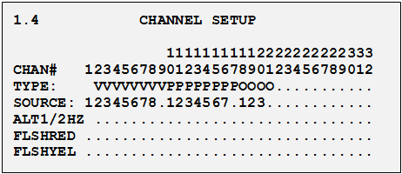
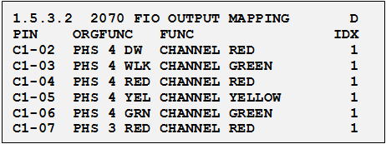
Notes:
Update I/O pages to current view

Slide 27
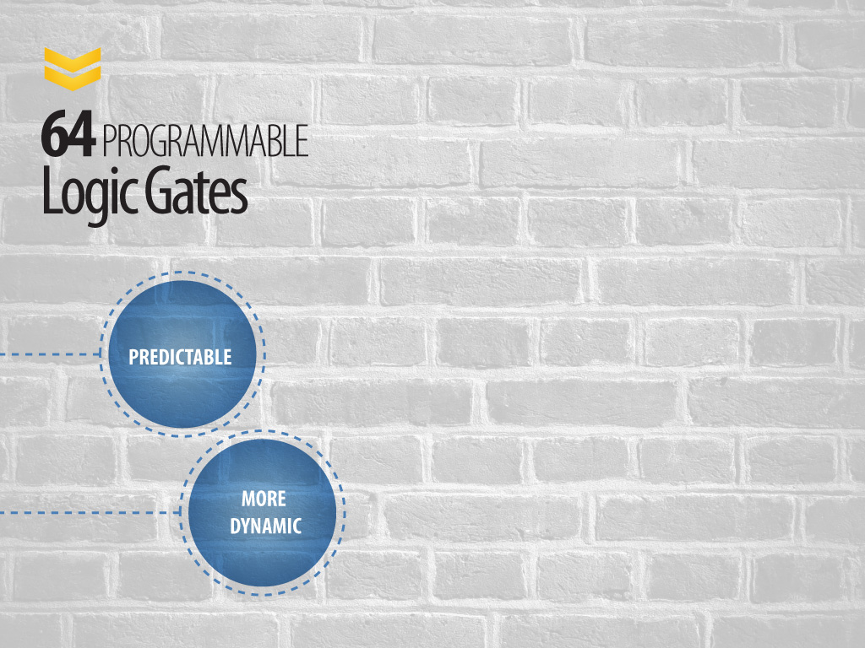
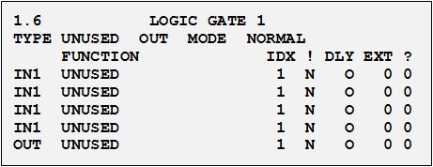
TYPE
Notes:
Logic gates - send the signal to a side street after preemption, flashing yellow, Hawk

Slide 28
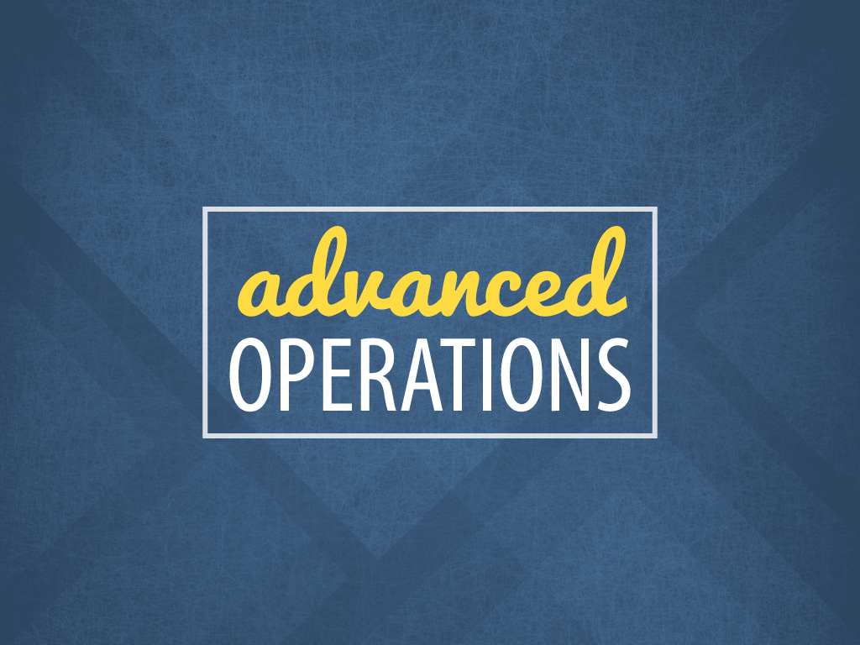

Slide 29
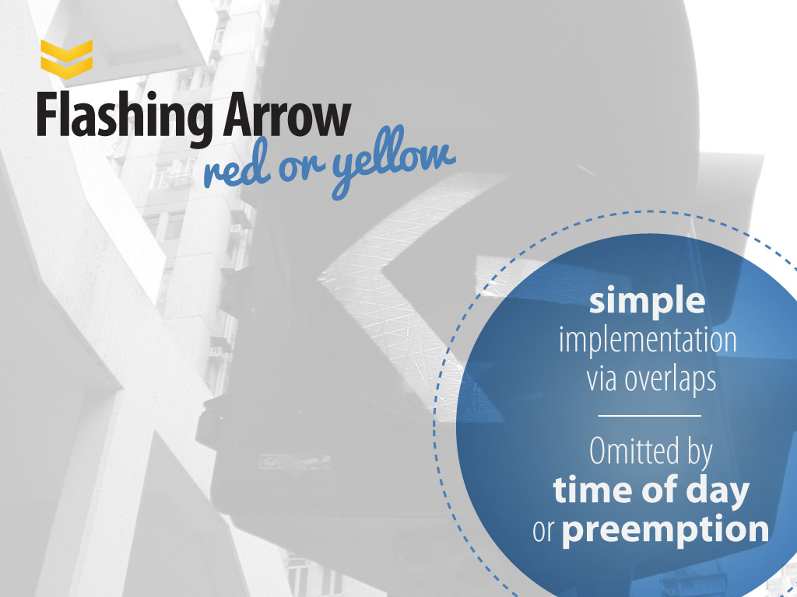

Slide 30
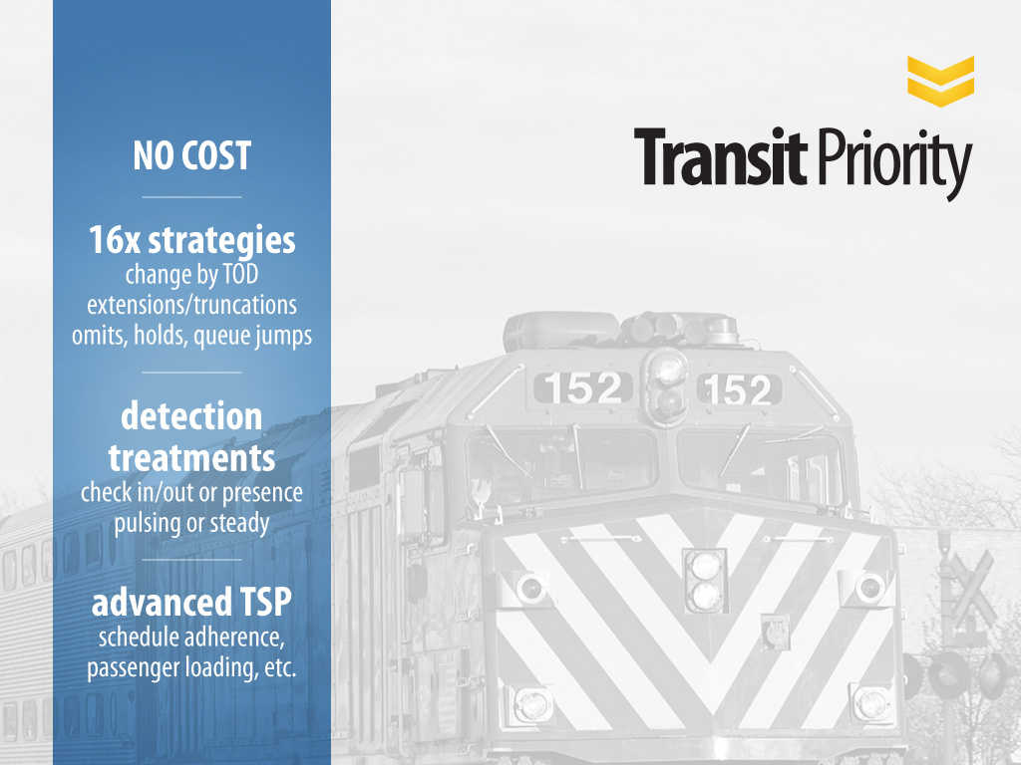

Slide 31

INTERSECTION 1
INTERSECTION 2
INTERSECTION 3

Slide 32


EXAMPLE
Remote function turns green on phase 1
Local function activates TSP call on strategy #1
IP based scheme – No serial connections
Up to 8 peers per intersection
Exchange up to 32 messages per intersection
‘Remote’ function activates local function(s)
Notes:
The local intersection local function(s) is activated by the ‘Remote’ function of a Peer

Slide 33
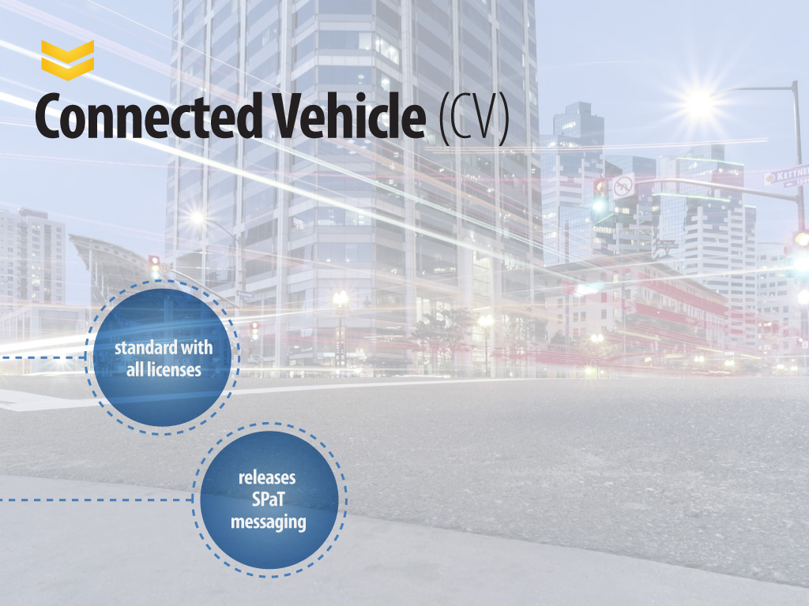
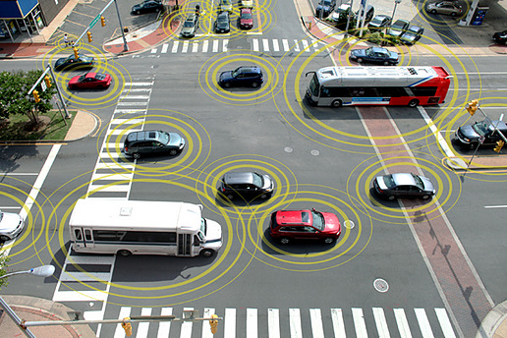

Slide 34


Slide 35
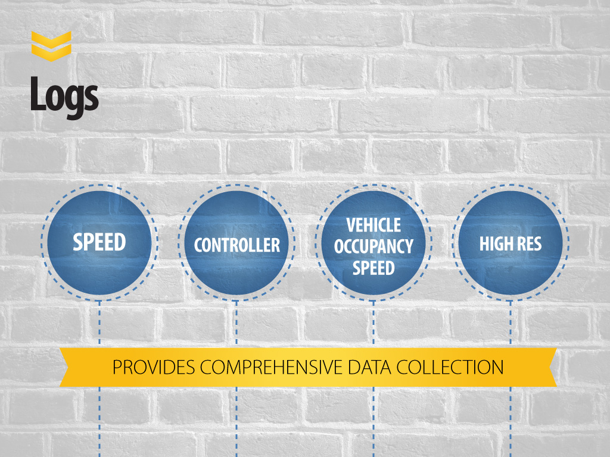

Slide 36
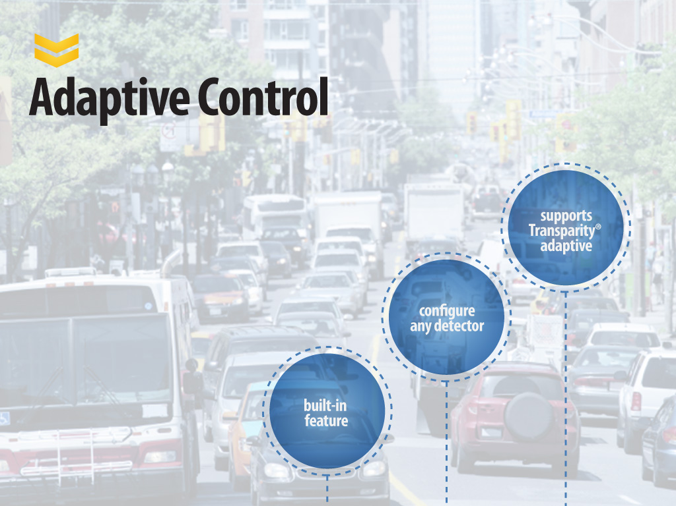

Slide 37


Slide 38


Slide 39

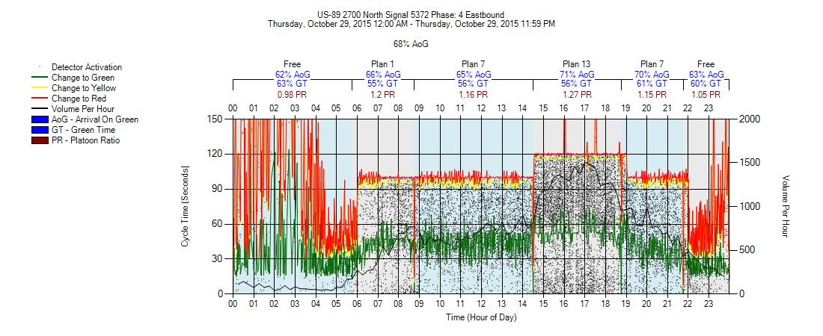
Coordination Diagram

Slide 40


Slide 41


Slide 42
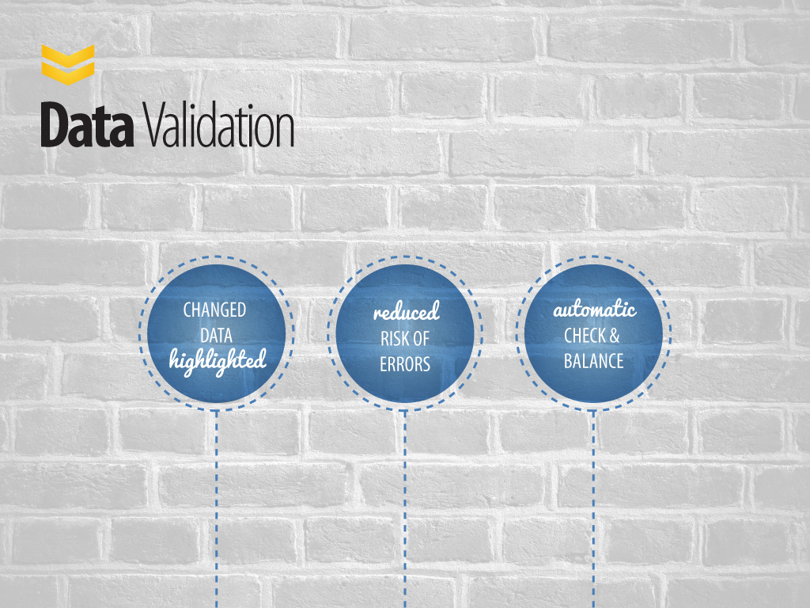

Slide 43
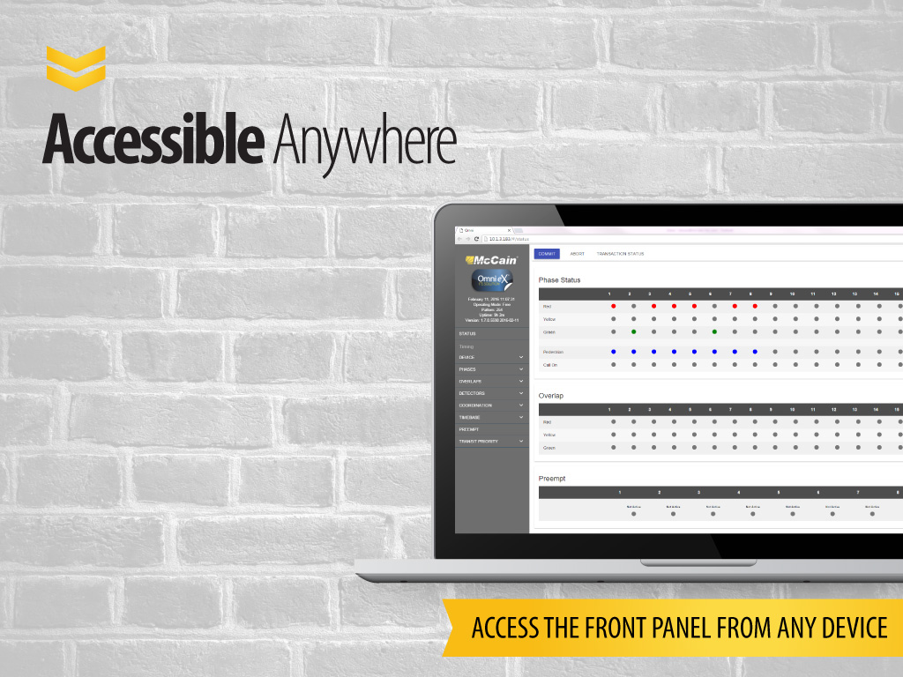

Slide 44
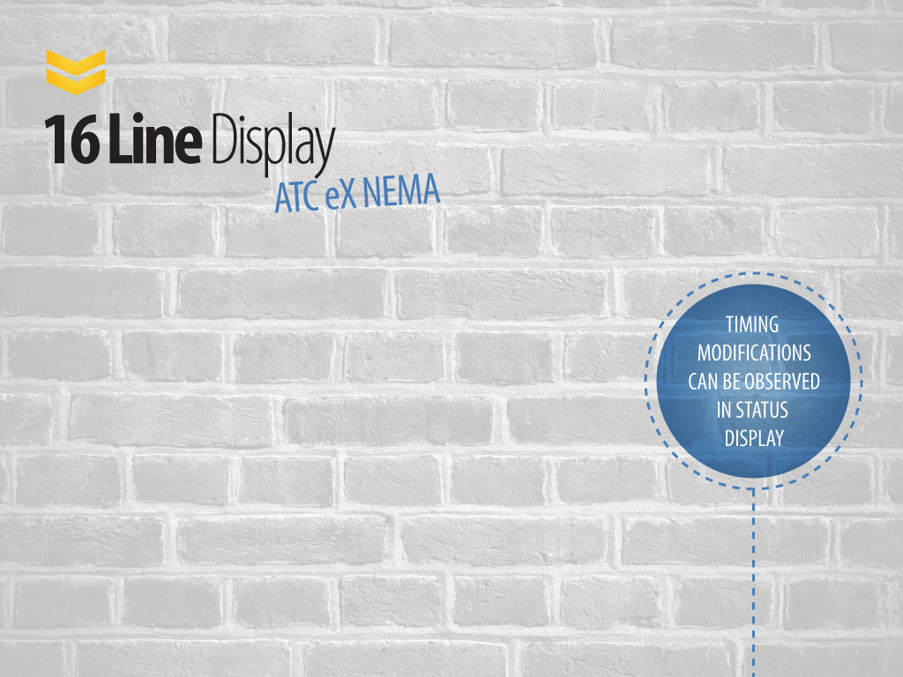
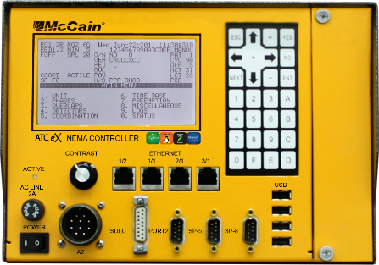

Slide 45

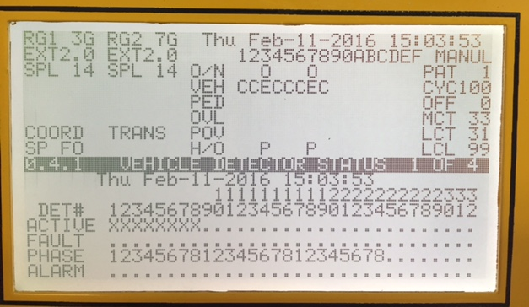
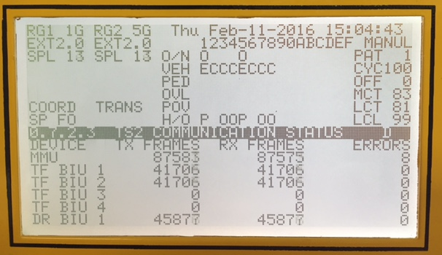
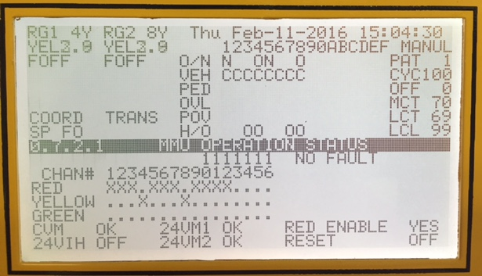
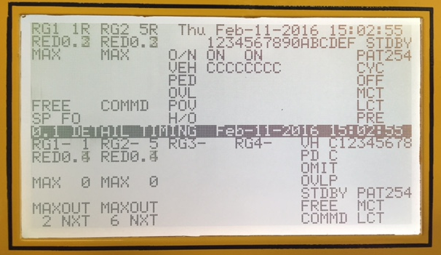
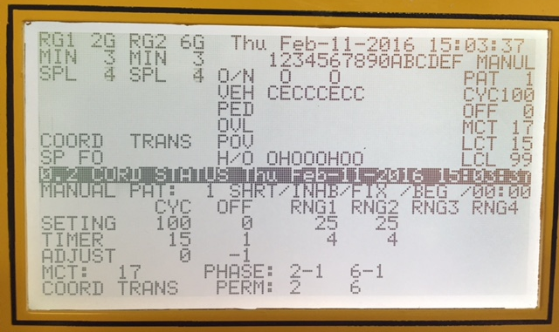
VEHICLE DETECTOR
TS2 COMMUNICATIONS STATUS
MMU OPERATION STATUS
DETAIL TIMING
COORDINATION

Slide 46


Slide 47


Slide 48


