Slide 1
Controller Overview
Nathan Welch
Controller Overview
Director of Sales
McCain, Inc.

Slide 2

Agenda
Snapshot of Standards
Legacy Controllers
Latest Controllers
McCain ATC Controllers

Slide 3
Controller Standards and Specifications

Slide 4
Controller Standards & Specifications
Caltrans TEES – Agency specification
  Model 170
  Model 2070
NEMA – Functional standard
  Traffic signal 1 (TS1)
  Traffic signal 2 (TS2)
ITE/ NEMA/ AASHTO – Functional standard (funded by FHWA)
  Advance Transportation Controller (ATC)
    ATC 5.2b
    ATC 6.24

Slide 5
Legacy Traffic Signal Controllers

Slide 6
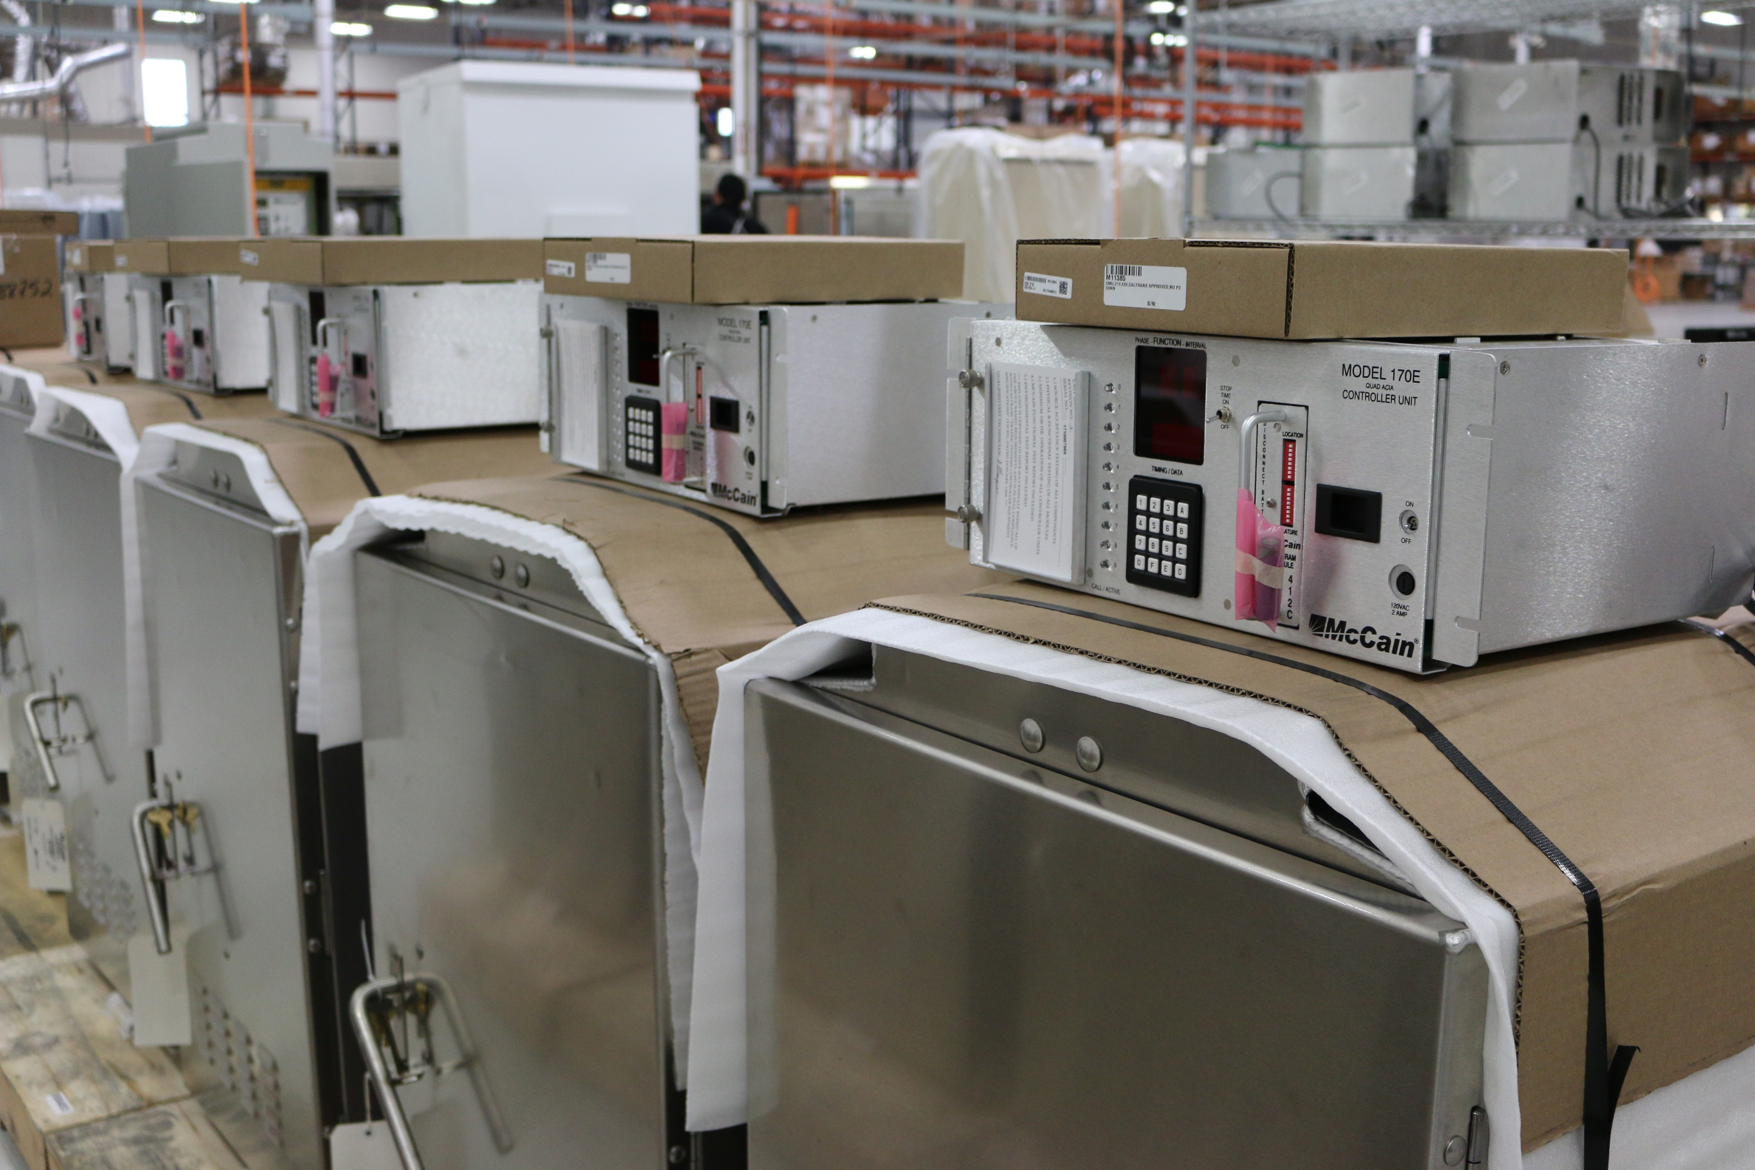

170E
PROS
RELIABLE
ROBUST
FLEXIBLE
PROVEN
USER FRIENDLY
McCain is the only MFG still producing this controller
Notes:
Era 1978

Slide 7
170E
CONS
OBSOLESCENCE ISSUES
CODE WRITTEN IN ASSEMBLY
LIMITED USER INTERFACE
NO MODERN DEV TOOLS
NO OPERATING SYSTEM
NO CONNECTED VEHICLE SUPPORT
NO NTCIP SUPPORT
NO HIGH RESOLUTION SUPPORT
NO NATIVE ETHERNET SUPPORT

Slide 8
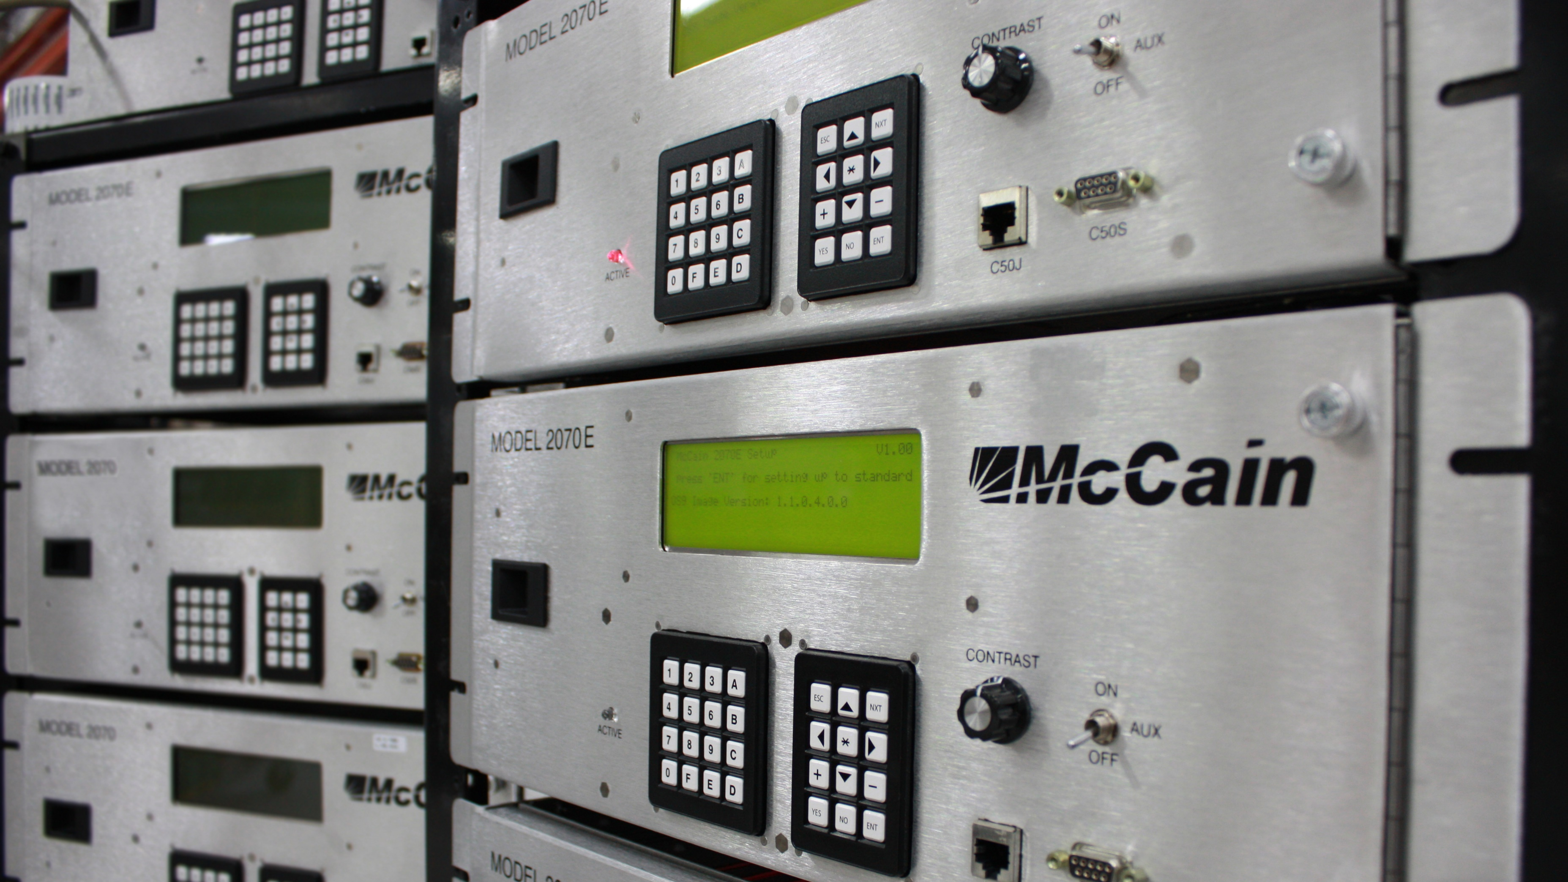
2070E
2070E
PROS
MENU DRIVEN
USES OS9
EXPANDED COMMUNICATIONS
TRUE OPEN ARCHITECTURE
Notes:
Era 2009
Menu Driven/LCD UI, no more 7 segment displays and LEDs
Uses OS9 (commercial operating system)
Expanded communication capabilities
True open architecture (separates hardware from software)

Slide 9
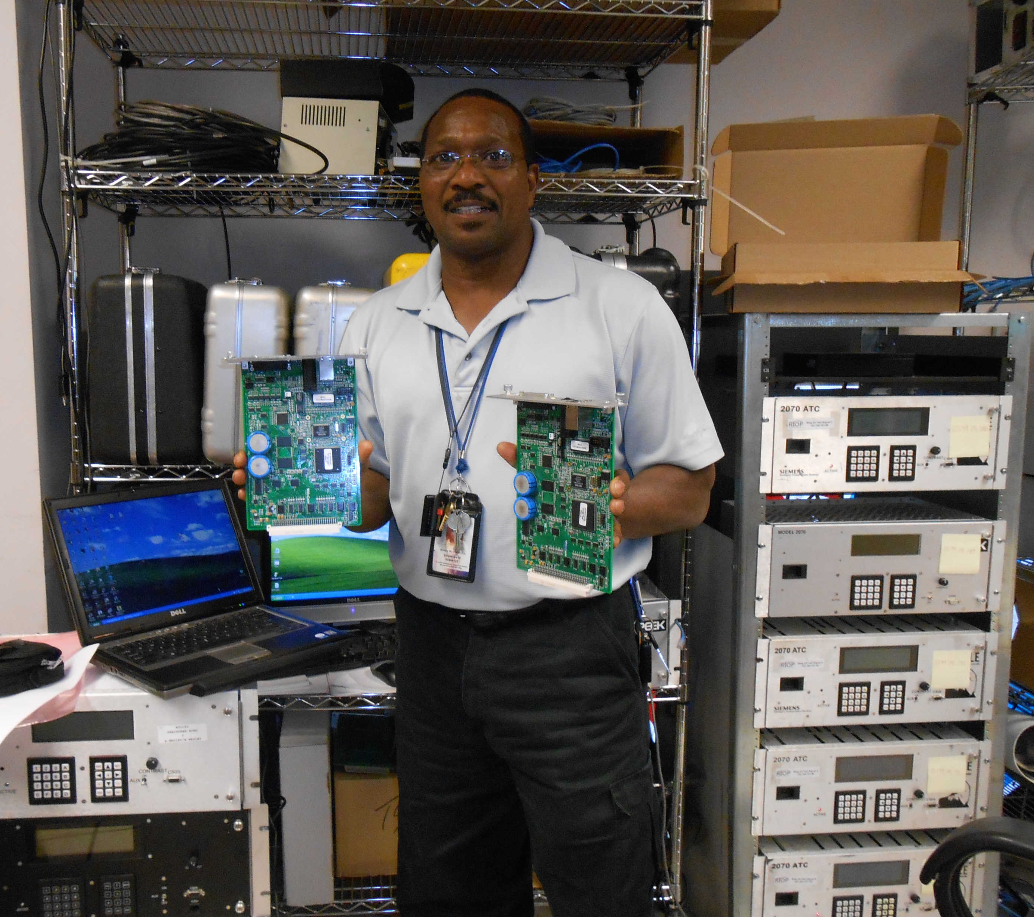
2070E
CONS
OS-9 (INITIAL RELEASE 1979)
PROPRITERY OS
LEGACY PROCESSOR (Freescale)
LIMITED MEMORY
NO USB

Slide 10
Latest Traffic Signal Controllers
ATC Standard

Slide 11
In the Beginning
1999 - agreement reached between AASHTO, ITE and NEMA
  Jointly develop, approve and maintain Advanced Transportation Controller (ATC) standards
  Working group created to develop a standard for the ATC
2002 - first official meeting
2006 – v5.2b
2017 – v6.24 (similar to Caltrans 2070LX)

Slide 12

Why the ATC Standard?
Provide an open architecture design for the next generation of transportation controller applications

Slide 13
The Goals of the ATC Standard
Interchangeable Processing Power
Specified design in standard is based on the concentration of computing power in a single component (the engine board) that is interchangeable with engine boards designed by other manufacturers
Notes:
First, the design specified in this standard is based on the concentration of computing power in a single component (the engine board) that is interchangeable with engine boards designed by other manufacturers.

Slide 14
The Goals of the ATC Standard
Protocol Communication Standards
Standard provides or required and optional features, all of which are based on open standard, common protocol communication standards
Notes:
Second, the standard provides for required and optional features, all of which are based on open standard, common protocol communication standards.

Slide 15
The Goals of the ATC Standard
Responsive Standard
Responsive to the functional requirements
Notes:
Third, the standard is responsive to the functional requirements

Slide 16
ATC Controllers

Slide 17
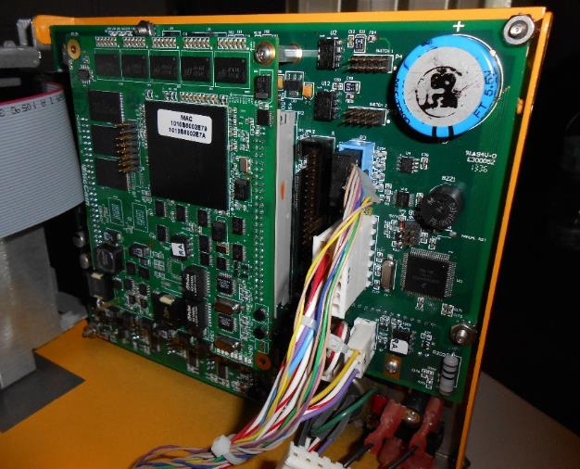
Form, Fit, and Function
Provides for easy hardware upgrades to adapt to:
  Newer processors
  Operating systems
  Increased memory size and speed
Requires engine board (CPU module) to conform to specific form and pin-out interface
  Shown mounted on host board.
Notes:
The ATC provides for easy hardware upgrades to adapt to newer processors, operating systems and increased memory size and speed. It does this by requiring that the engine board (CPU module) conform to a specific physical form and pin-out interface
Shown mounted on host board

Slide 18
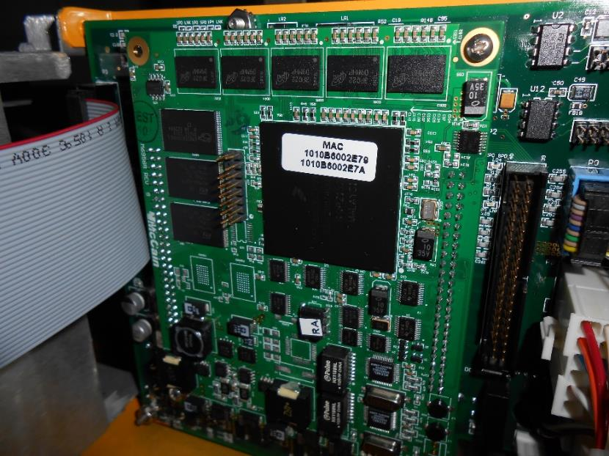
Engine Board
All computational functions concentrated on an engine board
Meets a set of defined minimum requirements

Slide 19

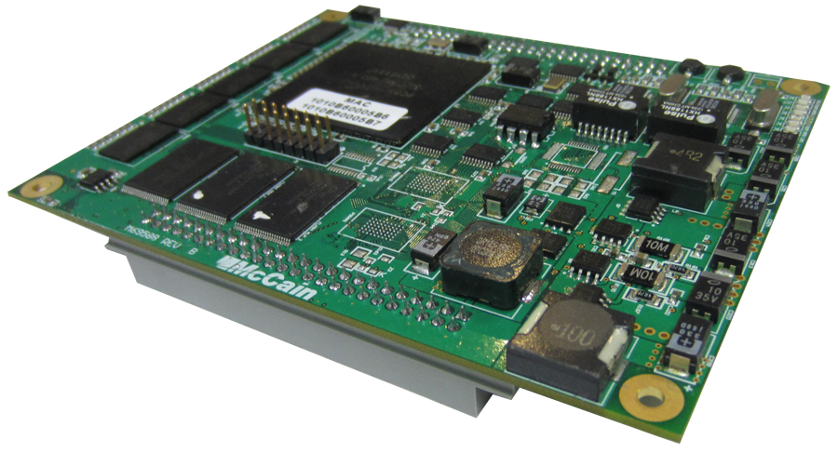
ATC Engine Board
5 in.
CPU
RAM
Flash Drive
All computational functions concentrated on an engine board
Meets a set of defined minimum requirements
4 in.
Communications
(Serial, Ethernet)

Slide 20
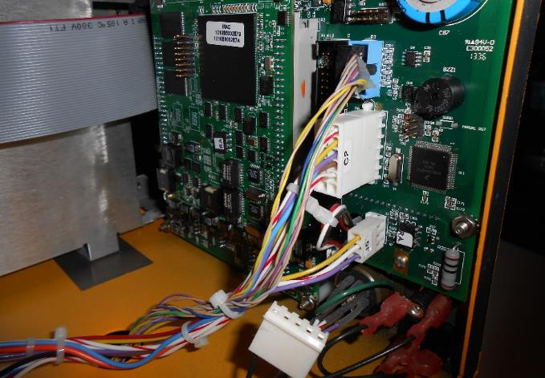
Minimum Requirements
CPU and RAM memory
Flash memory storage
Serial ports
Ethernet interface
Clock/calendar maintenance
Board support package

Slide 21
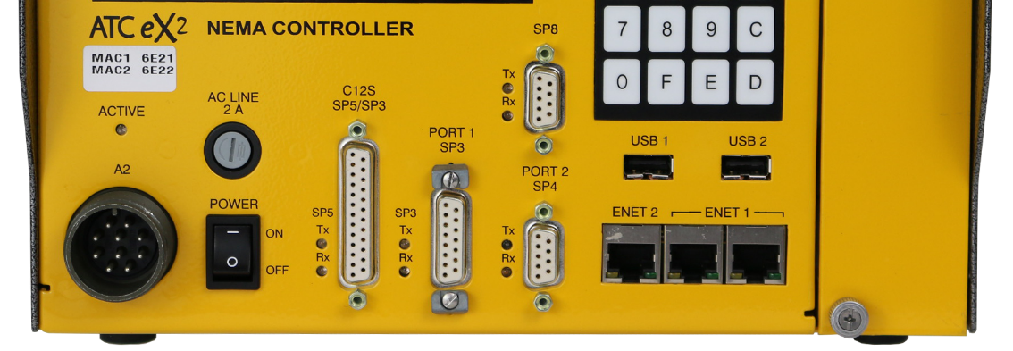
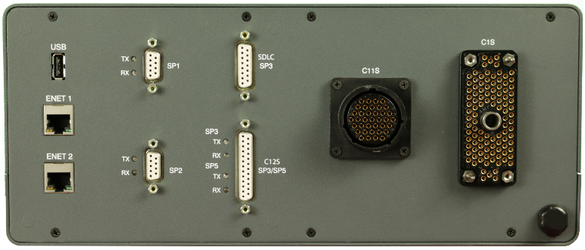
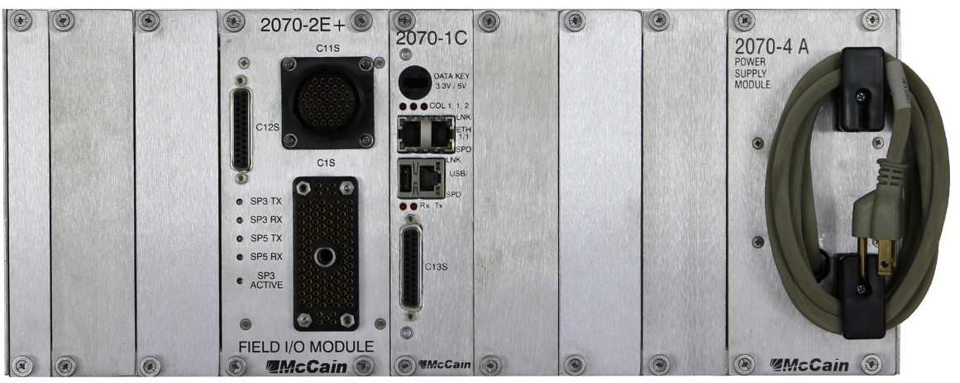
I/O Support
Input/Output
The standard requires a minimum of:
  Serial Coms for
    ATC cabinets
    NEMA TS2 (SDLC)
  Parallel Coms for
    Caltrans
    NEMA TS1

Slide 22
McCain ATC Controllers

Slide 23

Powerful Software Architecture
Omni eX® – flexible and feature rich
  16 phases in 4 rings
  16 overlaps and 16 peds
  8 RR/ EV preempts
  16 TSP strategies
  TSP and NTCIP-compliant
  Connected Vehicle (SPaT)
  High-Resolution Data (Signal Performance)
  Peer-to-Peer
  Integrated Web Server
Runs on all ATC form factors

Slide 24
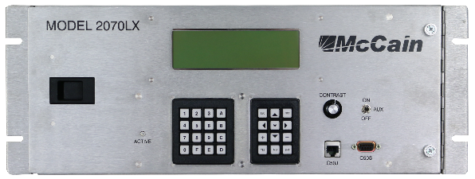
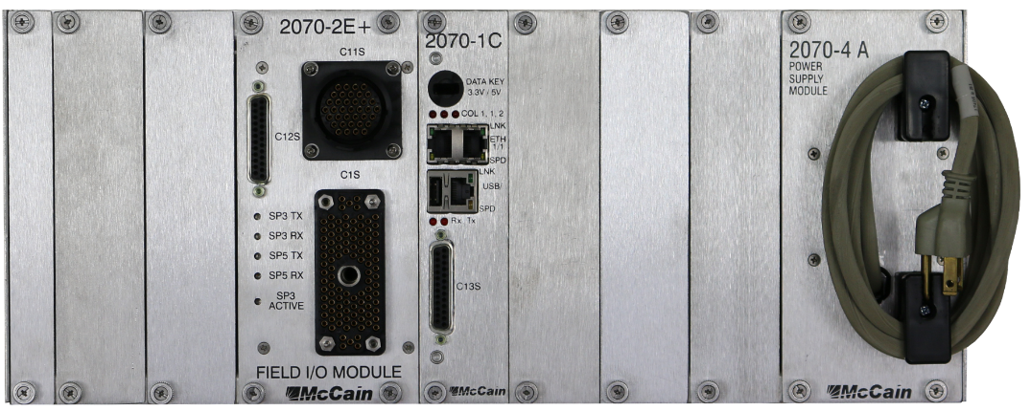
2070LX Controller
Linux operating system
Flexible configurations utilizing off-the-shelf modules
Caltrans QPL
8 Line Display

Slide 25
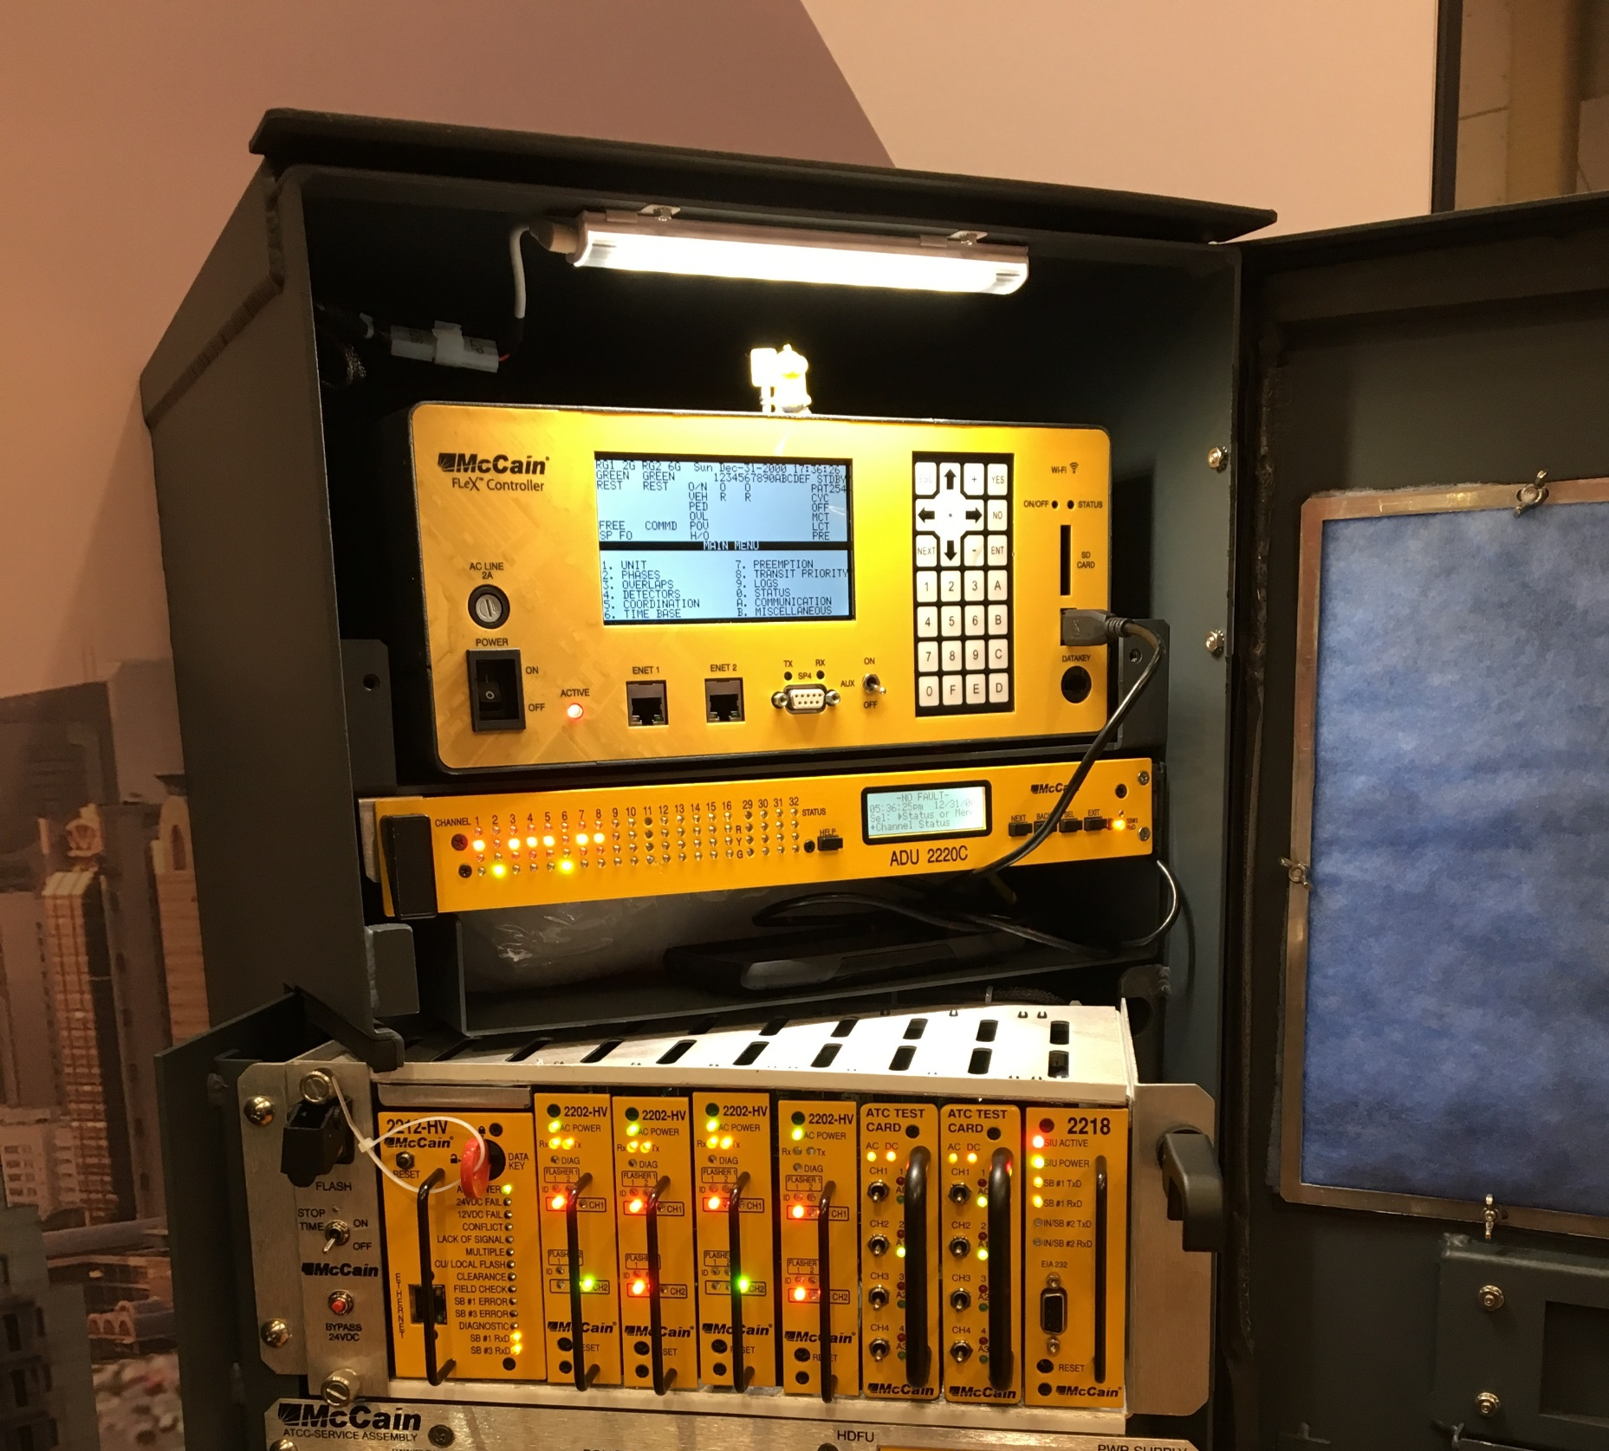
FLeX
Shelf Mount
ONLY 14” WIDE
TS2 & ATC/ITS SDLC PORTS
SD CARD SUPPORT
WIFI
GPS/CELL MODEM
16 Line Display

Slide 26
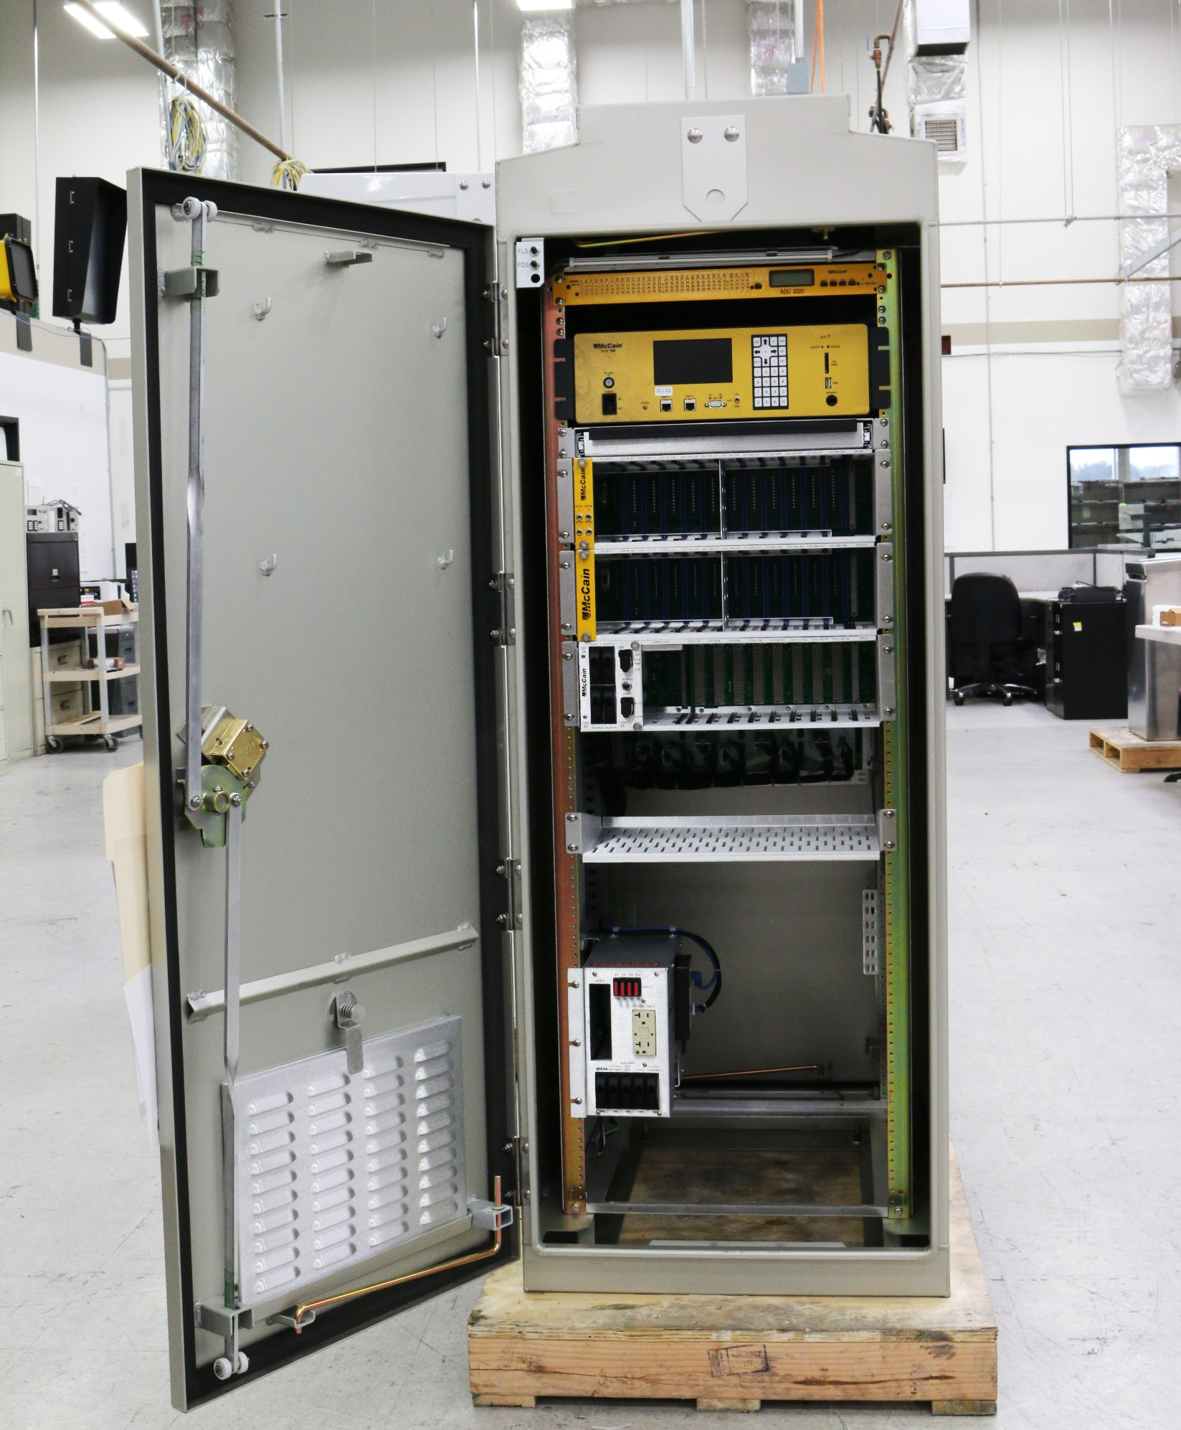
FLeX
RACK MOUNT
STANDARD 19” WIDE
CALTRANS CABINET COMPATIBLE
ATC CABINET COMPATIBLE
SD CARD SUPPORT
WIFI
GPS/CELL MODEM
16 Line Display

Slide 27

QUESTIONS?

