Slide 1
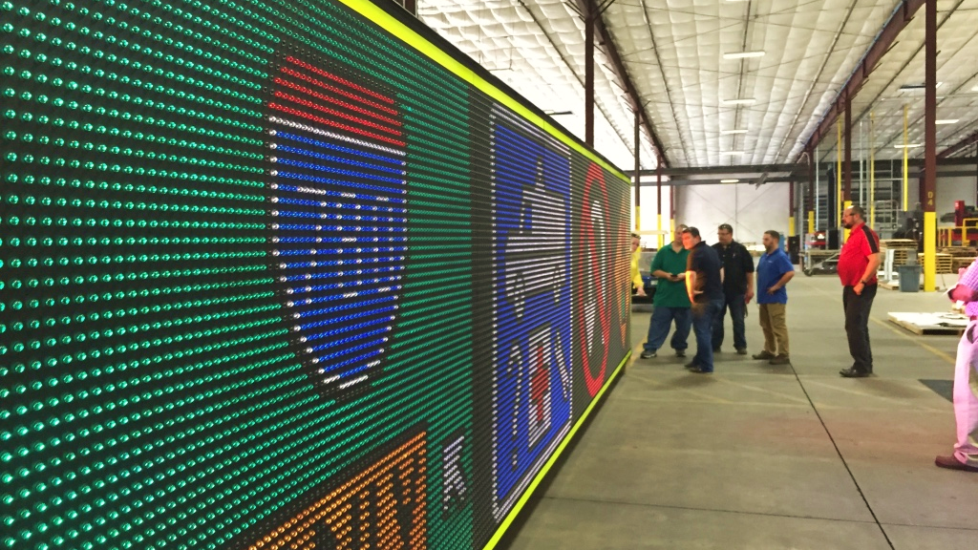
Stepping out with signs
Updates, tips and News

Slide 2
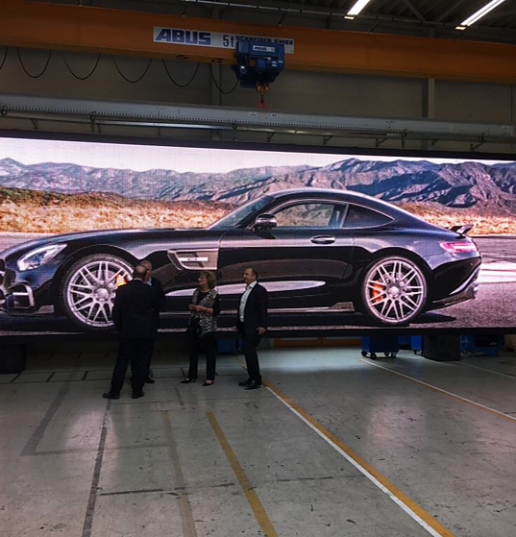
session agenda
Wins!
Caltrans district 11 project update
Caltrans district 7 project update
Variable speed limit signs (vsl) opportunity for growth
.
Ohio DOT / M.H. Corbin
Penn DOT / M.H. Corbin
Colorado DOT / Traffic Signal Controls
Agency approvals / key projects / what to look for
Where McCain is approved & where we need to go
State contracts / atm projects / its corridor
Highway, airport, wayfinding, tolling

Slide 3
Wins! update

Slide 4
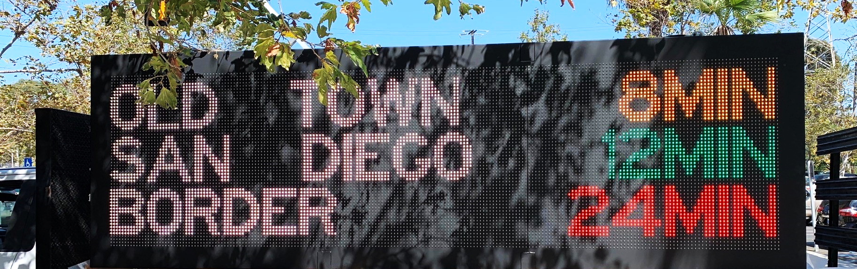
Caltrans district 11
Model cms 600 & cms 610
All signs are completed and most are installed
Caltrans transportation lab approved
Phase 2 (cv portion) expected to begin in 2020
Huge milestone for McCain and more on the way!

Slide 5
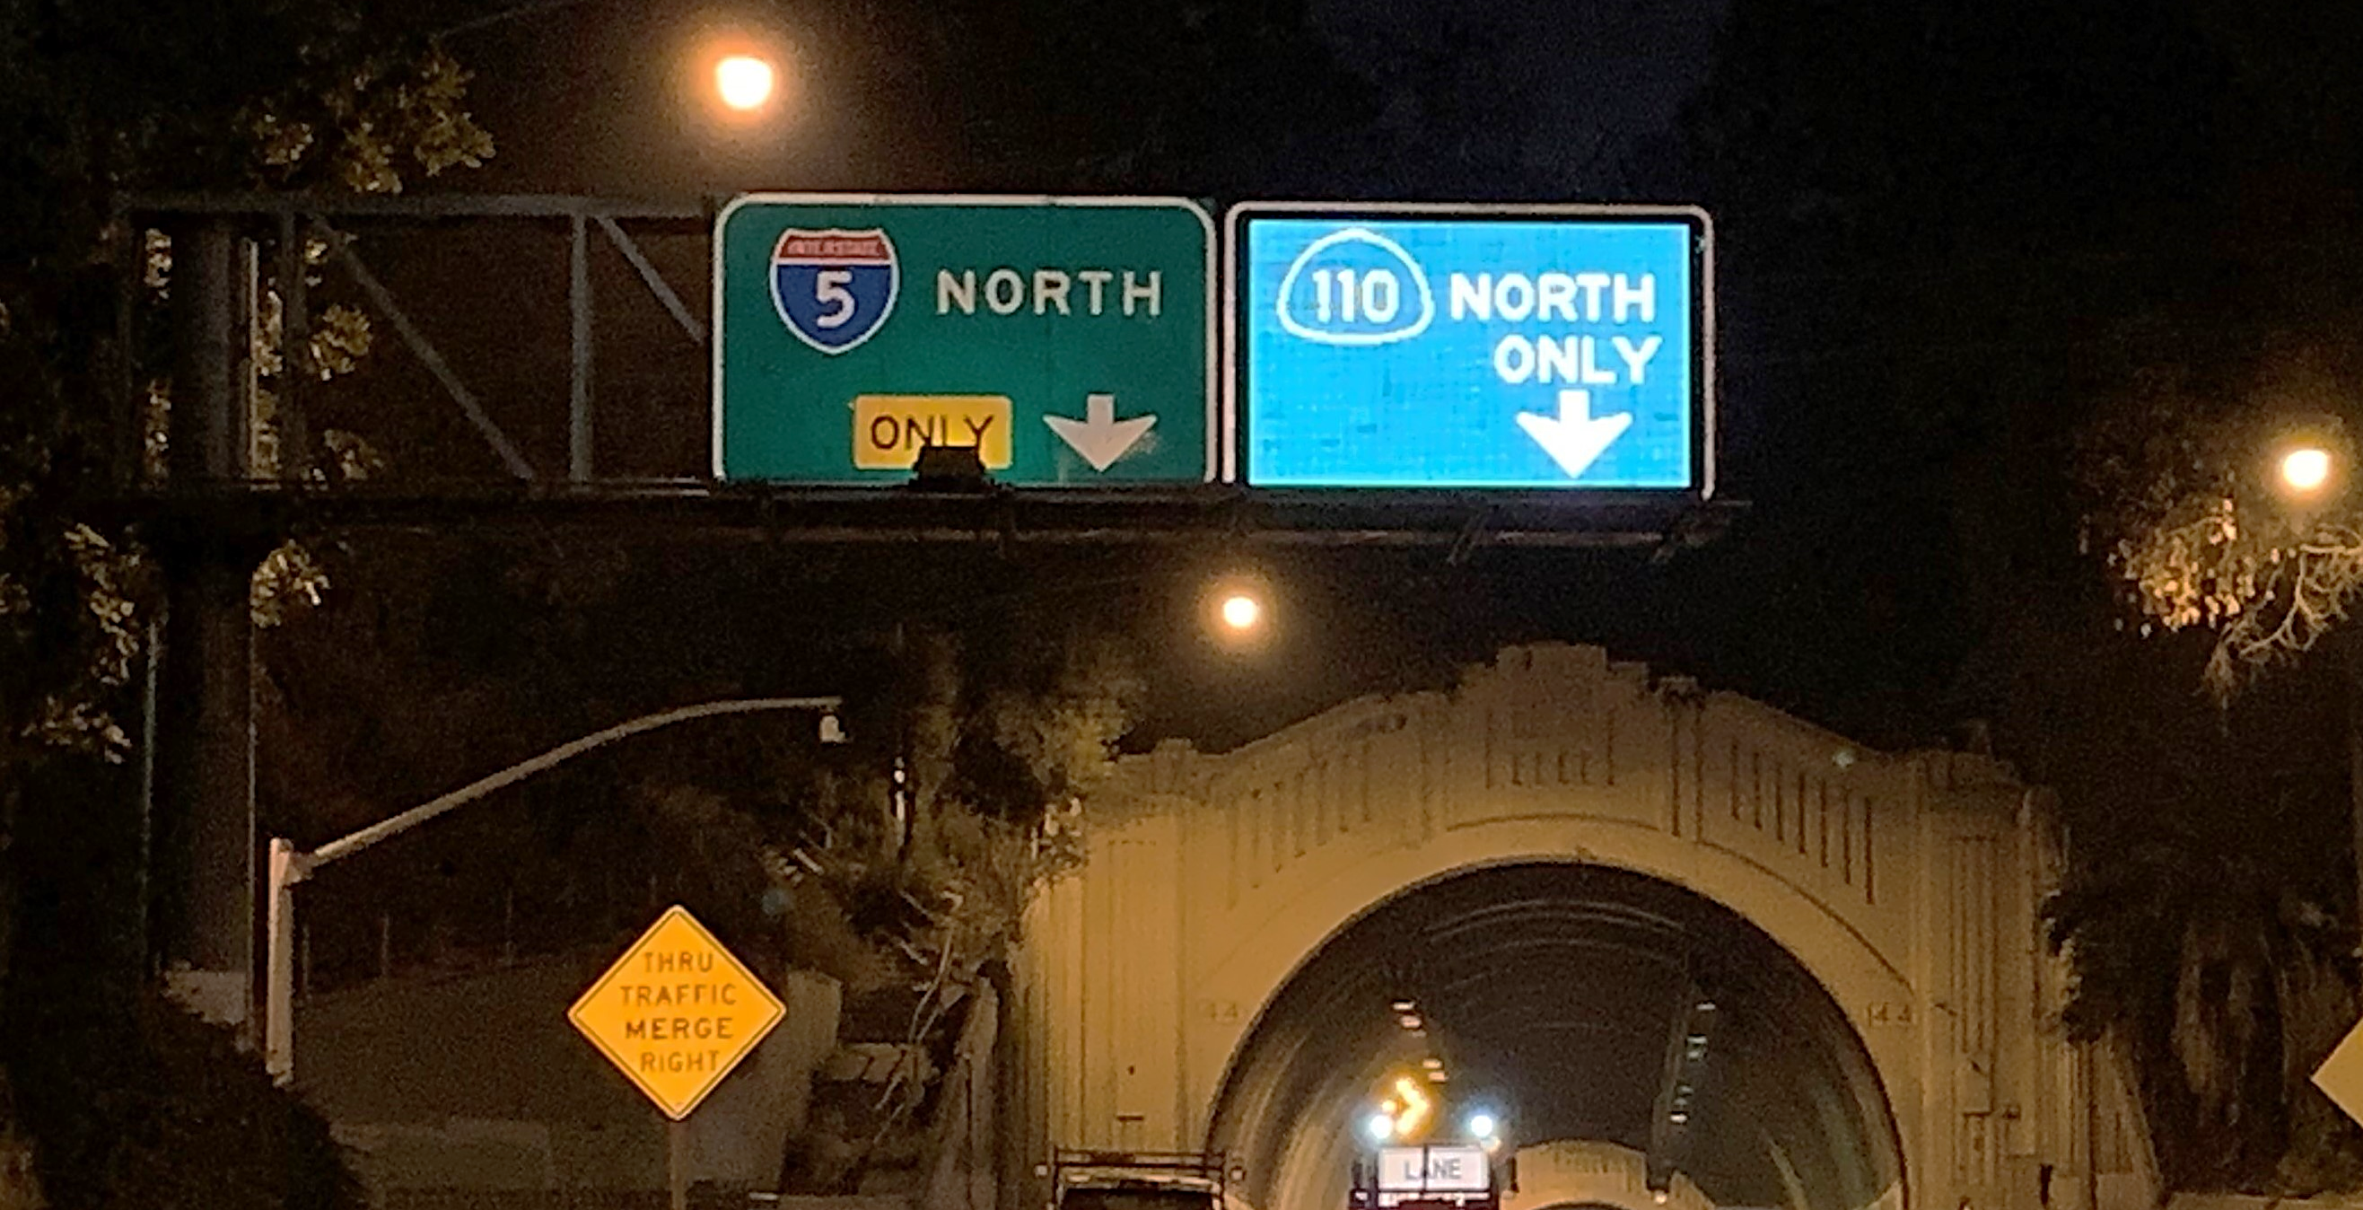
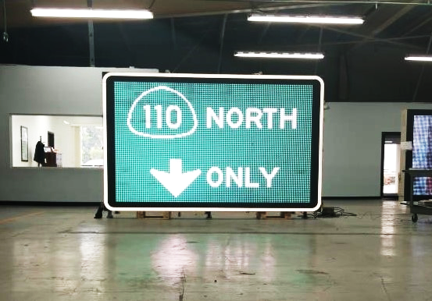
caltrans district 7
Quantity
differentiators
location
3 signs installed in august
Low light pollution for residents above sign structure in some locations
Installed on 110e between the 101 and i-5 near dodgers stadium

Slide 6
Variable Speed Limit signs opportunity for growth

Slide 7
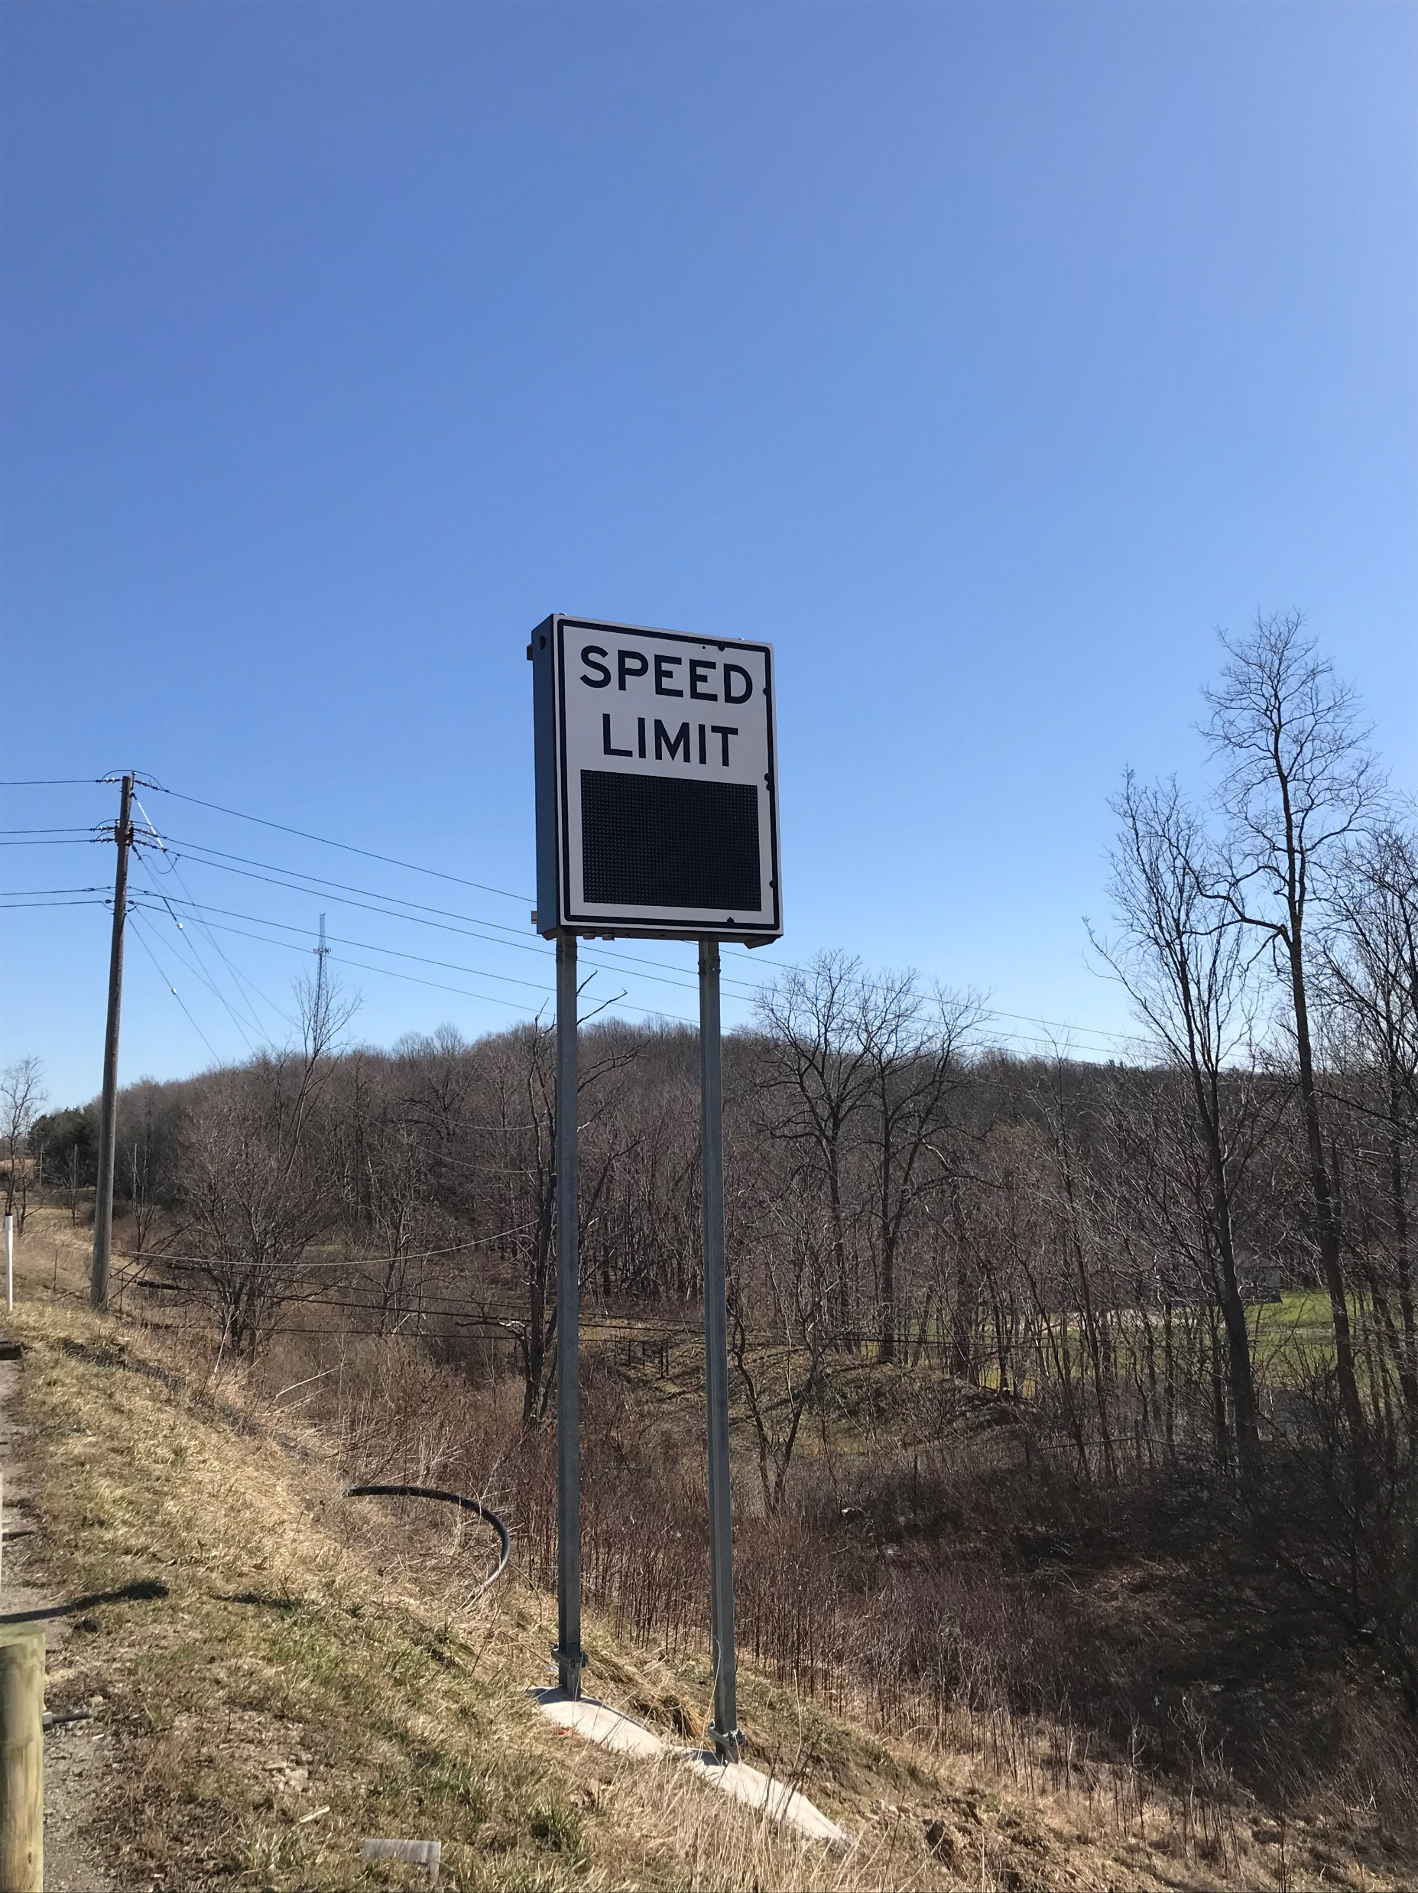
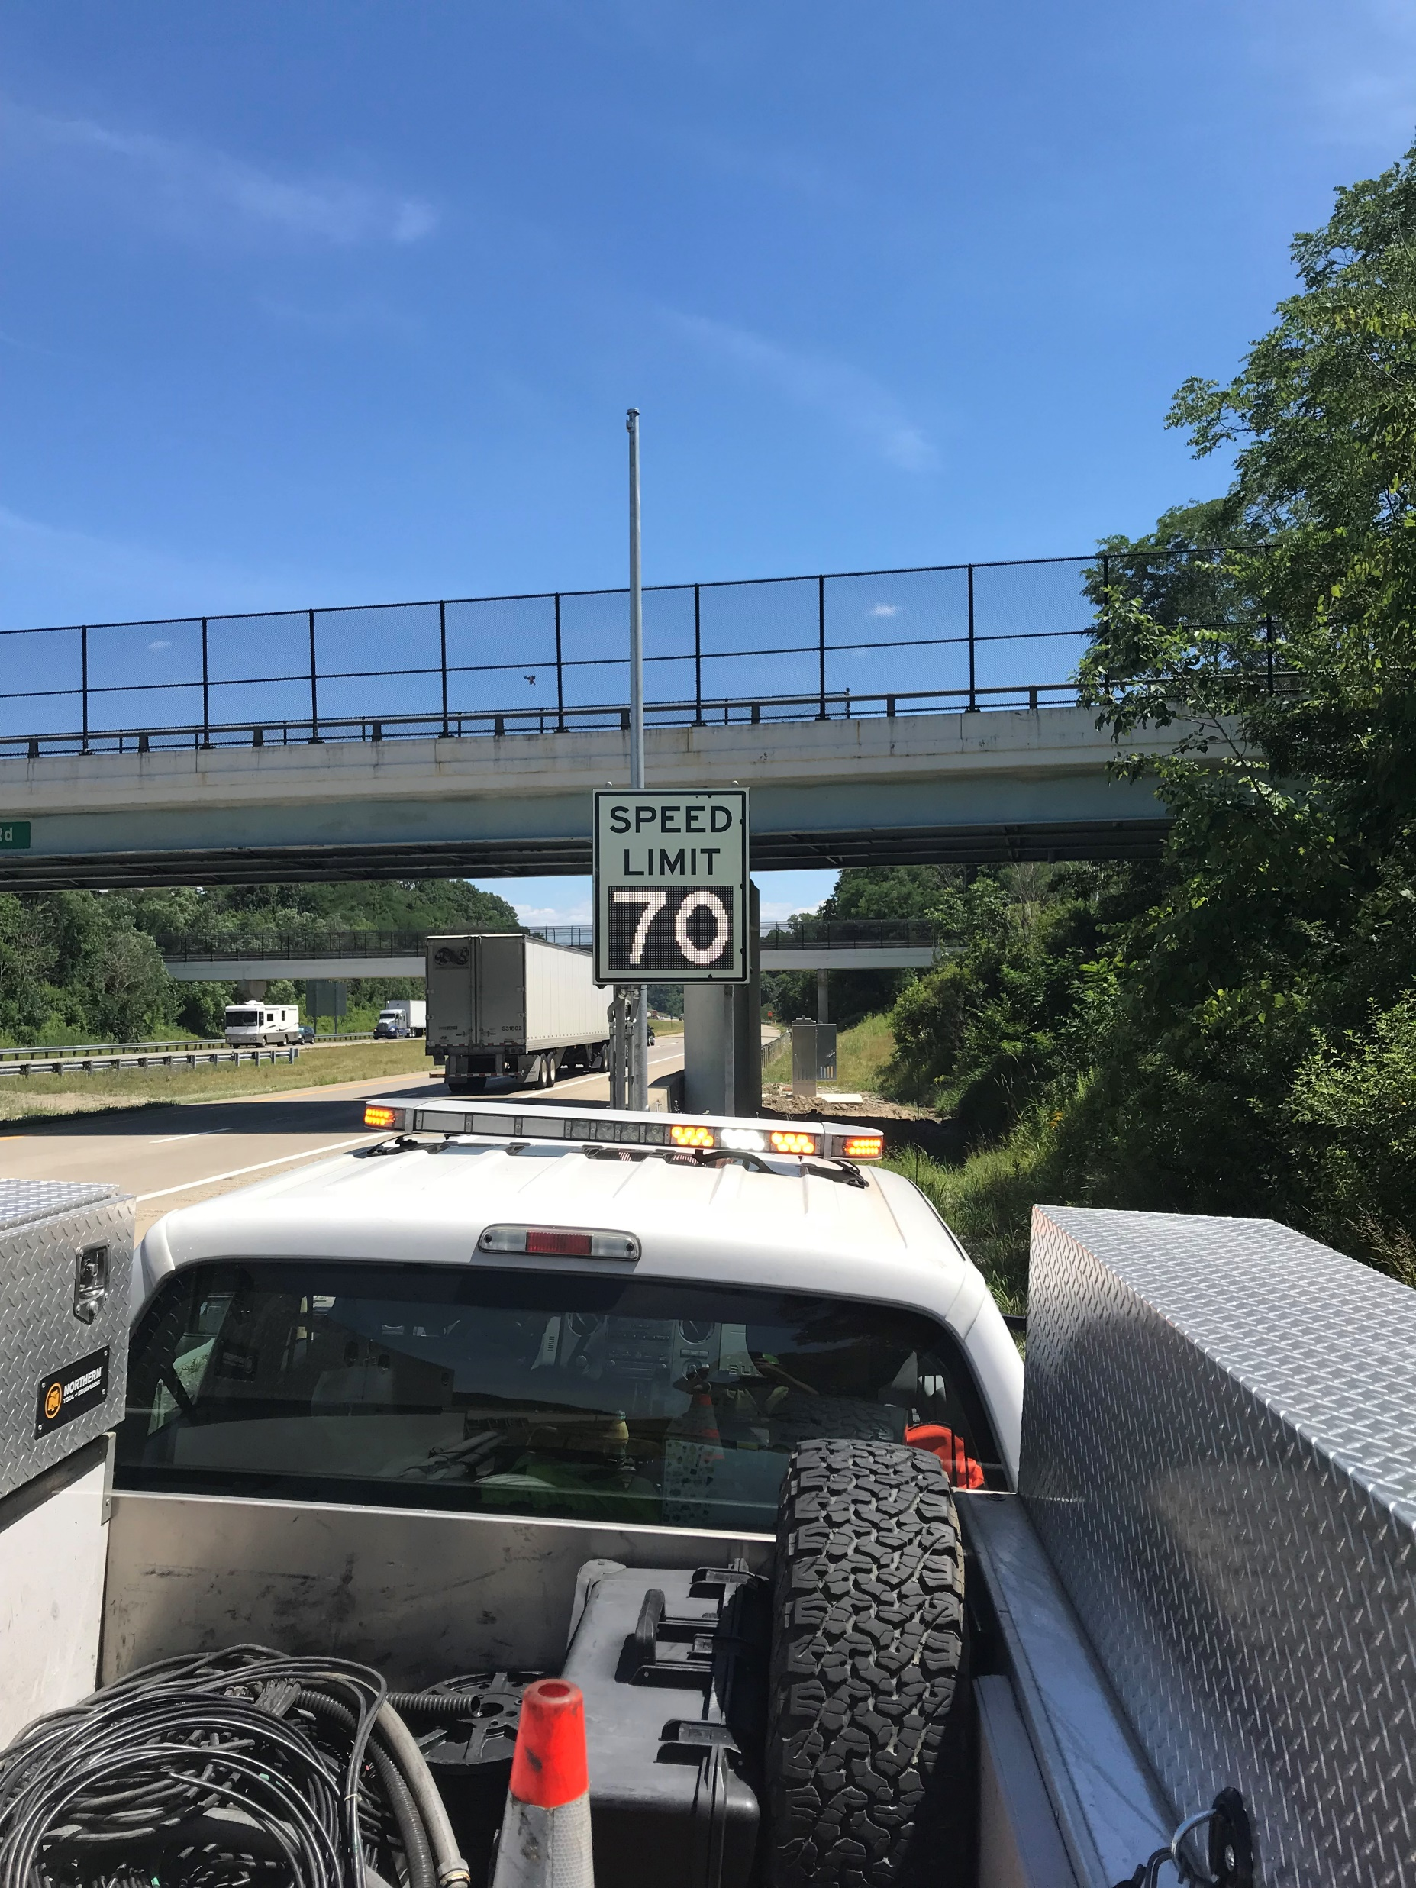


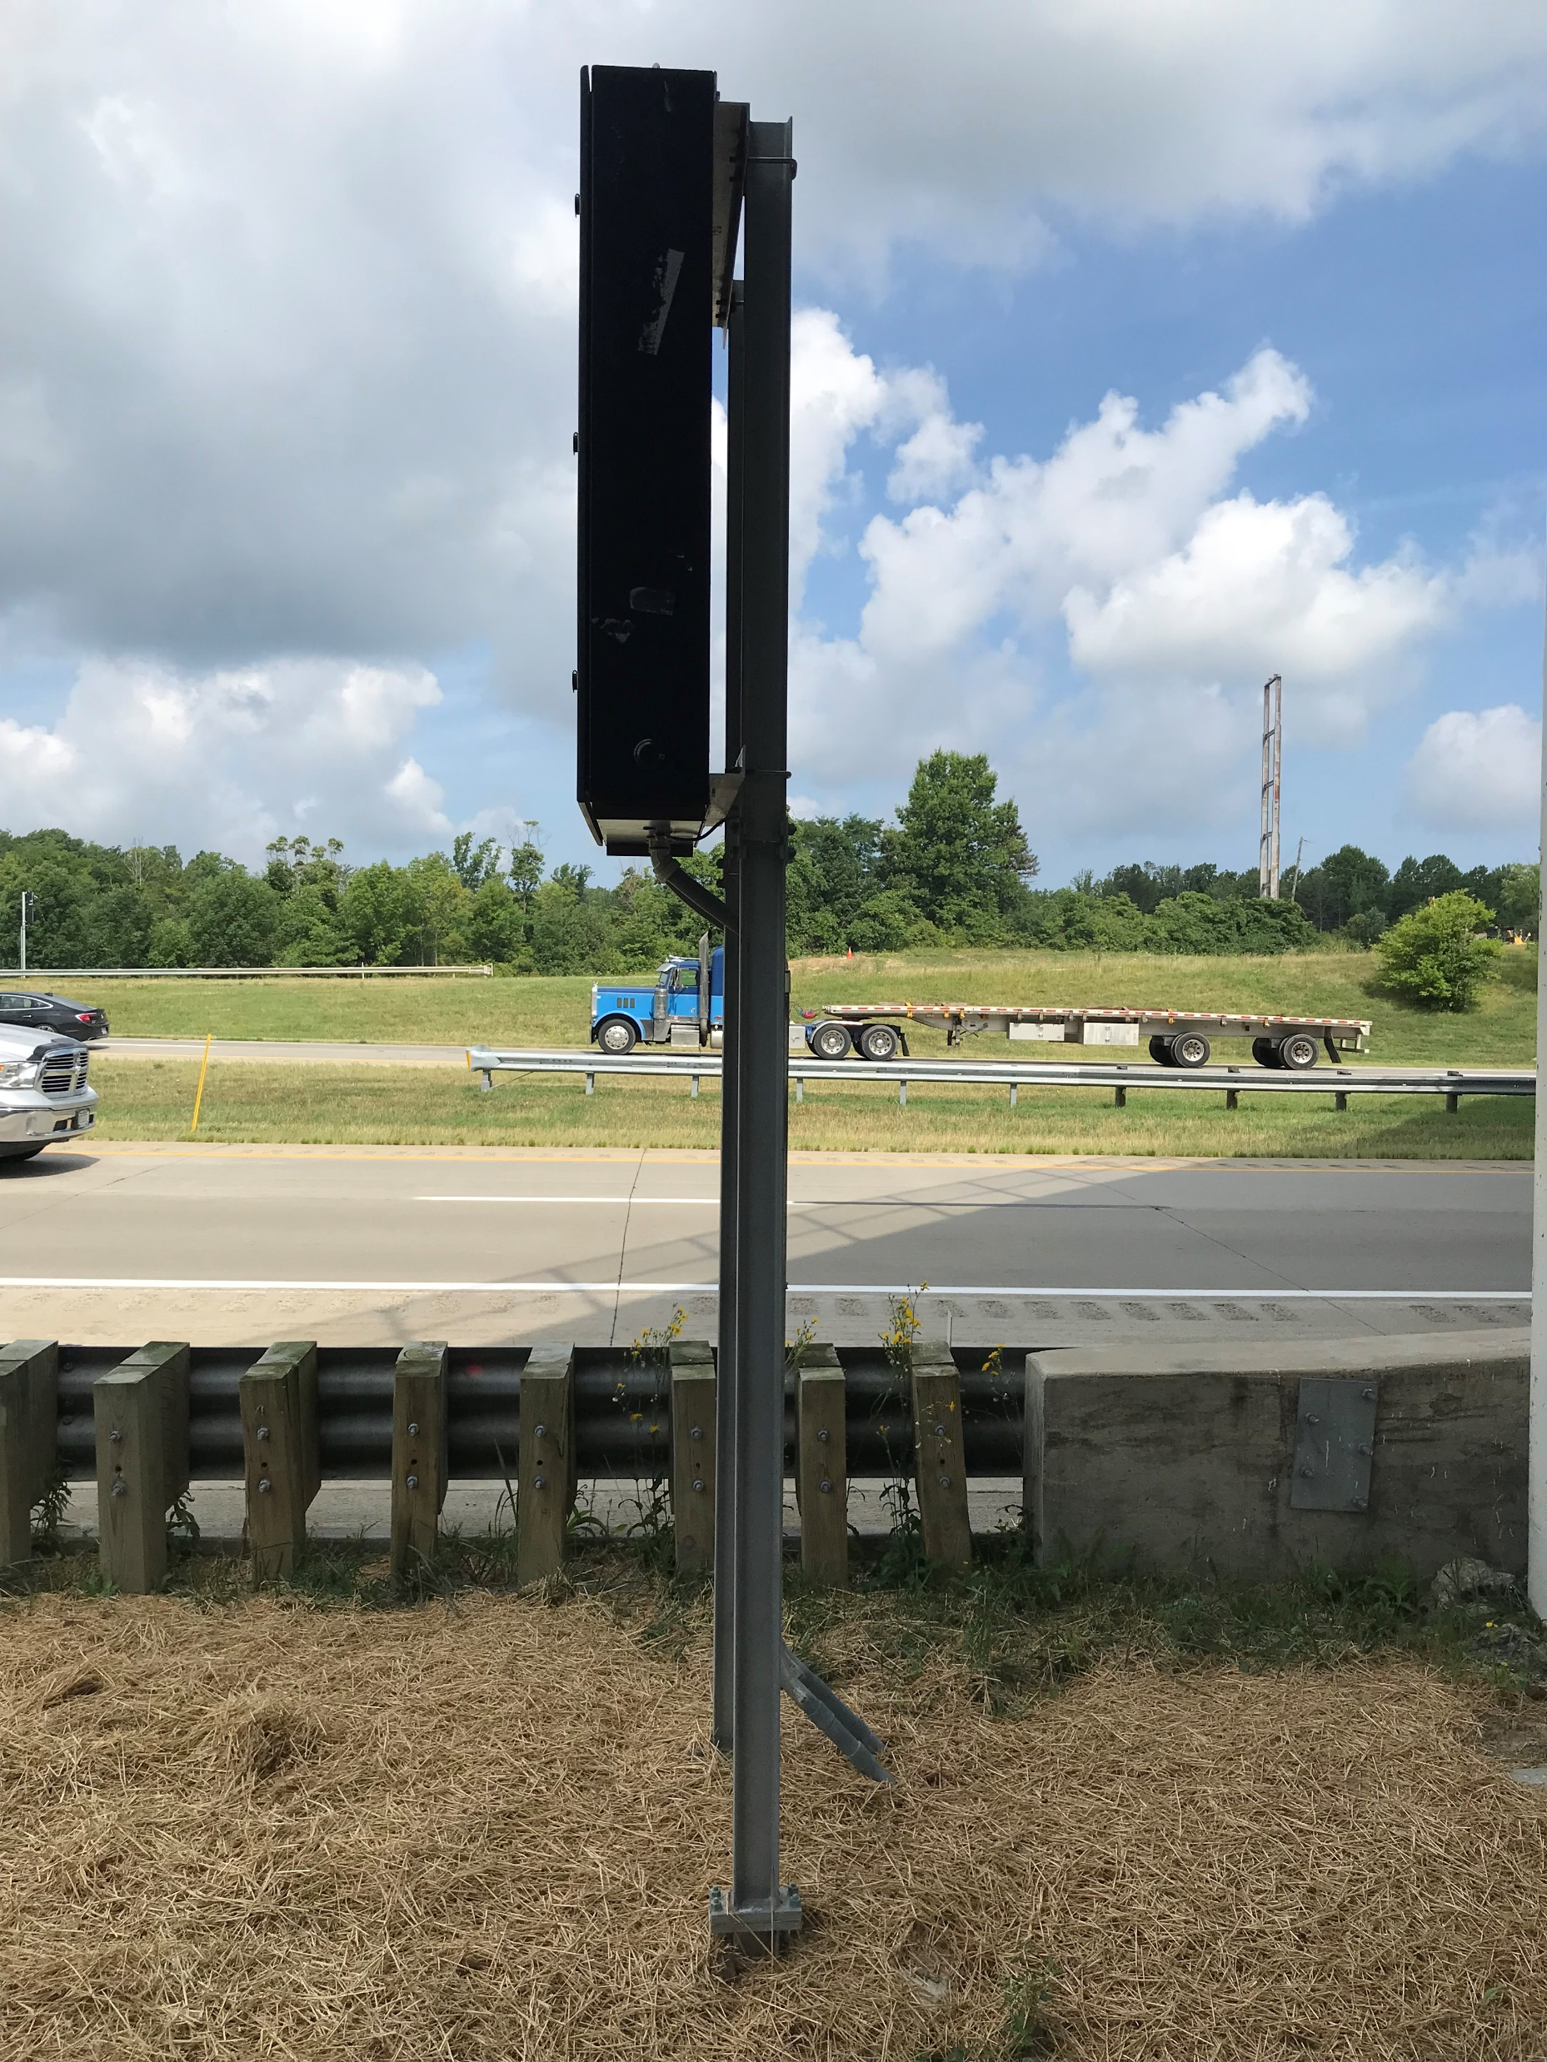
Ohio dot / vsl
m.h. corbin success story
Variable speed limit statewide contract bid
Only one competitor
Opens doors to larger or more variable message signs (vms)

Slide 8
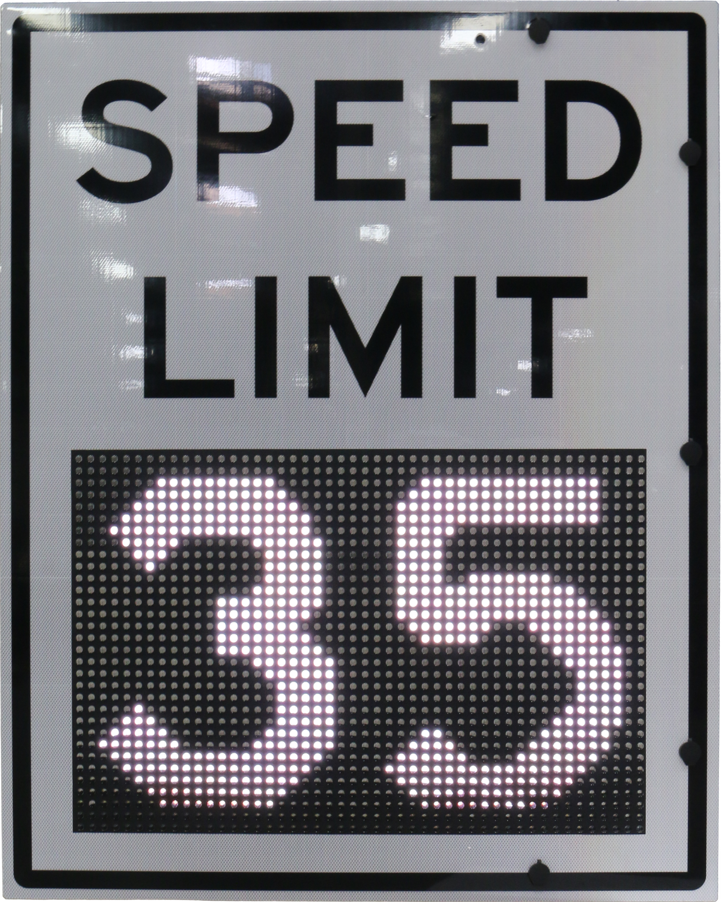
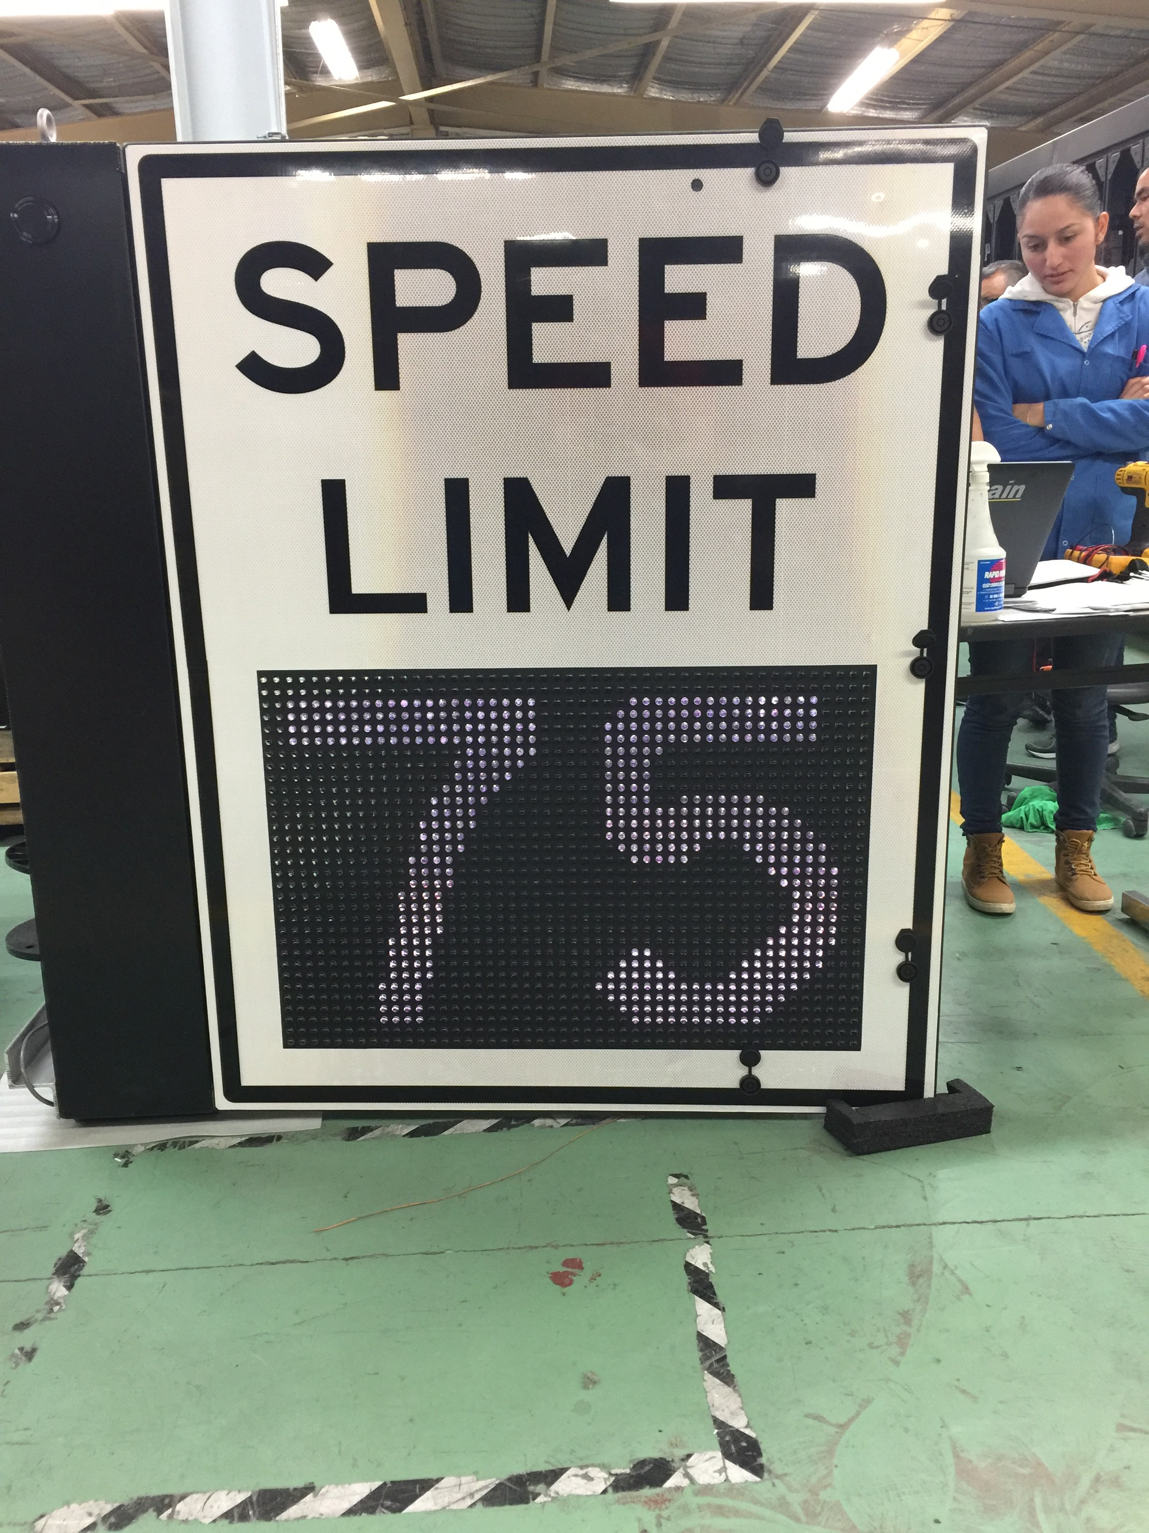

Pennsylvania DOT
m.h. corbin success story
I-76 VSL & Queue Warning System
Distributor aware of VSL from McCain
One competitor – “lower price”
Distributor relationship with contractor
opened doors at penndot

Slide 9

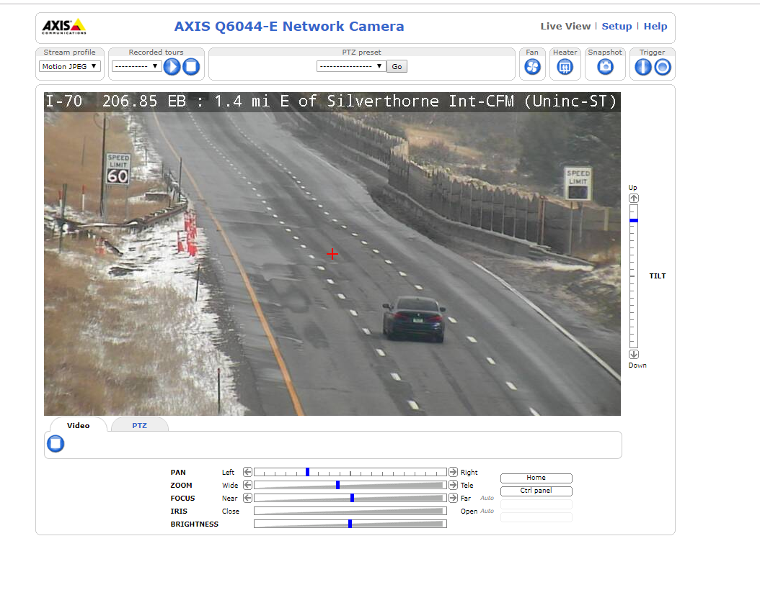

Colorado DOT / VSL
Traffic Signal Controls success story
Distributor facilitated meetings
Purchased demo test sign
New statewide spec for vsl
Opened doors for large walk-in vms
Working on new vms spec
City and County of Denver interested

Slide 10
Agency approvals key projects
Opening doors

Slide 11
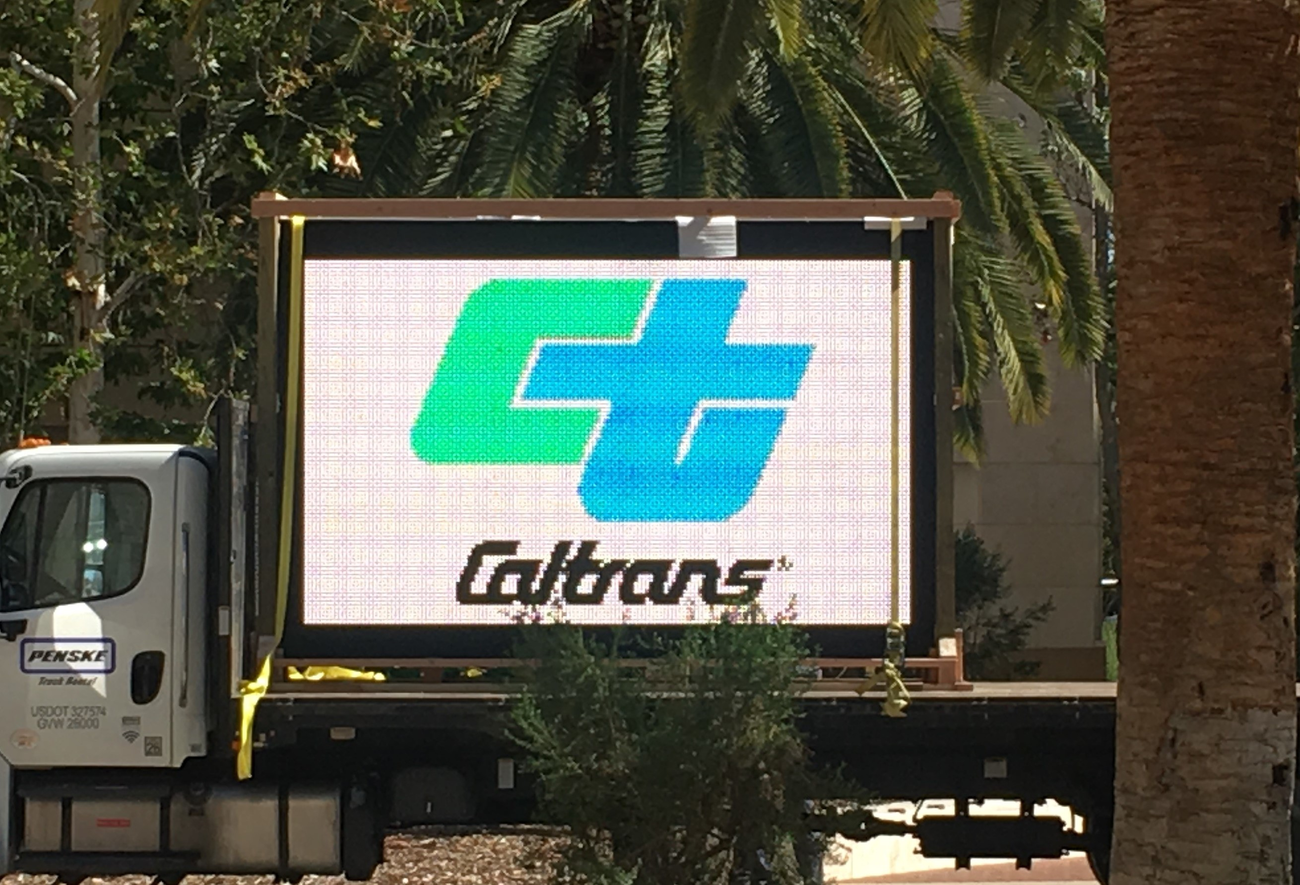
locations where our signs are installed or APL / qpl status
California
Colorado
Delaware
Georgia
Pennsylvania
New York
Ohio
Texas
New jersey

Slide 12
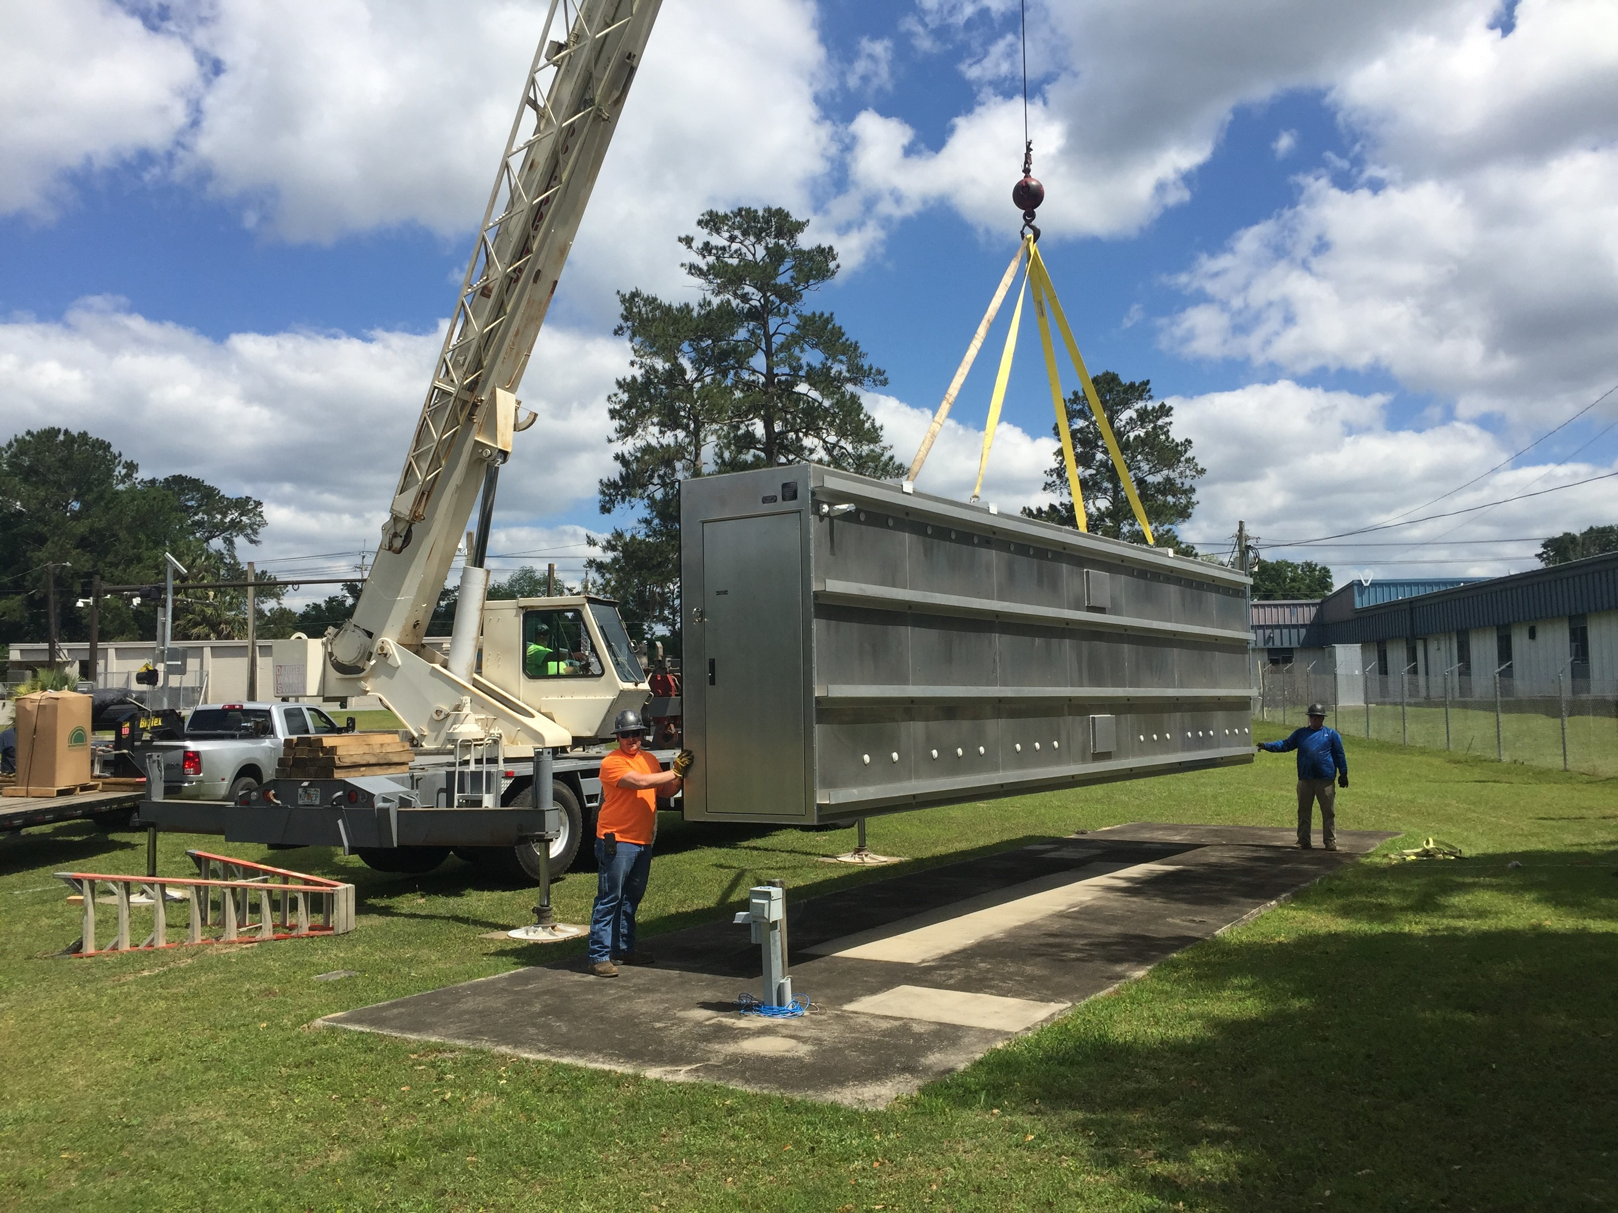
locations where we need ApL or QPL status
Florida
Arizona
Washington state
New Jersey (DMS)
Virginia
South Carolina
North Carolina

Slide 13
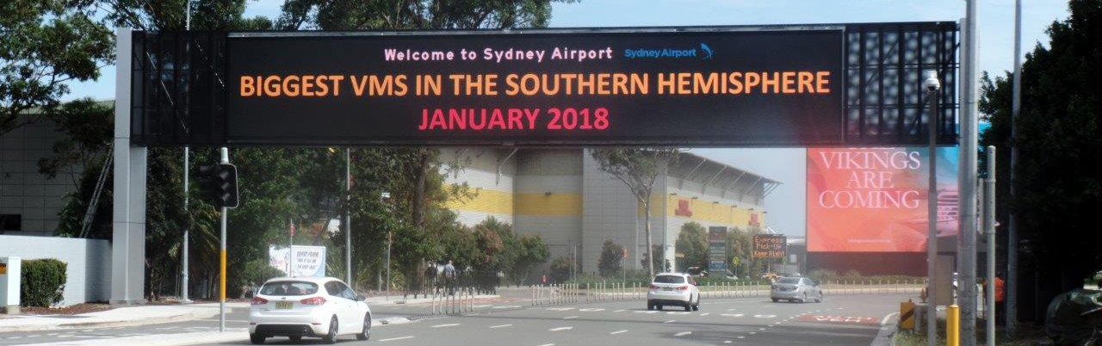
Projects and opportunities
Recognize opportunities early – future deployments
State Contracts
ATM Projects
ITS Corridor Projects
VSL projects
Partner for success

Slide 14
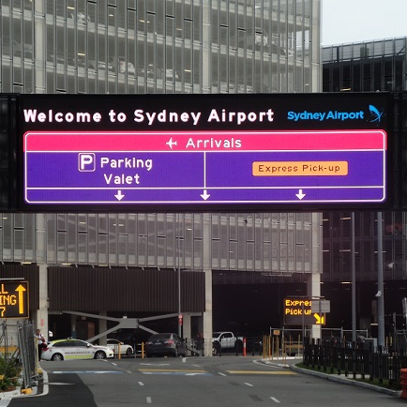
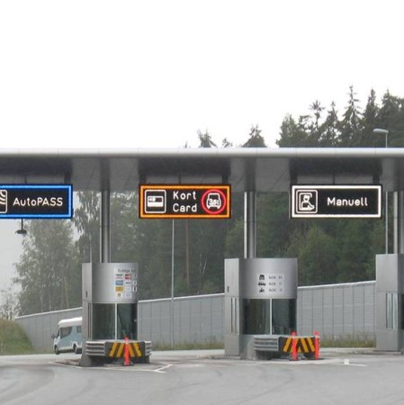
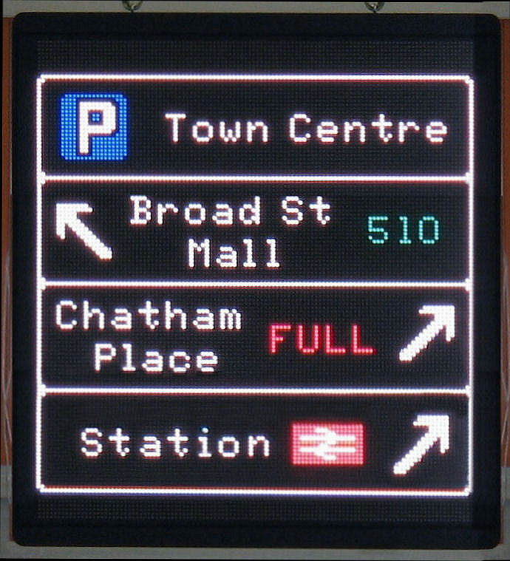
Other opportunities
airport
Toll roads
City wayfinding
We have provided signs for airports all over the globe
Our experience with toll road signage is vast
Several wayfinding or parking projects currently in progress

Slide 15
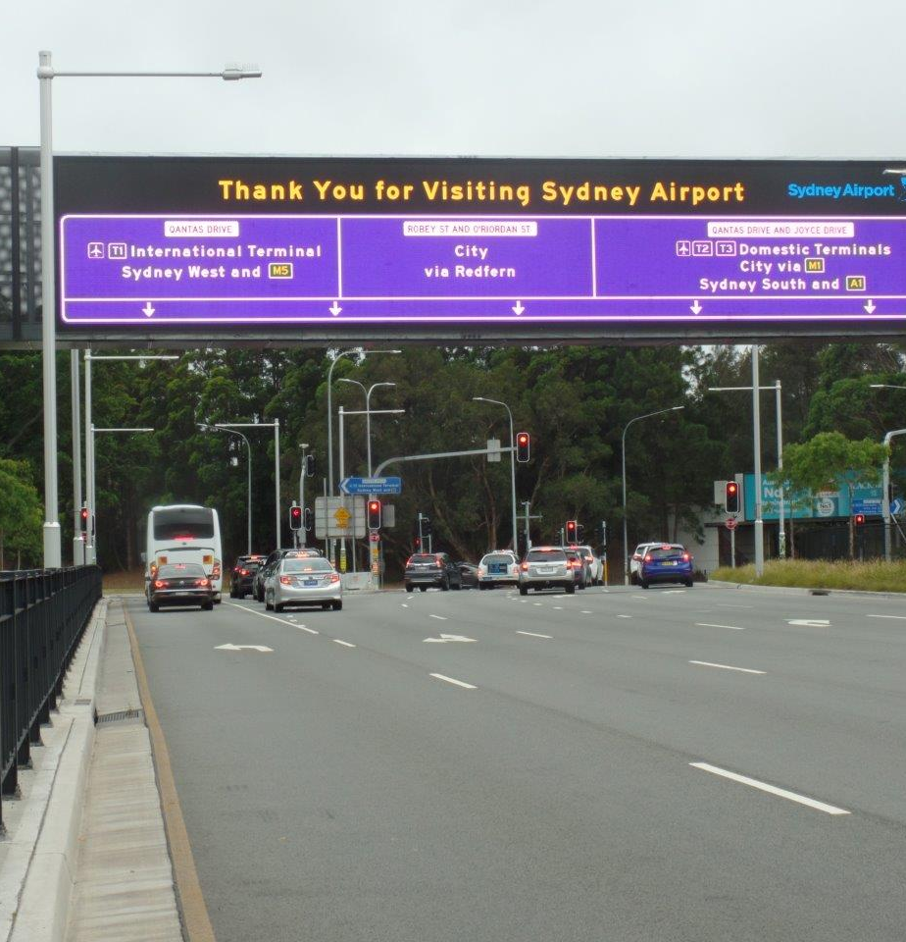
Questions? Thank you!
Randy Bobo
760.207.1220
rbobo@mccain-inc.com

