Slide 1
This VMS presentation has been created by McCain for use by McCain’s sales & distribution teams.
We invite you to co-brand this presentation, it’s as easy as 1-2-3!
Update the presenter’s name, title, and company on the first and last slide.
Add company logo to the first and last slide.
Remove this slide.
If you have any questions, please contact marketing@mccain-inc.com.

Slide 2

Variable Message Signs (VMS)
Powered by SWARCO Technology
Full Name
Job Title
Company
Presentation Date

Slide 3
Agenda
Introduction to SWARCO
Sign technology
Signs in the field
Key differentiators
Procurement tips

Slide 4
Company History
SWARCO to McCain

Slide 5


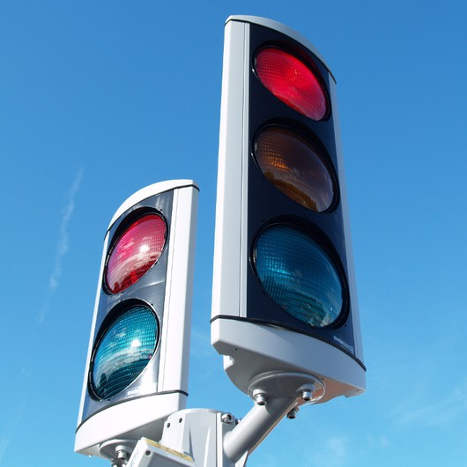
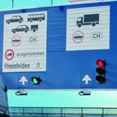
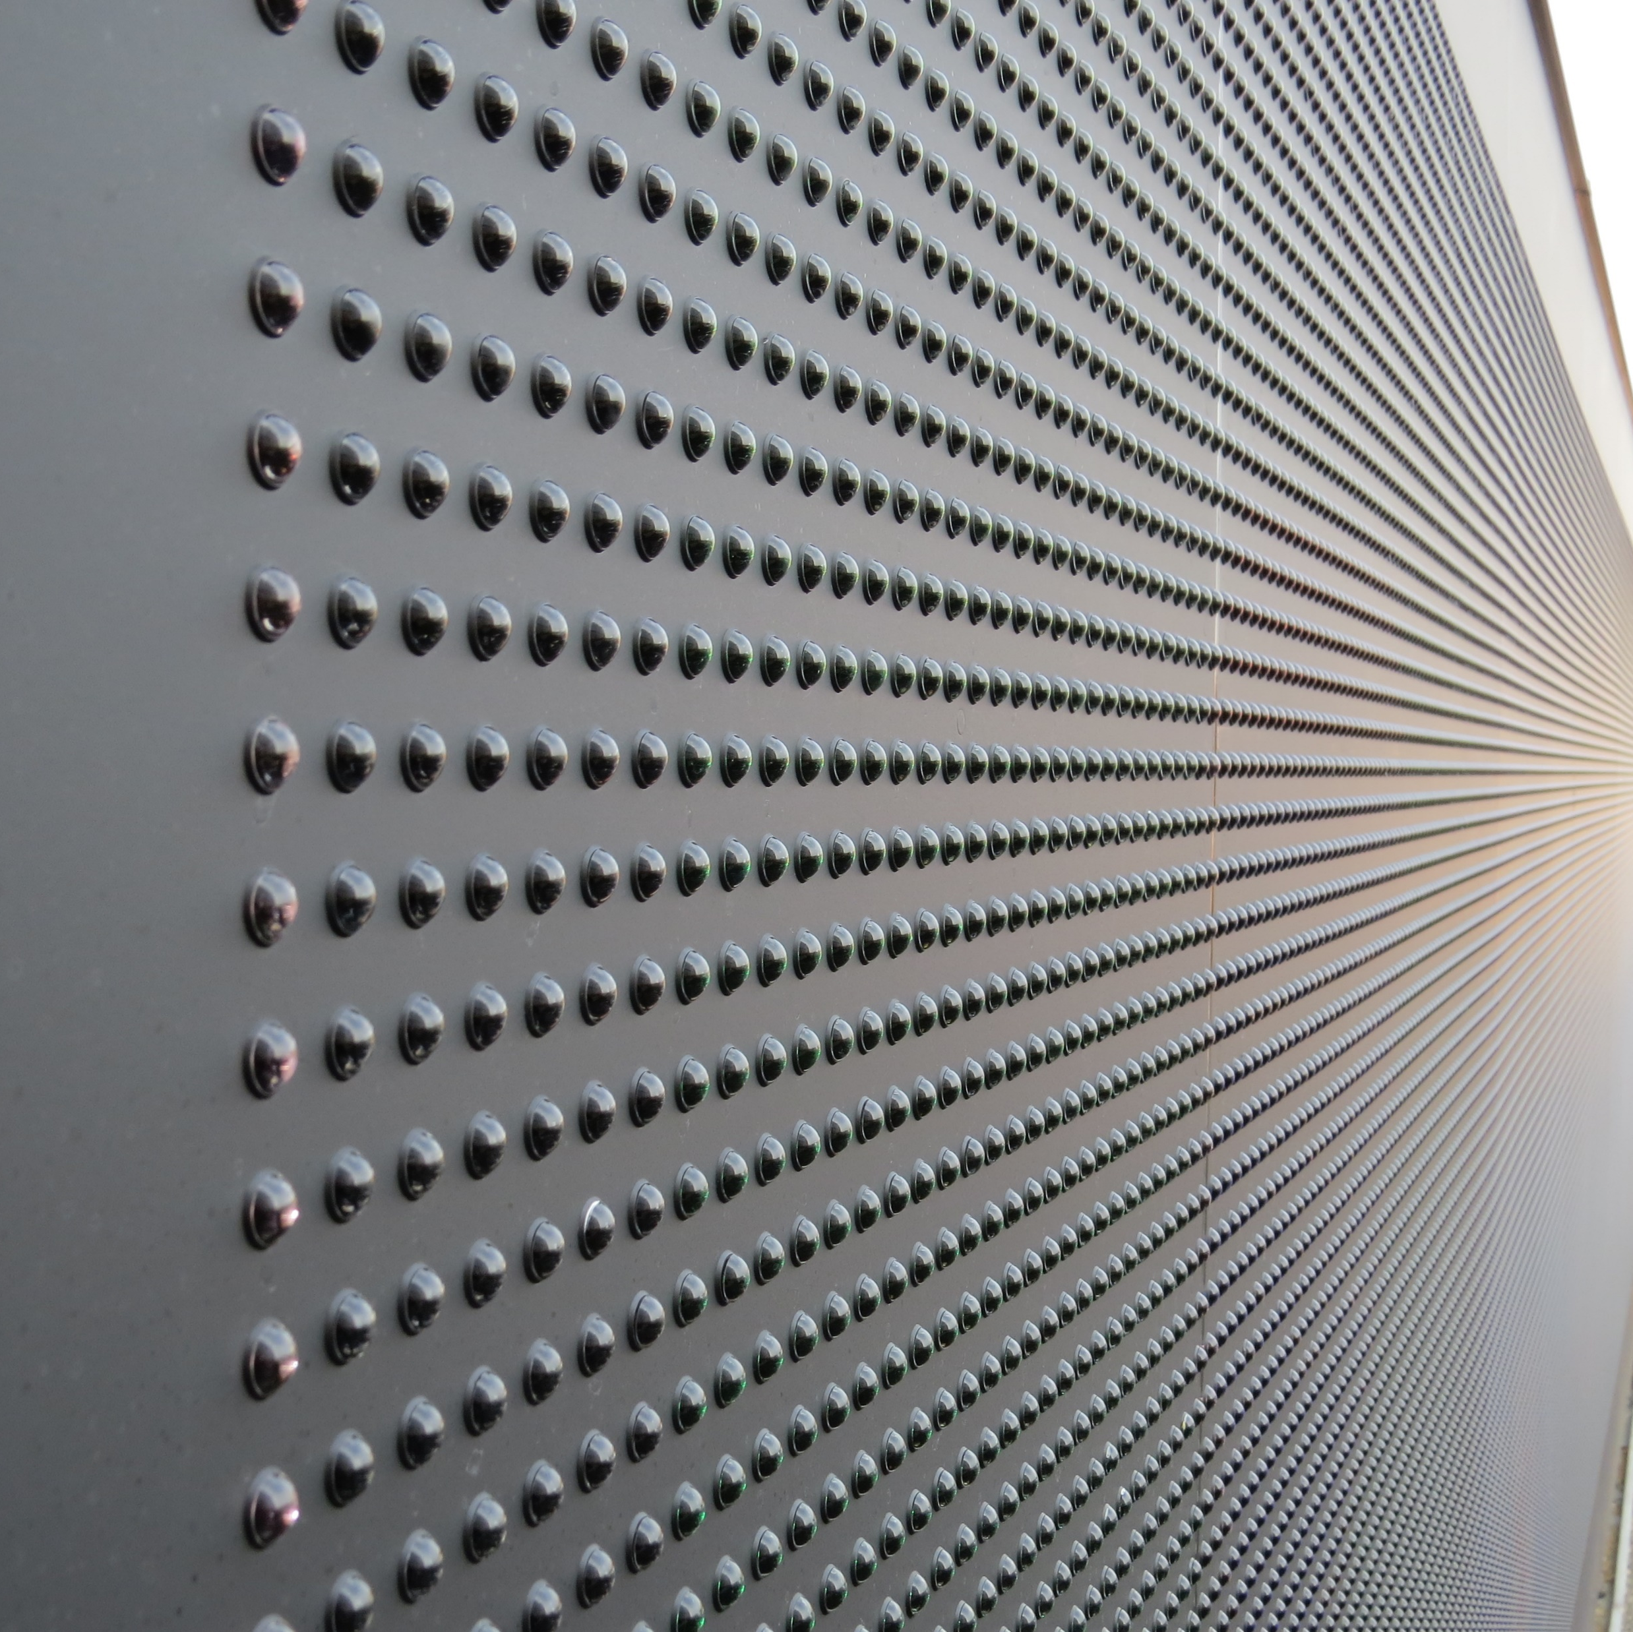

Brief History of SWARCO
SWARCO launched
US business operations
with 6 manufacturing facilities
SWARCO acquired
Dambach in
Germany
SWARCO acquired
McCain, Inc.
1969
1986
2014
1974
2008
2016
SWARCO founded
in Austria by
Manfred Swarovski
SWARCO acquired
FUTURIT/Austria
SWARCO began
Manufacturing LED
Variable Message Signs
Notes:
1969: SWARCO was founded in Austria by Manfred Swarovski
1974: SWARCO started US business operations (beads, tapes, thermoplastic)
6 manufacturing facilities in US
Columbia, TN – Glass Beads, Thermoplastic, Reflective Tapes
Mexia, TX – 2 Glass bead Plants
Denver, CO – Highway Striping Materials
1986: SWARCO acquired FUTURIT/Austria (Traffic Signals, RGB-LED VMS)
1997 First generation LED-DMS => conventional optical system
2003 Second generation => SMD boards with 2k-optic
2010 Third generation => 3in1 LED with 3G-”PrecisionOptic”
2008: SWARCO acquired DAMBACH in Germany (Rotary Drum Signs)
2014: SWARCO began manufacturing LED – VMS in Columbia, TN
2016: SWARCO acquired McCain Inc. – VMS in Vista, CA

Slide 6

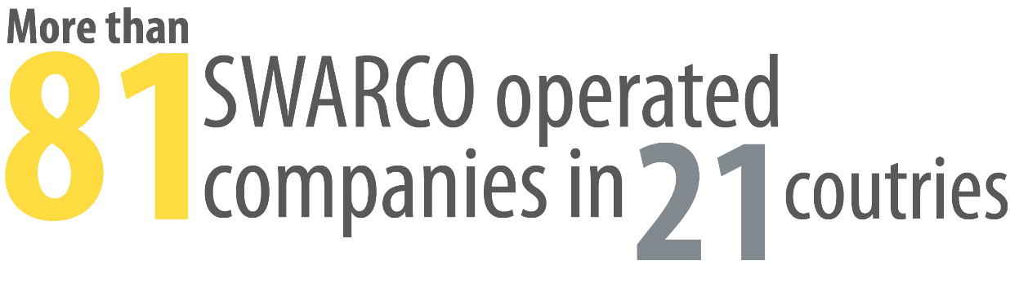


SWARCO by the Numbers
Notes:
SWARCO has operations of more than 81 companies in 21 countries
SWARCO is the number 1 producer of traffic signals in the world
SWARCO is the number 1 producer of glass beads in the world
SWARCO produces approximately 5,500 LED VMS per year, of 850 types
SWARCO has over 60,000 signs with over 150 million LEDs in the field
SWARCO has over 48 years of experience in the ITS industry
SWARCO has over 4,500 employees worldwide, closing at $780m in 2015
The McCain Inc. acquisition positions us as one of the largest ITS providers in the United States

Slide 7
SWARCO Sign Technology

Slide 8
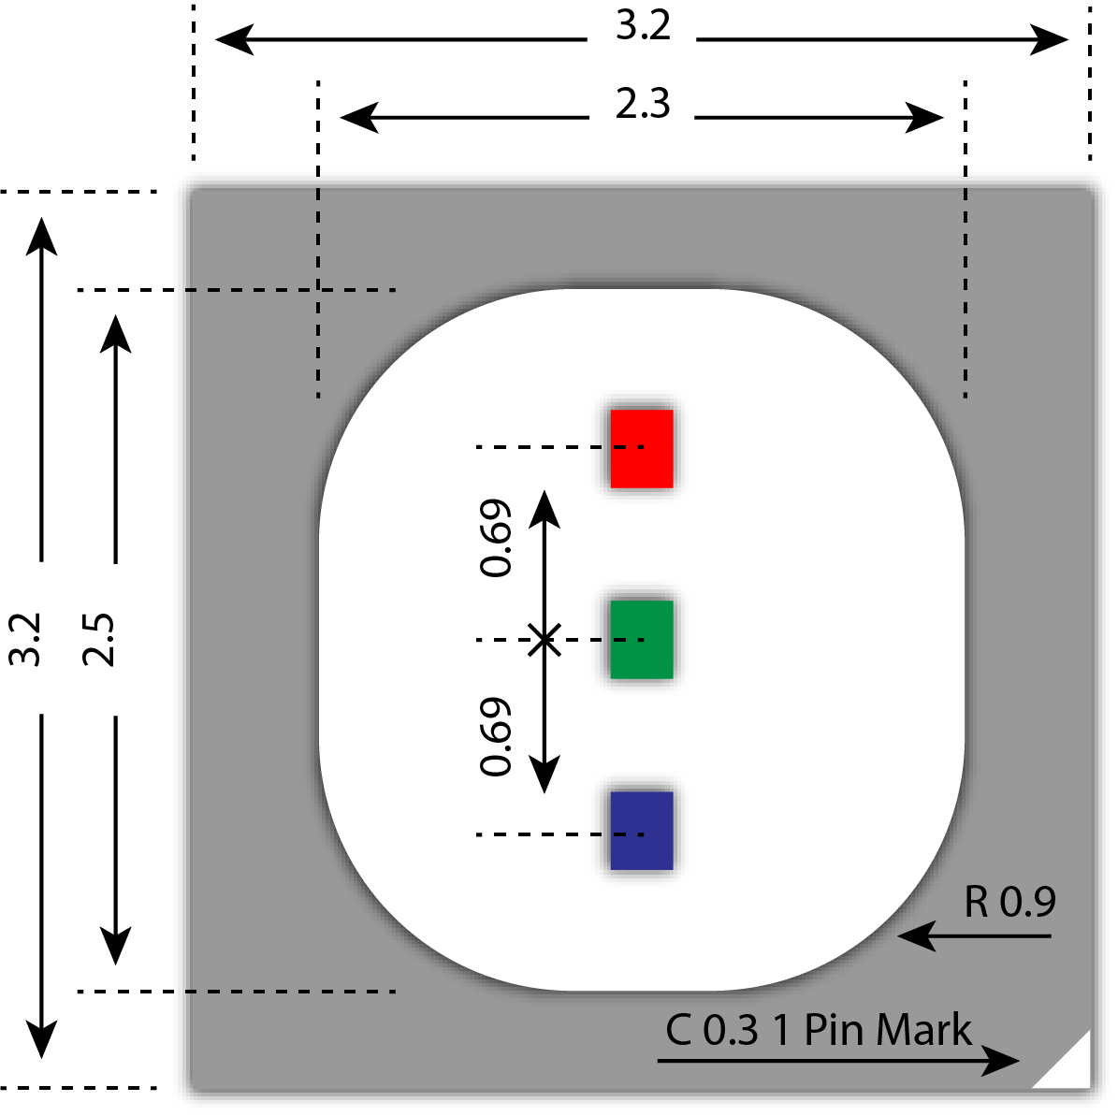

3-in-1 RGB LED
Allows smaller pixel pitch
Reduces junction temperature
Reduces parts to fail

Slide 9
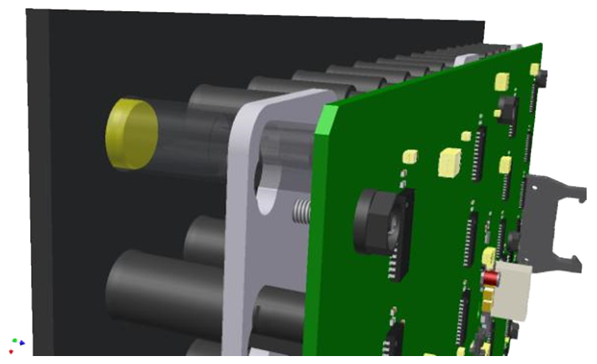

Precision Optic
Combines colors
Focuses the light
Redirects both incoming and outgoing light
Captures 100% of light energy emitted
Notes:
The Precision Optic combines the colors, focuses the light and redirects both incoming and outgoing light
By combining the 3-in-1 RGB SMD LEDs with the Precision Optic technology, our signs provide extremely sharp and vivid images, graphics and text

Slide 10





Precision Optic
Reduced Power
Consumption
Increased Light
Output
Eliminate Color
Wash and Fade
Reduced Maintenance
Costs
Increased Visibility
and Legibility
Notes:
Greatly reduced power consumption
No heaters or fans using power
Less power to drive the LEDs
By narrowing the angularity, the light is more focused and redirected toward the road therefore requiring less energy
No redundant power or LED drivers
By driving the LEDs at only 3-14% of their capacity, the MTBF is greater than 15 years, eliminating the need for redundant drivers
As a result of low drive current, degradation is minimal, even after 15 years
Greatly reduced Maintenance Costs
Minimal degradation of the LEDs combined with low operating stress on the power supplies, drivers and operating system means less failures which in turn, reduces maintenance and spare parts costs.
Greatly increased light output
Same amount of light being focused to a smaller area
Greatly increased visibility and legibility
Greater contrast as a result of focused light
Eliminated color wash and fade
Colors remain vivid and true even as the angularity changes

Slide 11
Contrast Ratio
McCain, Inc.
McCain/SWARCO VMS Technology
NEMA Requirements
26.5:1 Contrast Ratio
10:1 Contrast Ratio

Slide 12
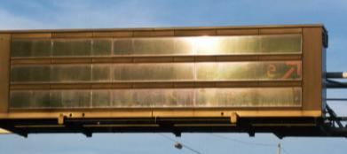
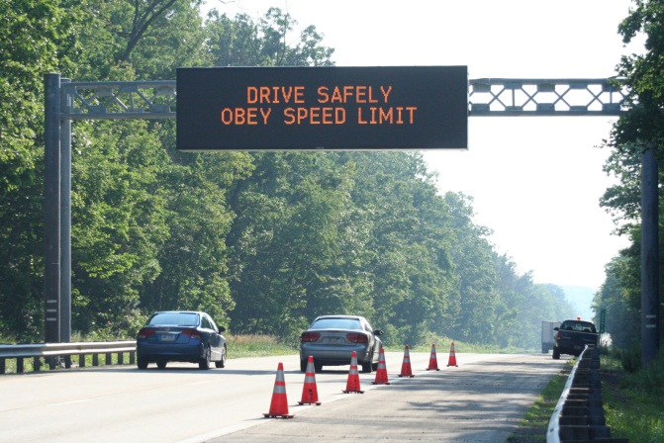
RGB-LED Variable Message Signs
No sunlight or headlight glare
No fogging or condensation
Notes:
No sunlight or headlight glare
With the lensing technology, the reflected light is nearly eliminated and high contrast is maintained, even at early and late sun angles
(Rush hours!)
No fogging or condensation to block light visibility
Because there is no front screen to fog, there is no need for heaters or fans, thus reducing energy consumption and parts maintenance

Slide 13
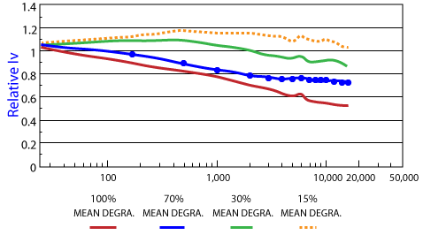
RGB-LED Variable Message Signs
LEDs are driven at 14% or less of maximum rated LED current
Power Supplies are driven at only 30 % of maximum rated wattage with all LEDs on full power
The Results: A longer lasting VMS that maintains constant brightness because of low LED heat/stress.

Slide 14
Power Consumption
Comparison data for standard signs

Slide 15
Front Access VMS For standard 5.25’ x 10.5’ sign
 | McCain VMS | Competitor “D”
Input Current Typical Max | 4.3 amps 32 amps* | 2 legs, 33 amps per leg unknown
Power Consumption Typical Max | 233 watts 517 watts | 1,531 watts 3,500 watts
Electricity Cost at $.06/KWH Annually 15 Years | $67 $804 | $938 $14,070
* includes a loaded 15 amp utility outlet

Slide 16
Walk-in VMS For standard 6.3’ x 25.5’ sign
 | McCain VMS | Competitor “D”
Input Current Typical Max | 4.3 amps 32 amps* | 2 legs, 33 amps per leg unknown
Power Consumption Typical Max | 641 watts 1,489 watts | 1,531 watts 3,500 watts
Electricity Cost at $.06/KWH Annually 15 Years | $192 $2,280 | $2,688 $40,320
* includes a loaded 15 amp utility outlet

Slide 17

Environmental Benefits
50%
Reduction in energy consumption
Saving over 25.5 tons of CO₂ emissions
That’s the equivalent of a car traveling over 10,000 miles

Slide 18
Signs in the Field

Slide 19
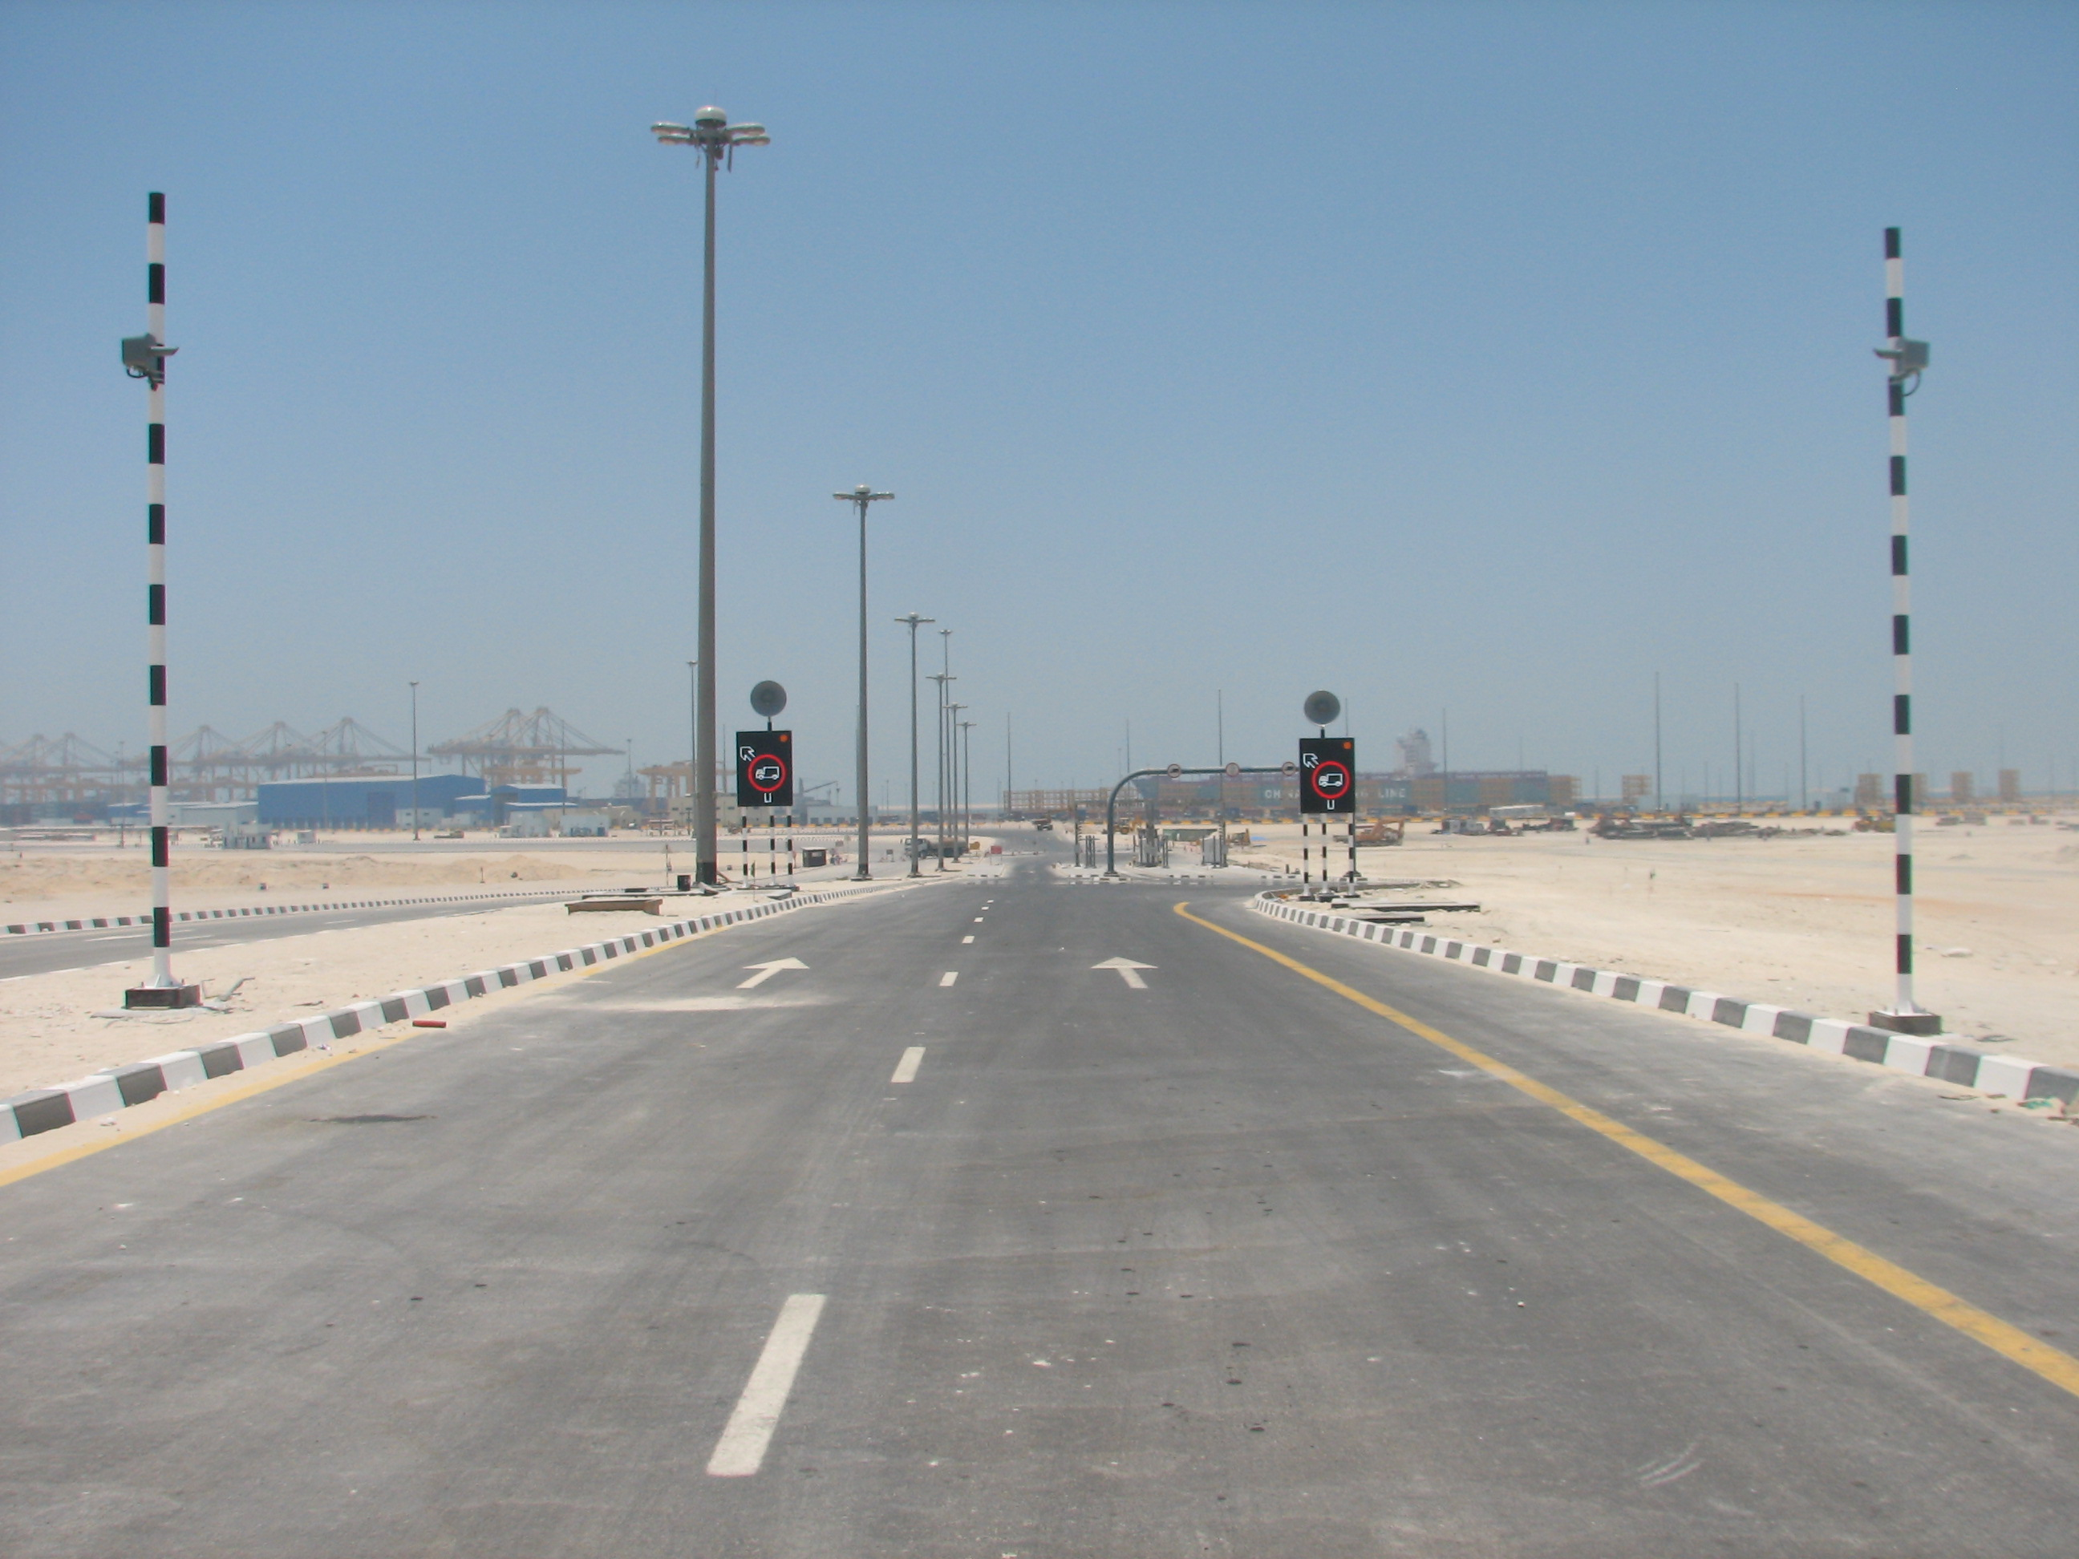
DUBAI
Notes:
SWARCO is currently producing over 5,000 signs per year. We produce roughly 750 new designs per year, that is roughly 3 new designs per day. We have signs all over the world performing in some of the toughest climates the world has to offer. The high heat and humidity of Brazil, the extreme heat of the deserts in the middle-east and the extreme cold of Sweden. The photo of the sign in Sweden was taken at -30° Celsius. None of these signs have heaters and only the sign in Brazil has a ventilation fan. Not to keep the sign cool, but to keep air moving to prevent condensation on the circuit boards.

Slide 20
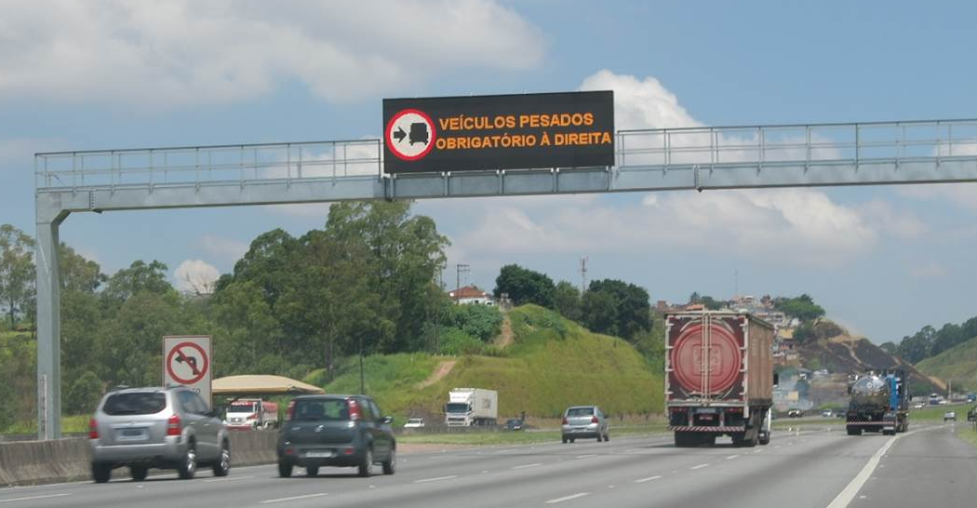
BRAZIL

Slide 21
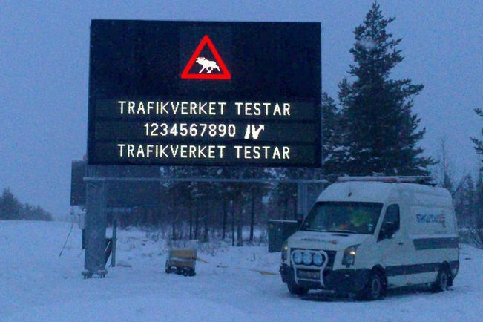
SWEDEN

Slide 22
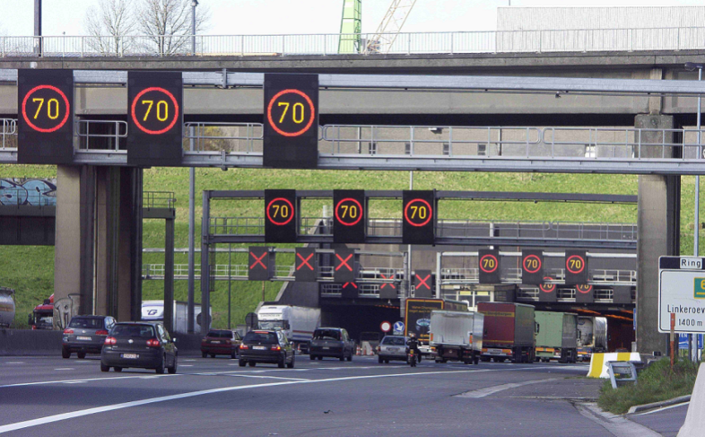
BELGIUM
Notes:
These are some examples of some signs from around the world. The signs in Belgium were delivered in 2003. In 2013, they were making some changes and removed and sent one of the speed limit signs back to the factory to have the light output measured. The signs had only 2% degradation versus the measurement taken at the factory acceptance test 10 years earlier. The tunnel sign in Sweden shows a full matrix sign. This sign, when completely lit as shown, uses only 70 watts of power. (Click Slide) The green sign on the left, is a drum sign. The Swedish authority was worried about putting LED signs in the tunnel do to frequent power outages. During a power outage, a drum sign would stay visible, even without the lights. Once they realized that our sign would only need 70 watts, they got UPS systems that would easily cover them and replace all of the drum signs. The drum signs, by the way, used 200 watts to light them up.

Slide 23
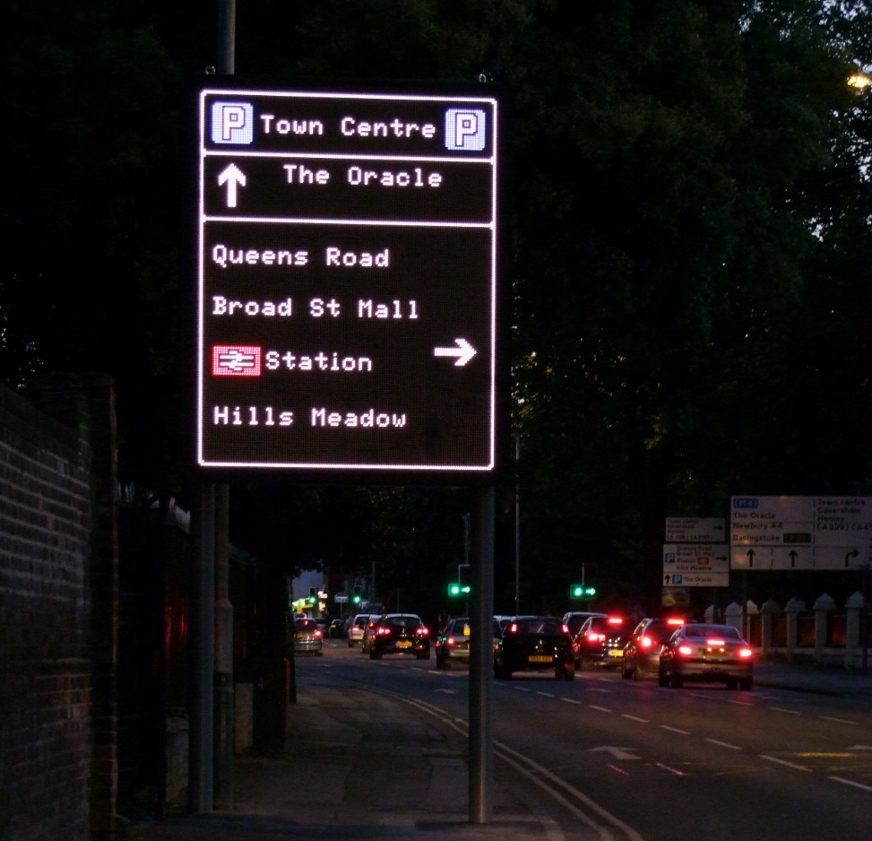
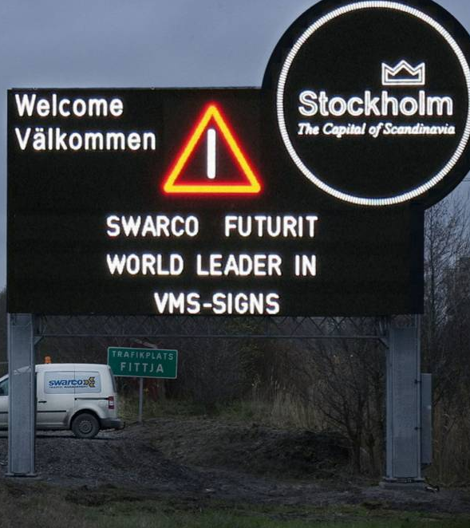
UNITED KINGDOM
SWEDEN

Slide 24
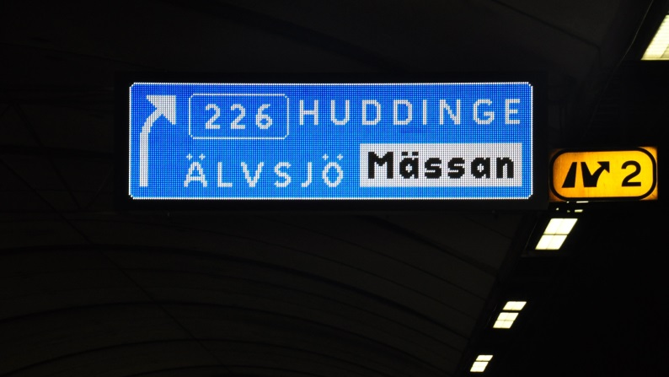
SWEDEN

Slide 25
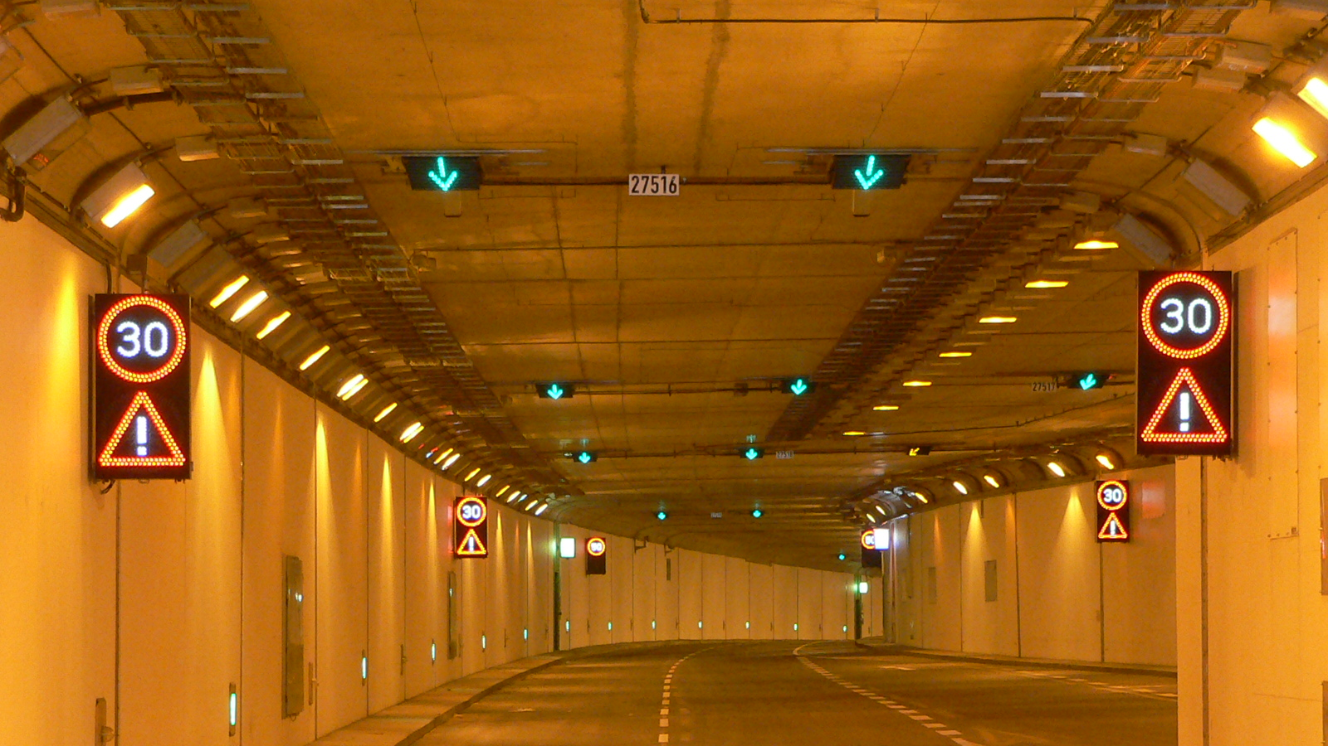
GERMANY

Slide 26
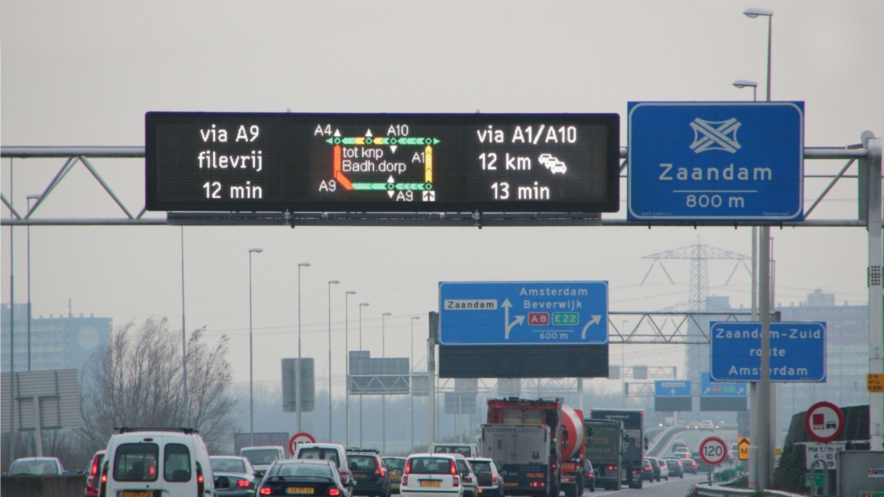
NETHERLANDS
Notes:
This sign, in the Netherlands gives very clear travel times as well as route guidance.

Slide 27
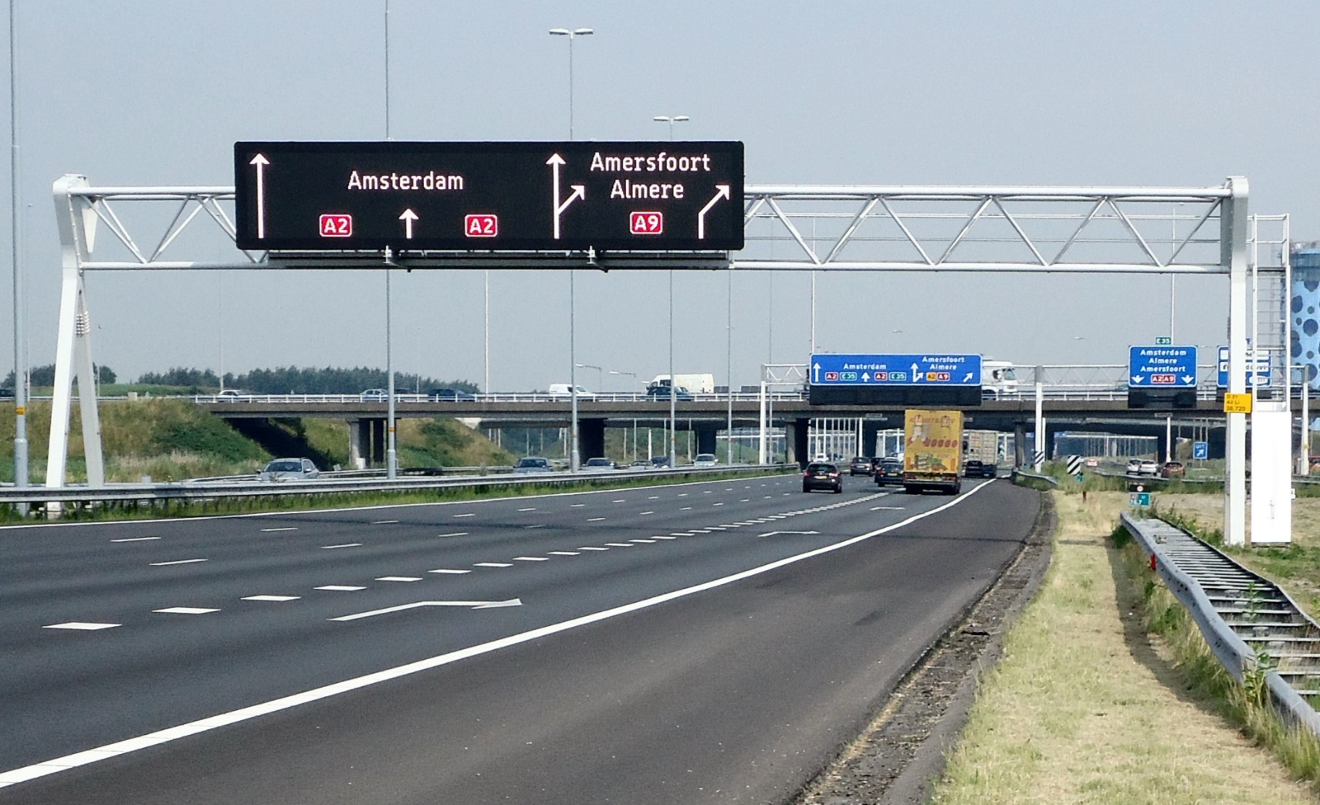
NETHERLANDS
Notes:
This sign is also in the Netherlands. An email was sent out by the Transportation Ministry to many recipients throughout Europe that are involved in the DMS industry. The email included this photo of a SWARCO sign, and simply the words “This is a real photograph of a DMS. No photo-shopping involved.” The contrast really shows off the nice lines of the arrows and text, great uniformity, best contrast and wide viewing angle.

Slide 28
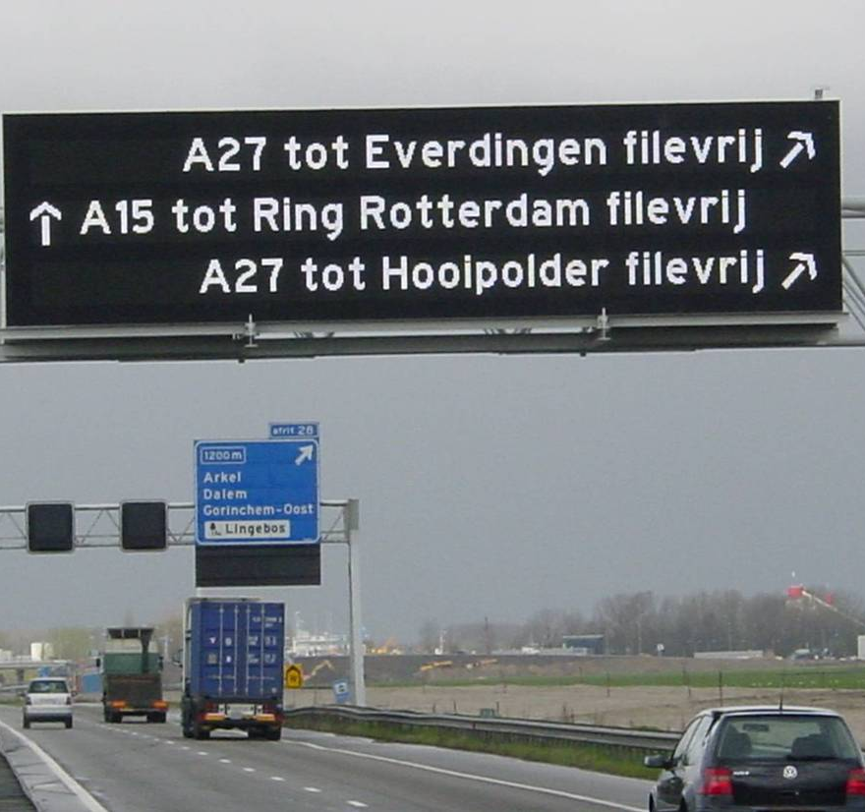
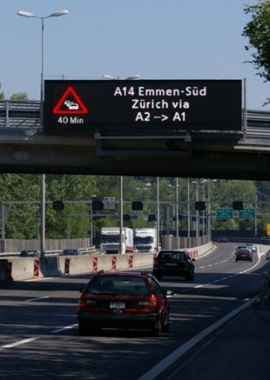
NETHERLANDS
SWITZERLAND
Notes:
Note the clarity and contrast of the sign in the Netherlands. There is no pixilation, just clean smooth lines of text.

Slide 29

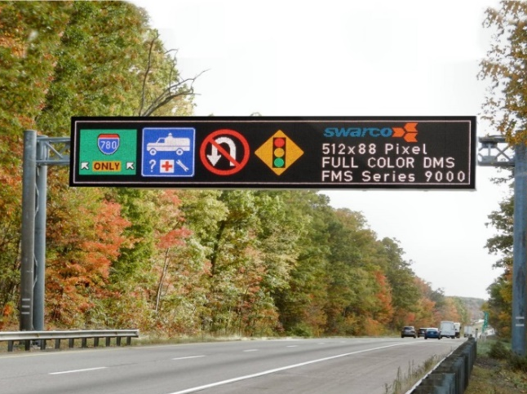
Notes:
The main photo is of a sign in PA on I-80 near I-81. The sign on the bottom left is not exactly as it appears. It is an actual photo of a sign getting ready to be sent out of the factory that was photo-shopped onto the gantry in PA. The sign itself was not re-touched, but shows some typical US graphics. It is important to note the clarity and contrast of these graphics as well as the text.

Slide 30
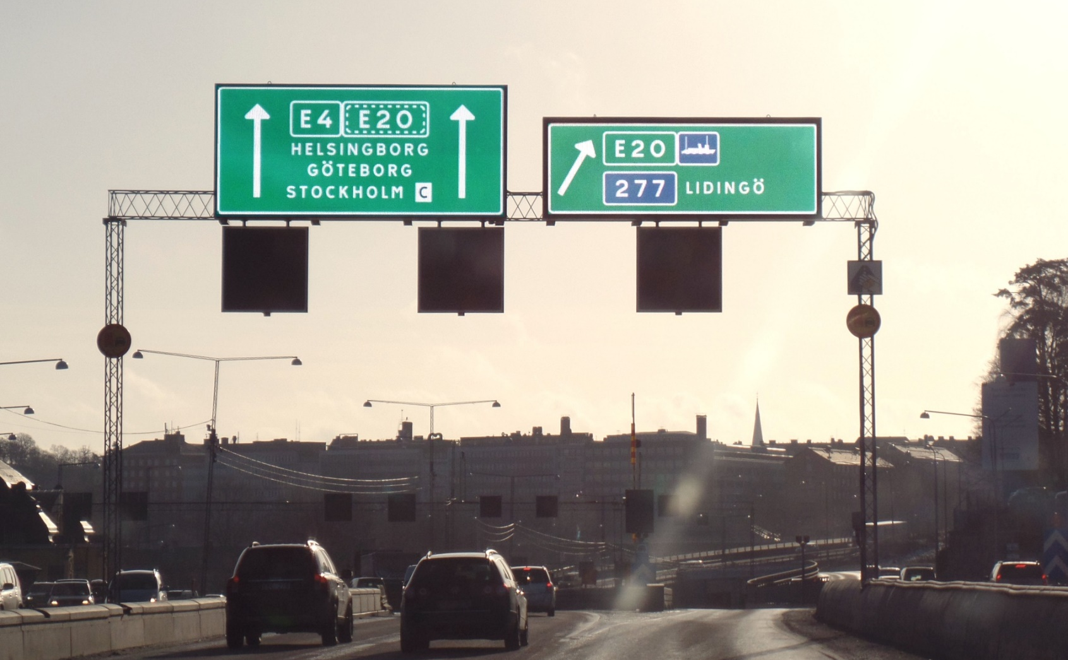
304 x 136 pixel @ 16 mm
Dimension: 16.4 ft x 7.5 ft
Display area: 114 ft²
124,032 LEDs
Typ. Power: 220 W
Cost od Operation: 190.-$ p.a
@ 10 ct / kWh
288 x 96 pixel @ 16 mm
Dimension: 15.1 ft x 4.9 ft
Displayarea: 76 ft²
82.944 LEDs
Typ. Power: 150 W
Cost od Operation: 130.-$ p.a
@ 10 ct / kWh
STOCKHOLM
Notes:
The picture show two pilot installations in Stockholm, the left one with RGB 16mm, the right one using RGB 12mm precision optic.

Slide 31
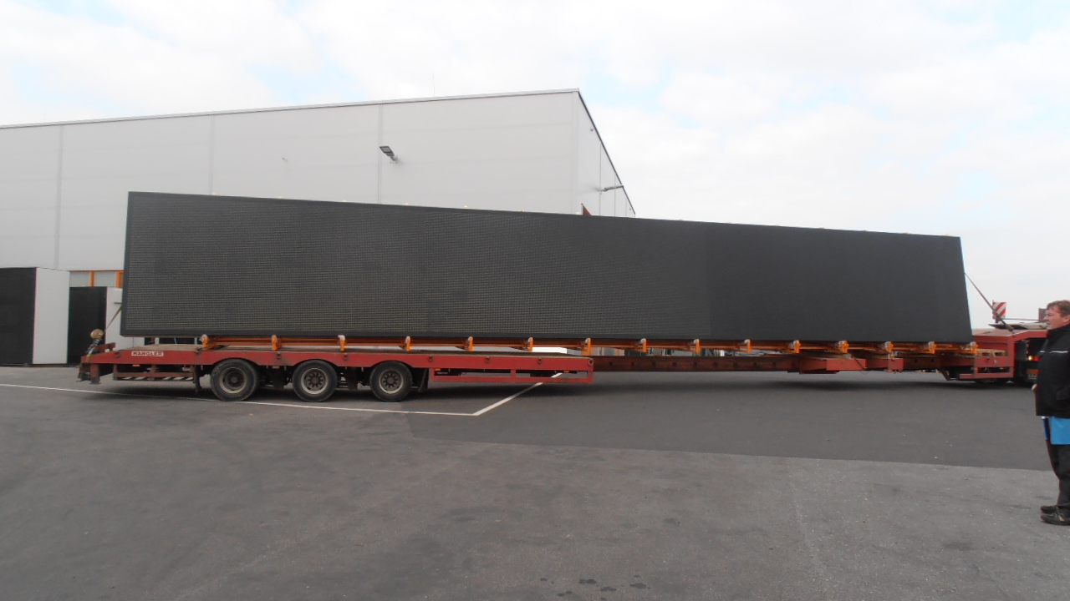
GERMANY
Notes:
2013-This sign, being sent to Germany was over 50 feet in length and 8 feet high.

Slide 32
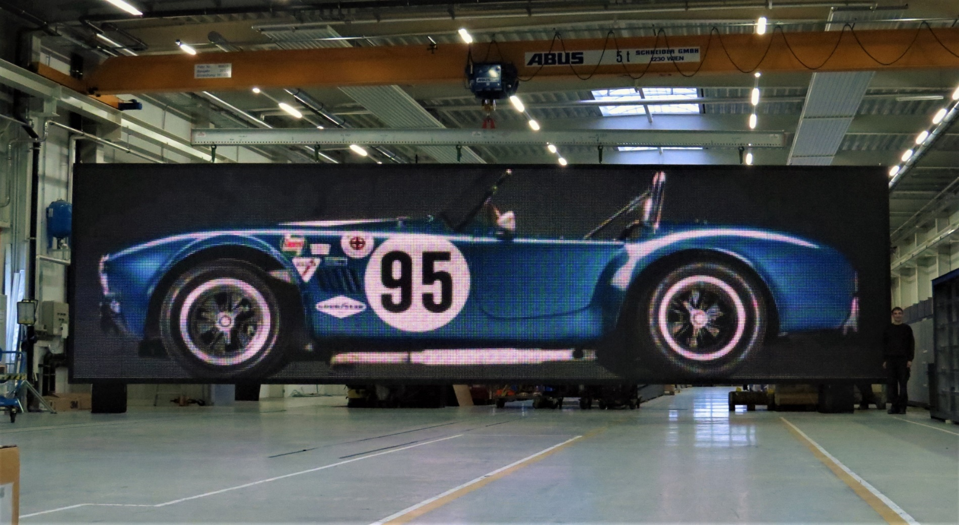
544 x 144 pixel @ 25 mm
Dimension: 44.6 ft x 11.8 ft
Displayarea: 527 ft²
235,008 LEDs
Typ. Power: 1,000 W
Cost od Operation: 740.-$ p.a
@ 10 ct / kWh

Slide 33
Key Differentiators

Slide 34
Low Power Draw
Lowest in the industry for all components & sign

Slide 35

Legibility
Proprietary Precision Optic technology focuses light for unrivaled legibility

Slide 36
Lighting Technology
3-in-1 RGB LED offers:
Reduced temperature
Longer life
Smaller pixel pitch
Clearer graphics

Slide 37

Reliability
Longest mean time between failure in industry
Very little maintenance required

Slide 38
Food for Thought
Items to consider when buying a VMS

Slide 39
Are you getting the best technology available?
Will the technology meet your future demands?
Technology

Slide 40

What are you basing your VMS specification requirements on?
Specifications
Notes:
Expected and required performance levels
OR
Are they based on older technical hardware requirements that reflect specific vendors?

Slide 41


Cost of Ownership
Total Power
Draw
Routine Maintenance
Installation Costs
Size & Strength
Notes:
-Total Power Draw: Total power draw for each sign on your network (power metering required)
-Routine Maintenance: filter replacement, board failure, diagnostics
-Installation Cost: size or gauge of copper required to supply load calculations
-Size/Strength: based on dead load and wind load

Slide 42


Cost of Ownership
Be sure to compare apples to apples
Light intensity
Power consumption
Display square footage
Pixel pitch
Notes:
-Total Power Draw: Total power draw for each sign on your network (power metering required)
-Routine Maintenance: filter replacement, board failure, diagnostics
-Installation Cost: size or gauge of copper required to supply load calculations
-Size/Strength: based on dead load and wind load

Slide 43

QUESTIONS?
Full Name
Title
Company
Phone Number
email
website

