Slide 1



Transparity
Traffic Management Software
Distributor Technical Training
Brian Wagner
Central Systems Product Manager

Slide 2
Agenda
Eliciting Customer Needs
OVERVIEW of NEWLY Released Features
TRANSPARITY Technical TRAINING
  User Experience
  Monitoring
  Control
  Analyze
  Distribute
Questions & Answers

Slide 3
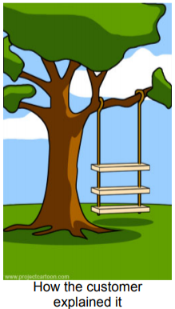
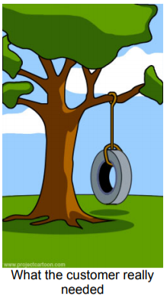
Evaluating VS. Eliciting customer Needs
Ask Facilitative Questions
NOT Open Ended Questions
An open question would be: “Why do you wear your hair like that?” The question is gathering data about a decision the questionee has already made and understands.
A Facilitative Question would be: “How would you know if it were time to reconsider your hairstyle?” The question leads the quesionee through past haircuts, current lifestyle choices, time, obligations, current hairdressers/stylists, and any biases the questionee might have about his/her appearance.
Notes:
McCain’s channel partners provide the relationships and localized intelligence McCain needs to sell and successfully deploy complex Traffic Management Systems. The key step to solidifying Transparity TMS as the right solution for your customers starts with careful Elicitation of customer needs.
In order to make you more comfortable with this process, I’m going to provide a technical training on KEY functionality and features of Transparity TMS, FROM THE USER’S PERSPECTIVE.
This approach is intended to help you understand WHY we’ve included the features in Transparity, so that you can help guide customers through the explanation of their “day-to-day” while revealing needs that our solution can address.

Slide 4


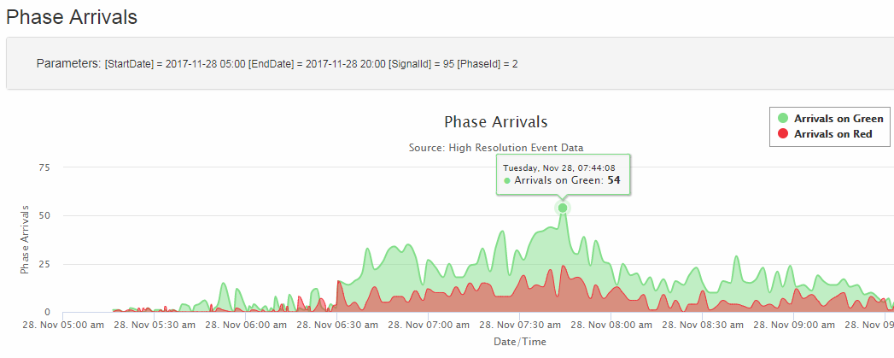
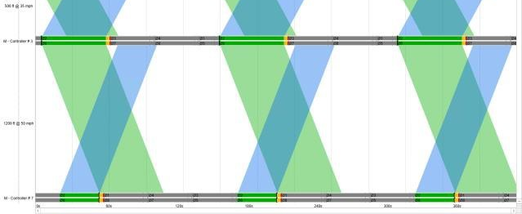
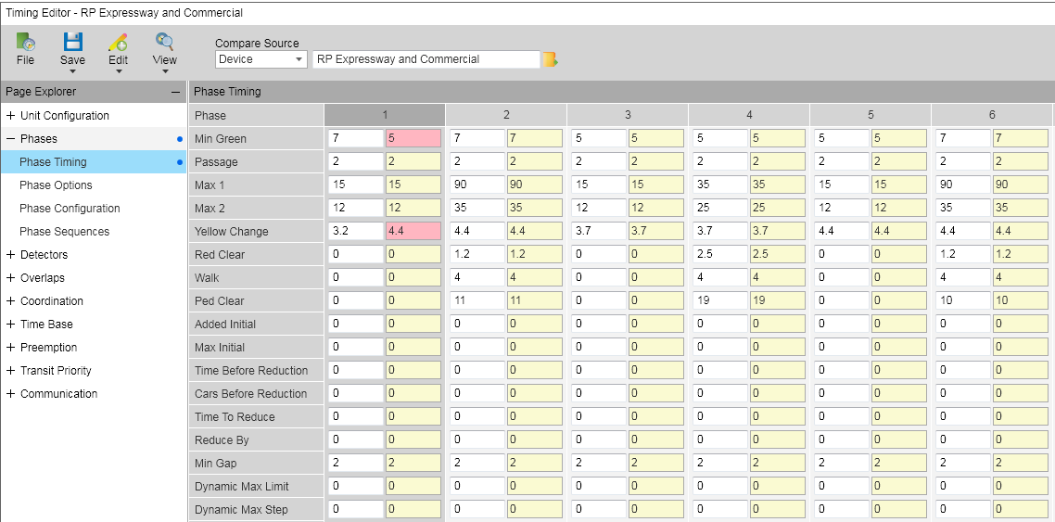
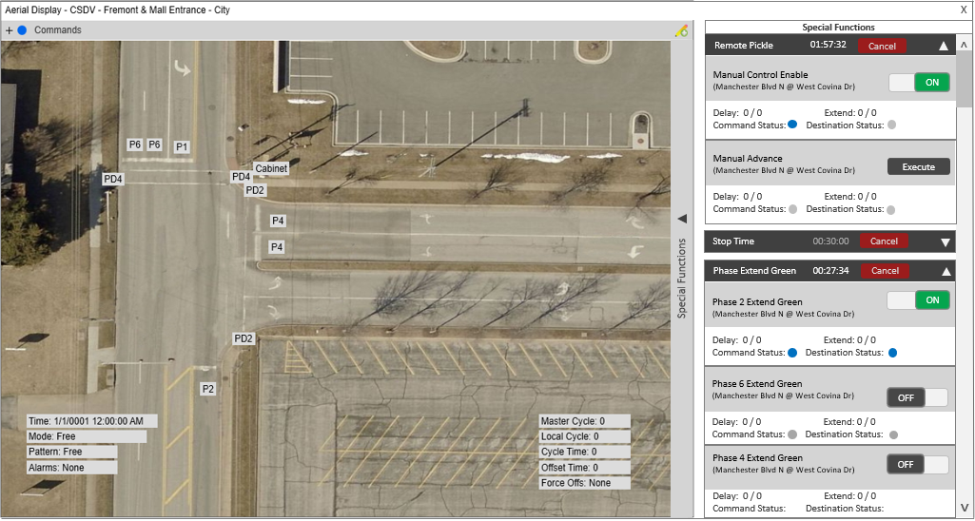
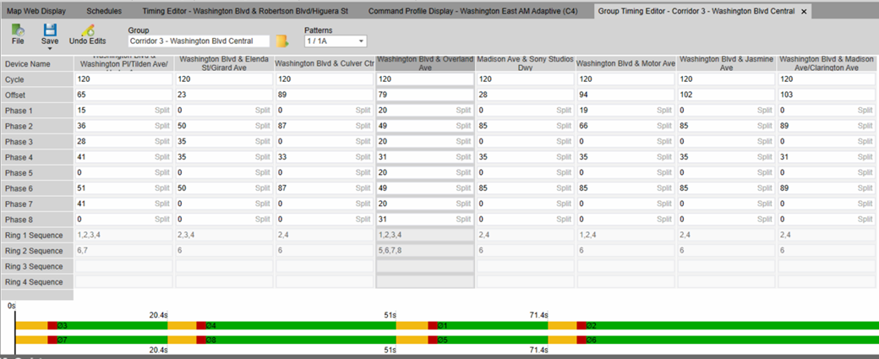
NEW RELEASE features
Travel-Time Data INTEGRATION
Signal Performance measures
Seamlessly weave external data into Real-Time Operations
Time-Space Diagram Improvements
Included in the latest Maintenance Release
VIEW Programmed, Real-time, or Historical Arterial Bandwidth
Group Timing Editor
User change tracking
Special Functions Interface
MULTI-CONTROLLER PARAMETER CHANGES & Coordination View
Review historical records of timing changes AND Archives BY Each UseR.
Remotely Override signal operations with user defined controls.

Slide 5





Monitor
Real-time Status & Notifications
Transparity
Traffic Management System
Control
Transparity® Traffic Management System (TMS) enables transportation professionals to proactively manage traffic flow and promote mobility through real-time traffic data collection and management tools.
Signal Timing Parameter management, Active Transportation Management, Adaptive Signal Control.
Analyze
Controller Logs, Time-Space Diagram, Signal Performance Measures
Distribute
Regional Systems, Connected Vehicle Technology, & System-to-System Integration
Notes:
We’ve discussed the primary roles of a TMS in past training sessions. Each of the features and functions of the TMS fit into the user experience while utilizing the system

Slide 6

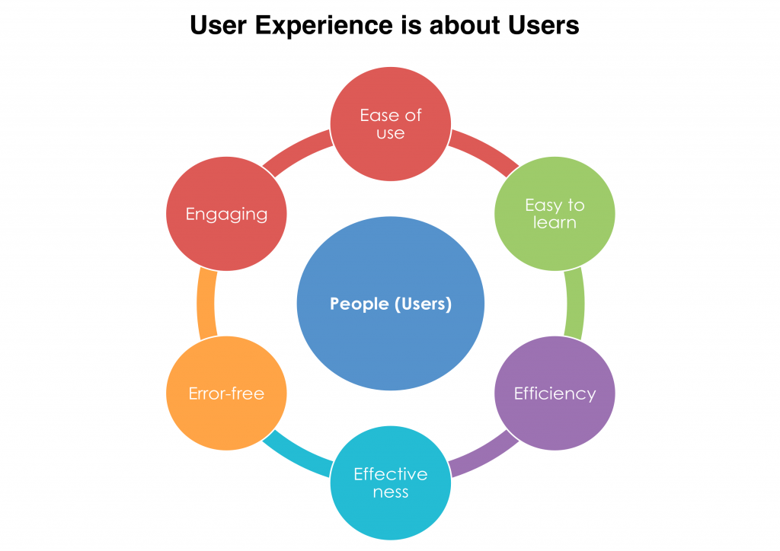
User Experience

Slide 7
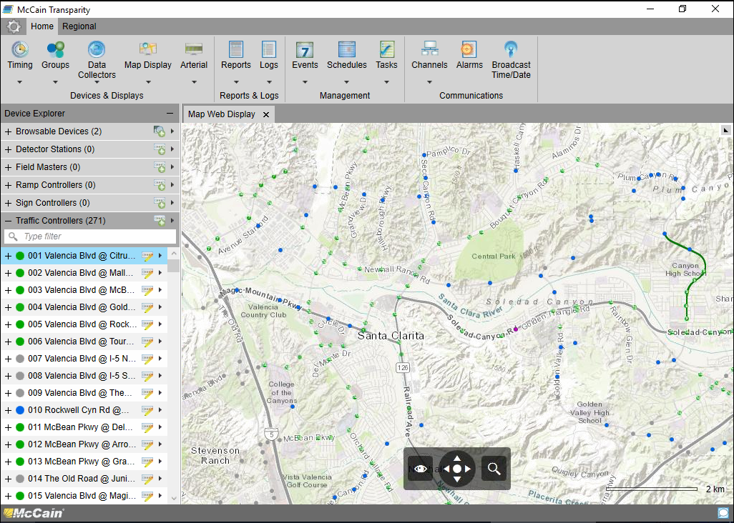
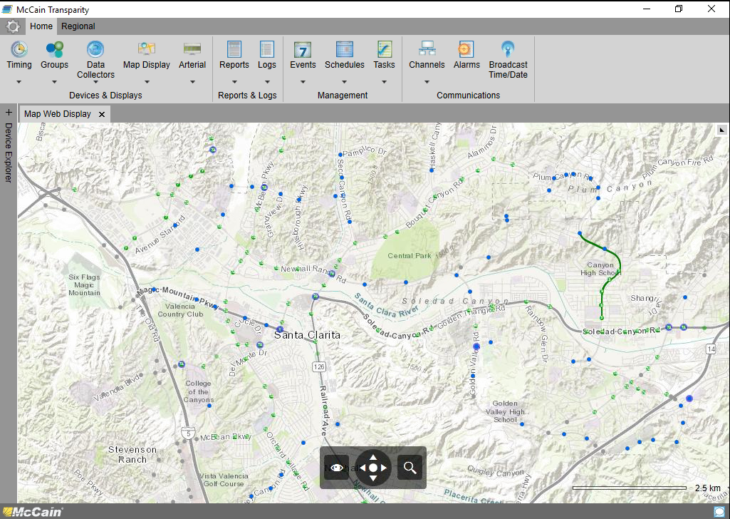

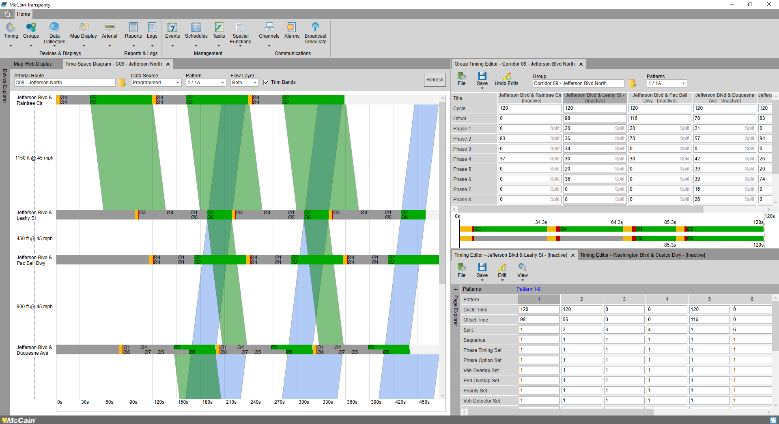
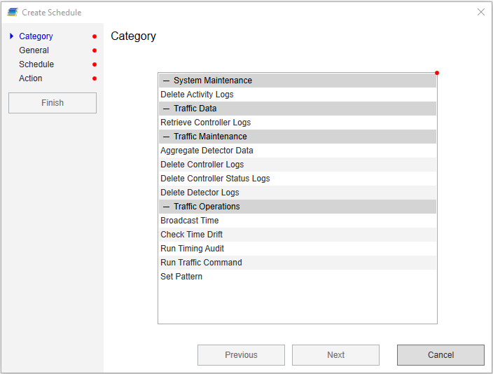
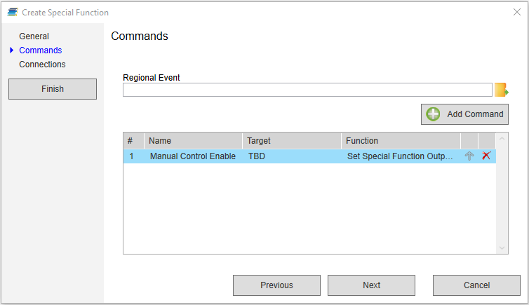
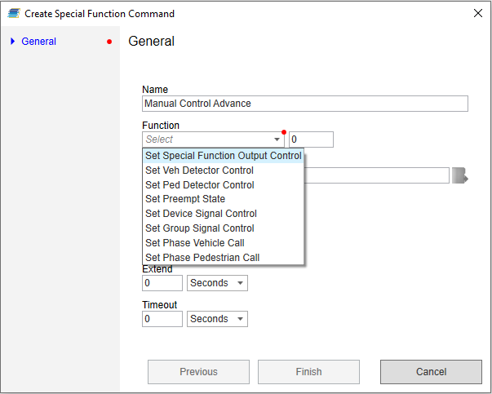
User Interface (GUI)
Simplicity
“Simplicity is the ultimate sophistication”.
Transparity provides a simple user experience via intuitive navigation, configuration wizards, and consistent theming throughout each feature.
Consolidation of Functionality
Transparity Prudently consolidates multiple functions into fewer user interfaces; thus enhancing the usability and Promotes understanding of complex features.
Utilize multiple features in a single view
The docking regions of Transparity enable users to interact with multiple Transparity features without having to manage a multitude of “Floating” windows.
In this manner, the user can simultaneously issue commands, verify the response, and analyze the effect in a single view.
users can easily expand any feature to full screen and re-dock the feature when finished.
Notes:
Before I provide specific training on

Slide 8

Monitor
Status, Information, Alarms, and Notifications

Slide 9
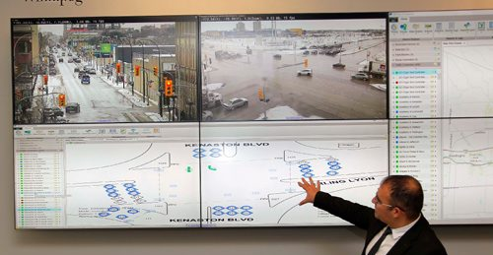
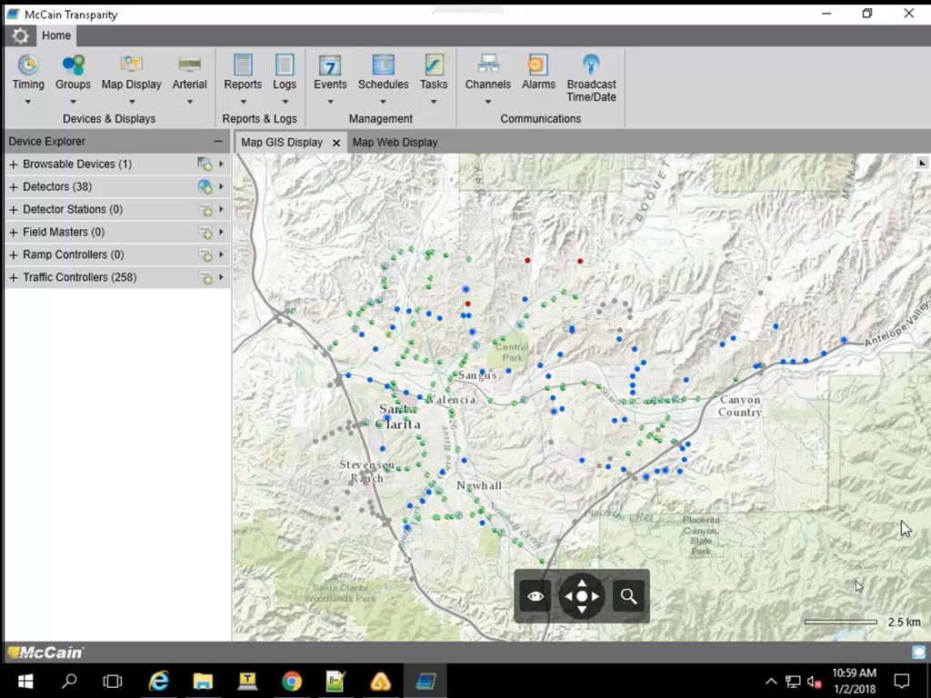
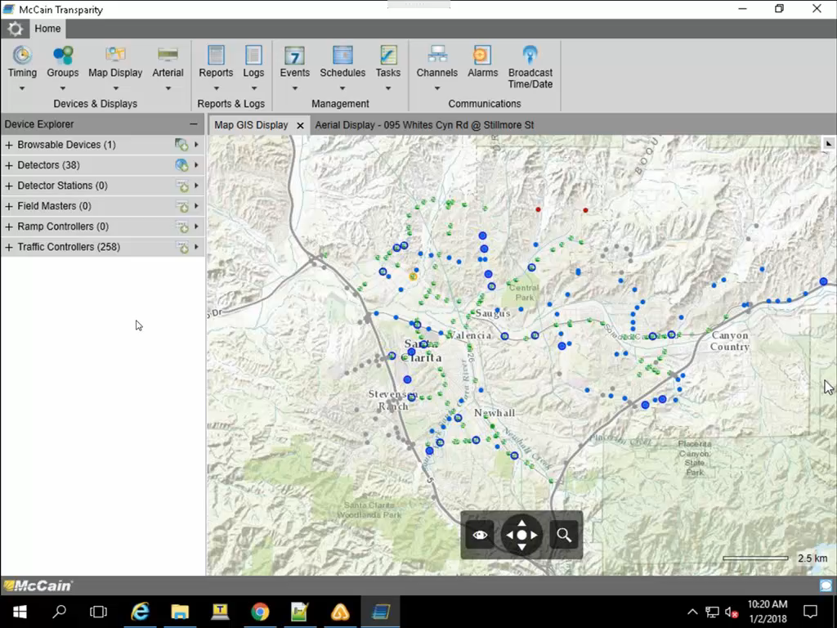
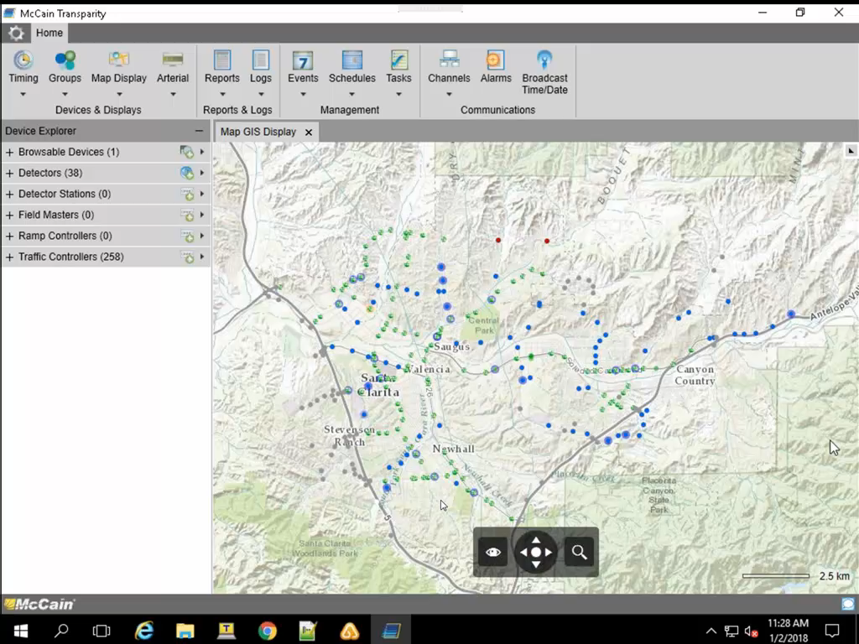
Traffic Controller
Transparity TMS provides users with real-time displays and notifications which reveal:
Active alarms, congestion events, and details of Traffic Controller Operations
“As a System Operator, I need to become aware of changes in traffic conditions, active alarms, and the real-time operational status of each intersection.”
BASIC STATUS - POLLING
EXTENDED STATUS - MESSENGING
EVENT NOTIFICATIONS

Slide 10
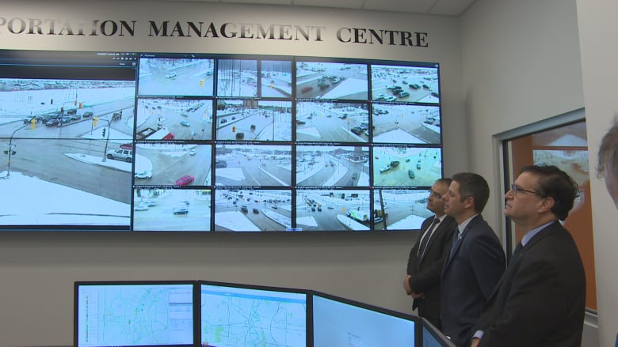
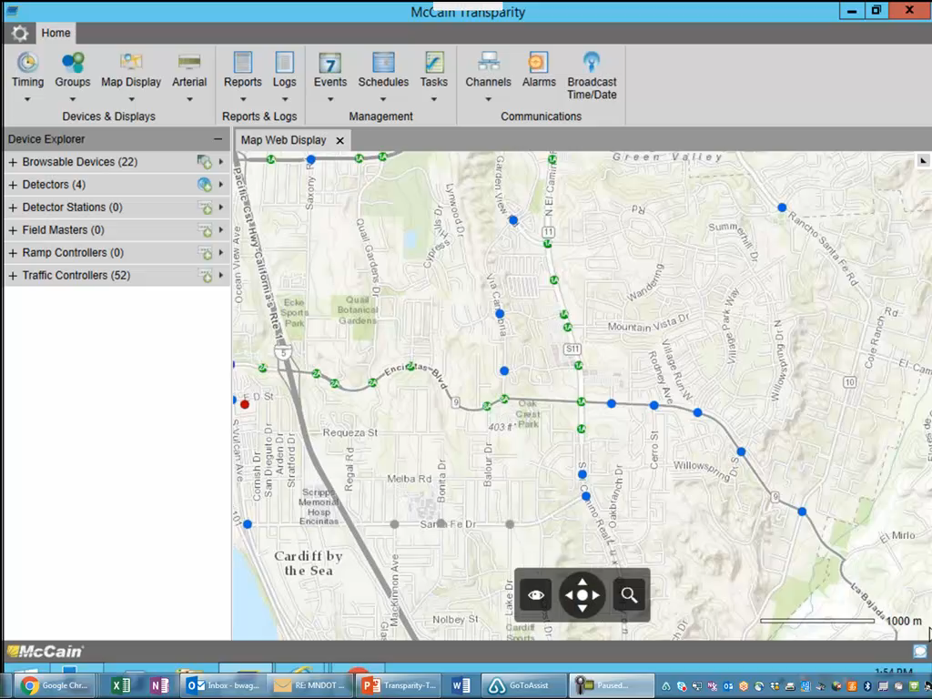





External Systems / Devices
Transparity TMS was designed to consume information from 3rd Party ITS Devices
“As a System Operator, I need a solution that can consume and display data from ITS Devices such as PTZ Cameras, Conflict Monitors, and Travel-Time Systems.
CCTV Camera Systems
Detection Systems / Conflict Monitors
Detection Systems / TRAVEL-TIME DATA

Slide 11

CONTROL
Signal Timing parameters, user intervention, & Advanced Operations.

Slide 12
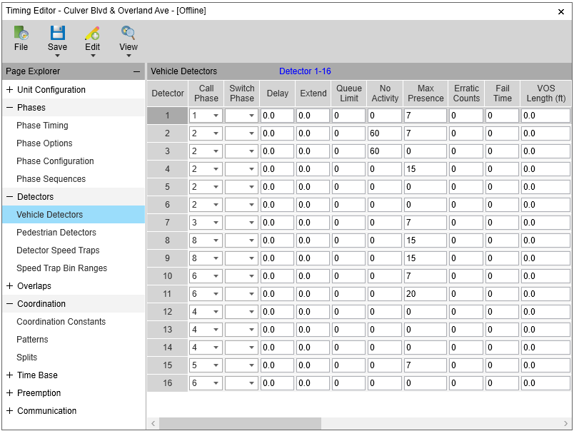
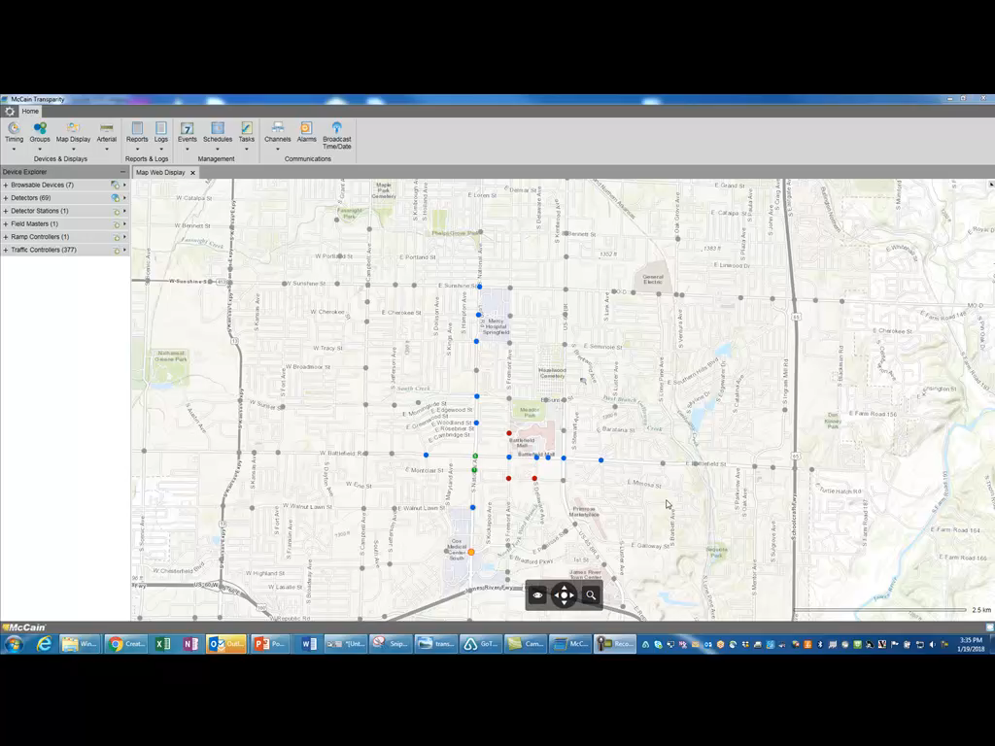
TIMING EDITOR
EASE of USE
intuitive navigation vs. a mess of tabs
Clear means of comparing different sources
Provides feedback to user for validation and confirmation
CREATE, REVIEW, UPDATE, DISTRIBUTE
Transparity timing editor provides a full complement of tools necessary to modify and manage signal timing parameters, including: full database audit, archives, templates, and printable reports.
Management
Audits can be scheduled for automatic comparison
IMPORT / EXPORT for management of offline or newly developed intersections

Slide 13
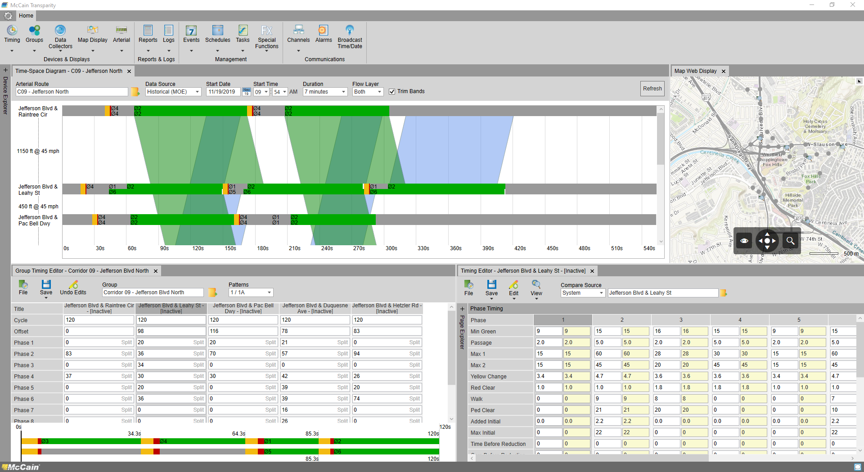
Group TIMING EDITOR
Improve Synchronization
ADJUST COORDINATION PARAMETERS IN A SINGLE VIEW
REVIEW SEQUENCE and PHASE SPLIT DIAGRAM
IMPORT / EXPORT OPTIMIZED timing
Complements Time-Space Diagram
Adjust offsets and refresh the display
Verify, validate, and confirm changes
IMPLEMENT changes in field devices

Slide 14
Special Functions
ACTIVE MANAGEMENT OF OPERATIONS
User DEFINED COMMAND INTERFACE
ISSUE ANY NTCIP COMMAND OBJECT
COMMANDS ARE INITIALIZED VIA:
  User Intervention
  Automatically
  Regional Event
Use CASES
STOP TIME
MANUAL CONTROL / ADVANCED (aka “Remote Pickle”)
PHASE EXTENSION
REMOTE Preemption
Regional Evacuation / Flush Pattern

Slide 15

Adaptive Signal Control
Event/incident coordination
Event and/or Incident driven Coordination overrides existing operations and implements the operational mode assigned to the event or pattern issued by an Integrated Corridor Management System.
Alters Signal Operations
Adaptive coordination
Transparity adaptive can implement operations designed to maximize throughput, equitably distribute green time, implement favored or balanced progression, and/or alter phase sequence.
Mode of Operation
PHASE DURATION / Arterial CYCLE LENGTH
FAVORED DIRECTION OF TRAVEL
FIXED coordination
Improves SIGNAL Synchronization
While Fixed Coordination patterns do not efficiently address uncertain traffic conditions, many have been developed after years of experience and efficiently move traffic during peak hours.
Optimizes offsets between intersections
Characterizes the directional volume and favors flow with highest demand
Peer-to-Peer (P2P) Synchronization
P2P Synchronization offers an innovative approach to signal synchronization by establishing fully actuated coordination via controller-to-controller communication.
Straightforward Integration & Maintenance
Supports all detection technology
Scalable Sophistication (Basic vs Advanced)
SIMPLE Configuration
NO maintenance above and beyond traditional PM
FREE
As traffic demand drops, synchronization is no longer the priority of the arterial system and Free operations can be implemented via user-defined volume thresholds.
Notes:
SCALABLE SOPHISTICATION :
In September of 2014, I participated in my first and last interview with the Union Tribune regarding adaptive signal control systems:
Specifically I shared that ALL adaptive signal control solutions are effective, but there’s a marked different in the sophistication of each.
The point is, we’ve retained the basic mode, but added the ability to increase the level of sophistication and functionality.

Slide 16
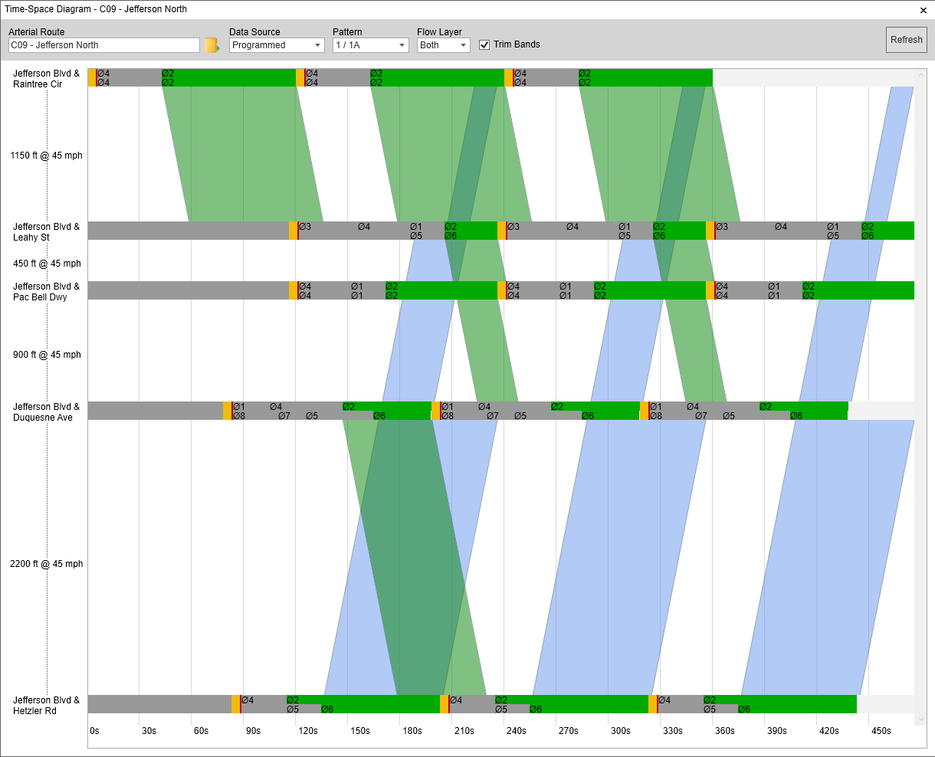
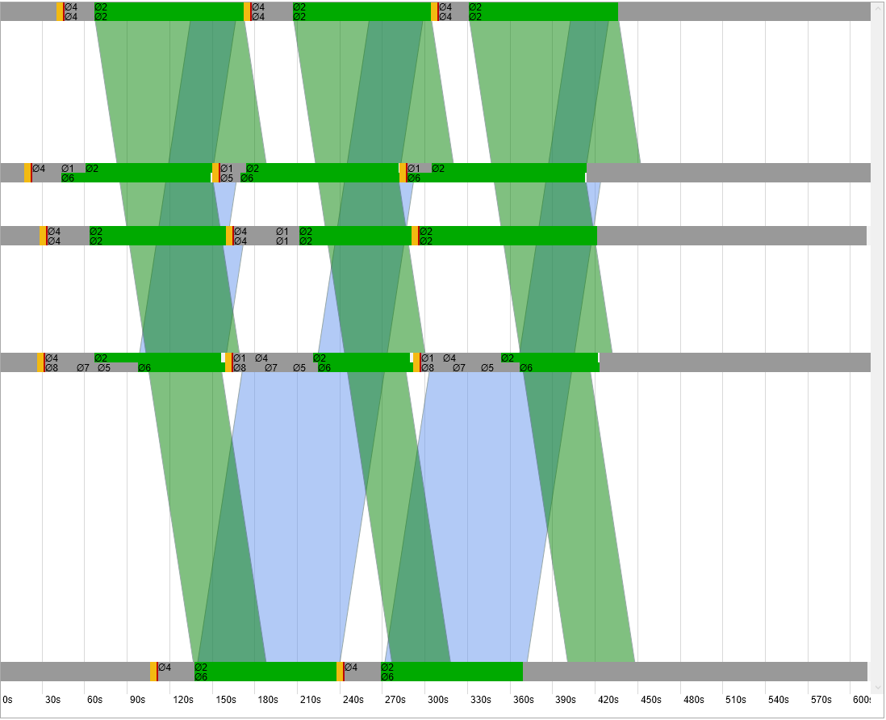
Adaptive Signal Control
Alters Signal Operations
Mode of Operation
PHASE DURATION / Arterial CYCLE LENGTH
FAVORED DIRECTION OF TRAVEL
Improves SIGNAL Synchronization
Optimizes offsets between intersections
Characterizes the directional volume and favors flow with highest demand
Straightforward Integration & Maintenance
Supports all detection technology
Scalable Sophistication (Basic vs Advanced)
SIMPLE Configuration
NO maintenance above and beyond traditional PM
Notes:
SCALABLE SOPHISTICATION :
In September of 2014, I participated in my first and last interview with the Union Tribune regarding adaptive signal control systems:
Specifically I shared that ALL adaptive signal control solutions are effective, but there’s a marked different in the sophistication of each.
The point is, we’ve retained the basic mode, but added the ability to increase the level of sophistication and functionality.

Slide 17
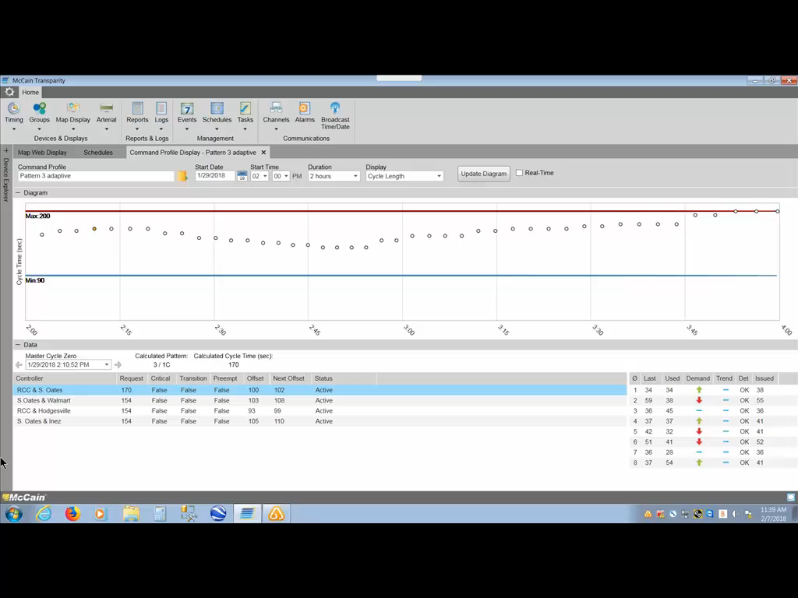
Adaptive Signal Control
Alters Signal Operations
Mode of Operation
PHASE DURATION / Arterial CYCLE LENGTH
FAVORED DIRECTION OF TRAVEL
Improves SIGNAL Synchronization
Optimizes offsets between intersections
Characterizes the directional volume and favors flow with highest demand
Straightforward Integration & Maintenance
Supports all detection technology
Scalable Sophistication (Basic vs Advanced)
SIMPLE Configuration
NO maintenance above and beyond traditional PM
Notes:
SCALABLE SOPHISTICATION :
In September of 2014, I participated in my first and last interview with the Union Tribune regarding adaptive signal control systems:
Specifically I shared that ALL adaptive signal control solutions are effective, but there’s a marked different in the sophistication of each.
The point is, we’ve retained the basic mode, but added the ability to increase the level of sophistication and functionality.

Slide 18

Analyze
Events, arterial bandwidth, & Signal Performance Measures

Slide 19
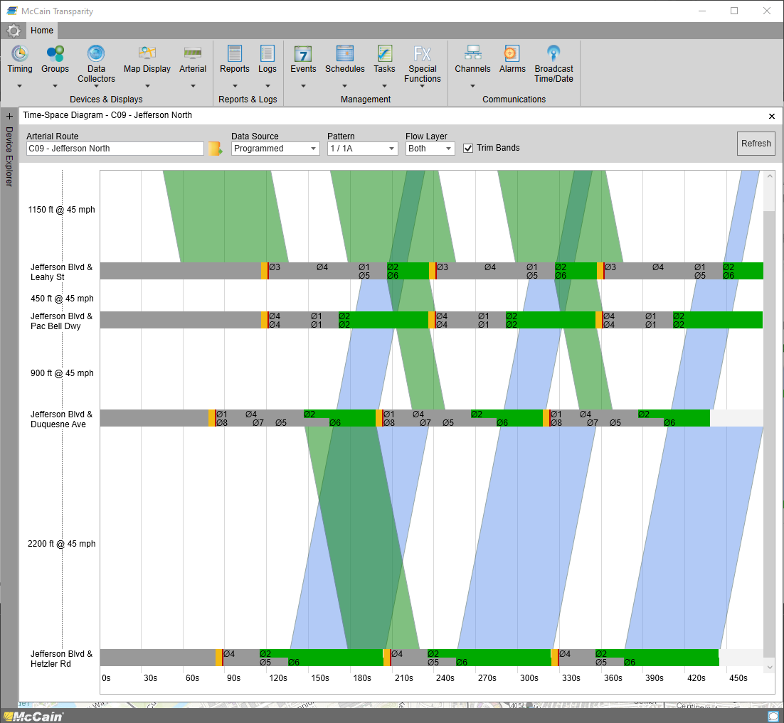
Time Space Diagram
Visualize Arterial GreenBAnd
Real-Time, Programmed, Historical
Trim Bands illustrate stops and restrictions
Compare directional bandwidth
Excellent Engineering Tool
Review imported /optimized Signal timing
Alter system values before field implementation
Validate optimization
Notes:
SCALABLE SOPHISTICATION :
In September of 2014, I participated in my first and last interview with the Union Tribune regarding adaptive signal control systems:
Specifically I shared that ALL adaptive signal control solutions are effective, but there’s a marked different in the sophistication of each.
The point is, we’ve retained the basic mode, but added the ability to increase the level of sophistication and functionality.

Slide 20
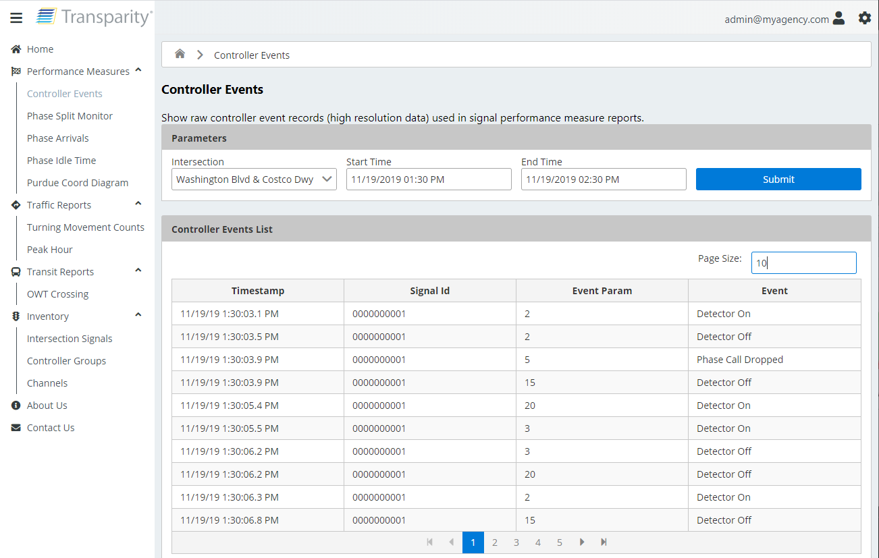
Signal Performance Measures -
High Resolution Events
Event Data
Automated traffic signal performance measures (ATSPM), signal operations, signal retiming, volume counts, turning movement analysis.
Activate Notifications

Slide 21
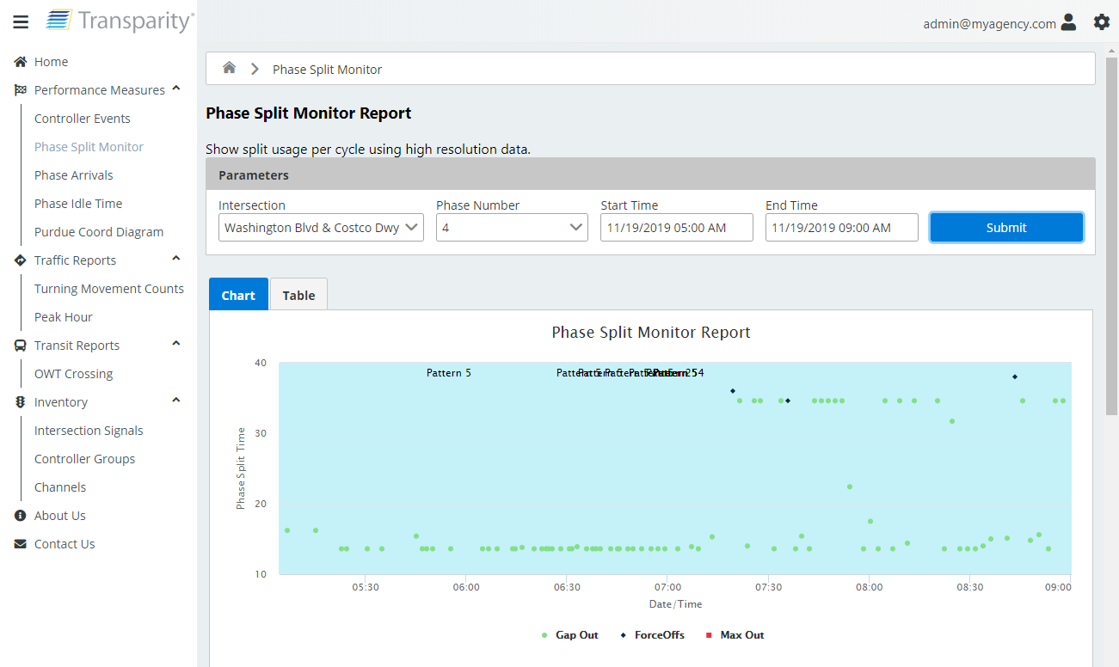
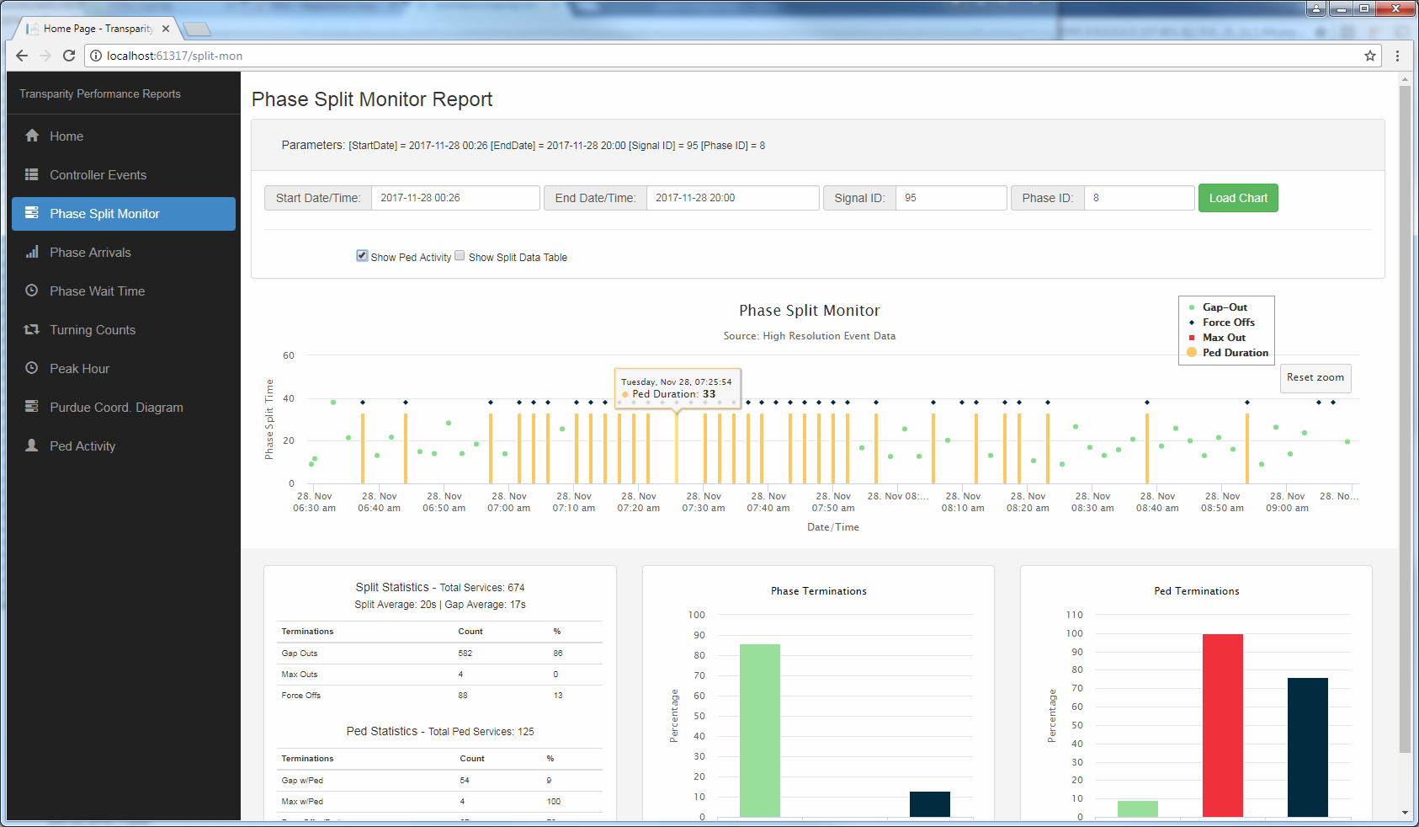
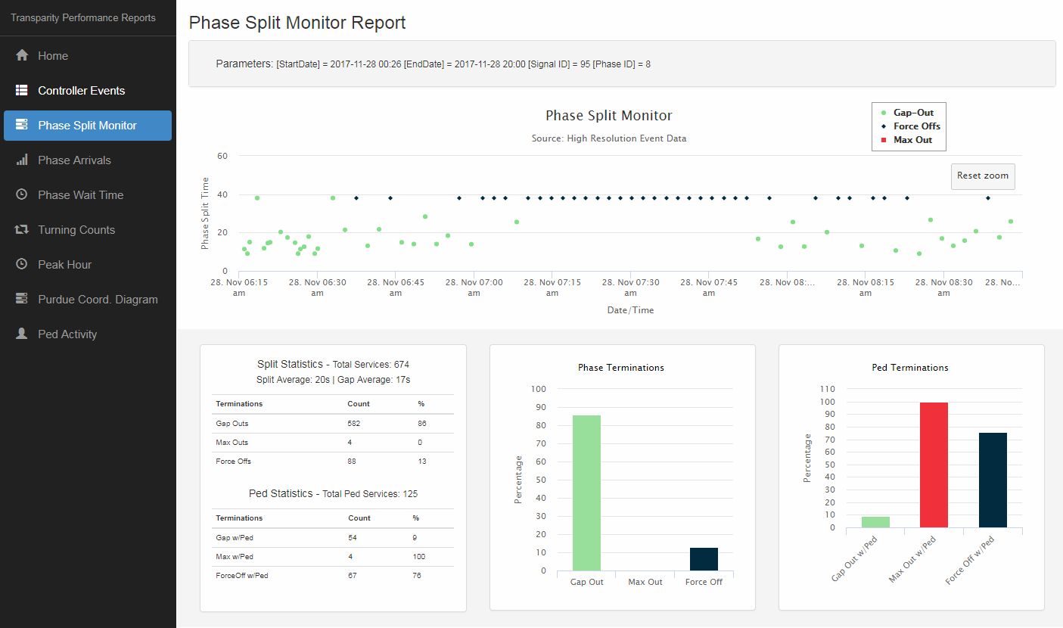
Signal Performance Measures -
SPLIT MONTOR
Duration
The amount of split time used each cycle
AVERAGE GaP-OUT
Reason for Termination
PERCENTAGES
Gap-OUT
MaX-OUT
Force Off
Pedestrian Activity
Pedestrian service / duration per cycle
% of max/FO due to presence of pedestrian
Activate Notifications

Slide 22
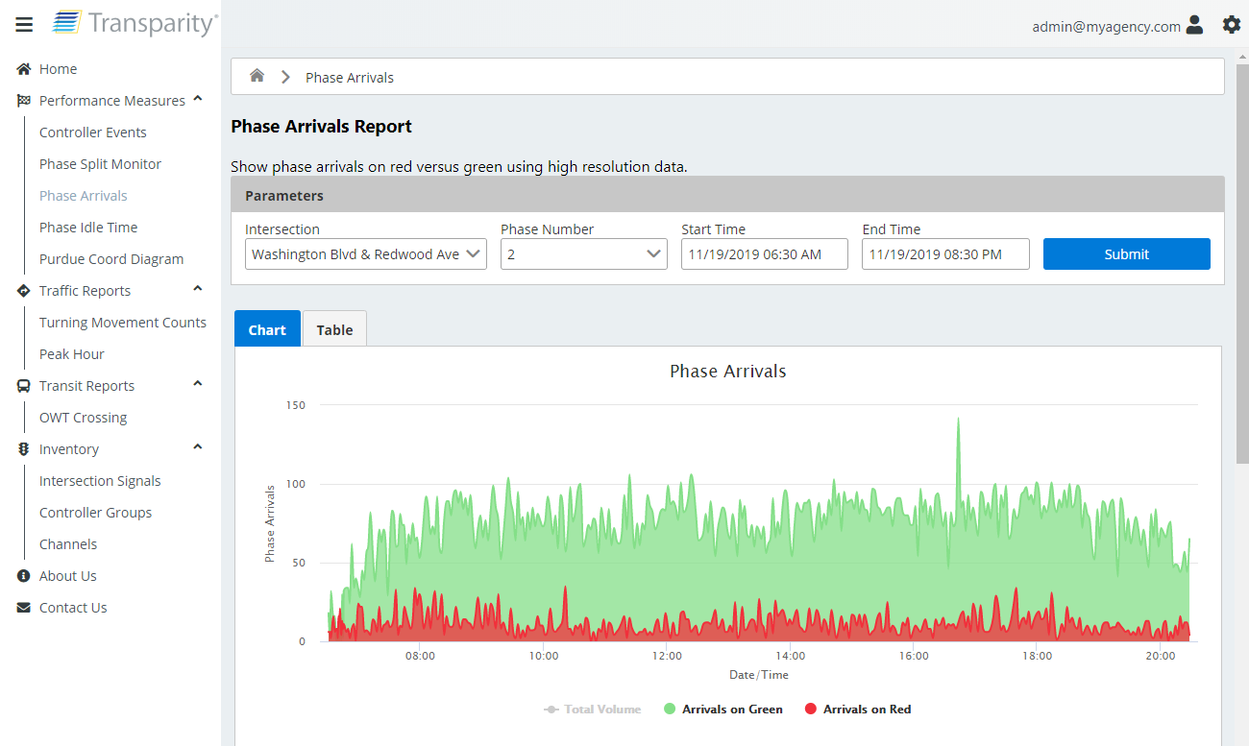
Signal Performance Measures -
Phase Arrivals
Consolidated Approach volumes
Transparity SPM Reports consolidate the total approach volume, arrivals on Green, and Arrivals on RED measures.
Activate Notifications

Slide 23
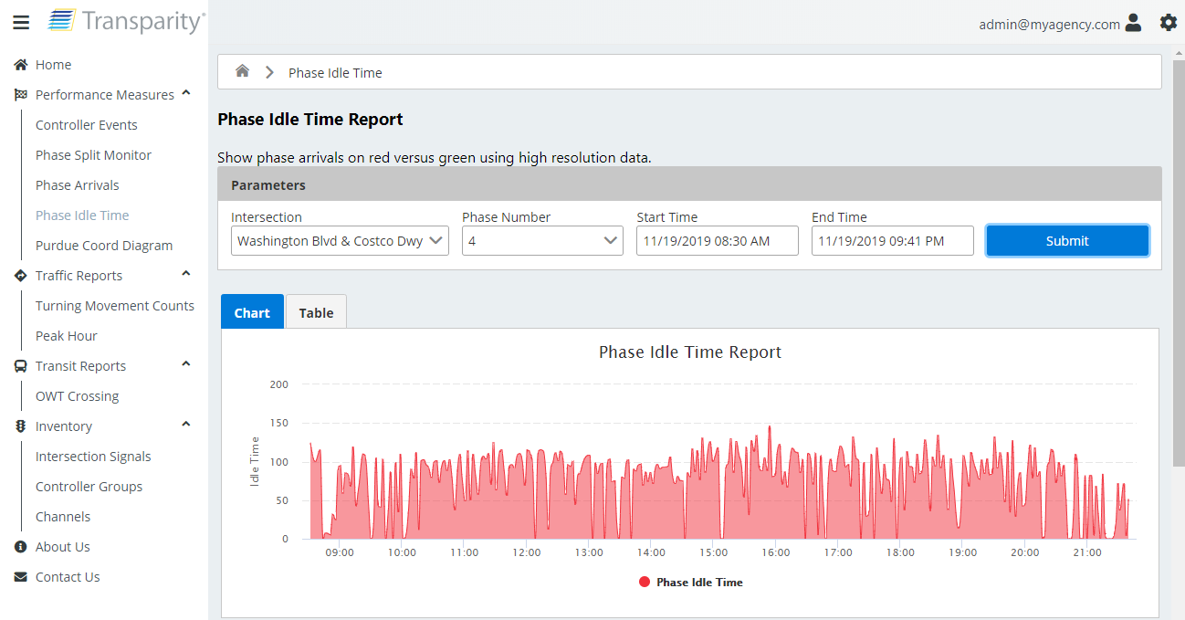
Signal Performance Measures -
Phase IDLE TIME
IDLE TIME VS DELAY
This report is often called “Approach Delay” in Specifications; however, “DELAY” is a specific measure that high-resolution event data cannot capture.
Excellent performance measure for non-coordinated movements

Slide 24
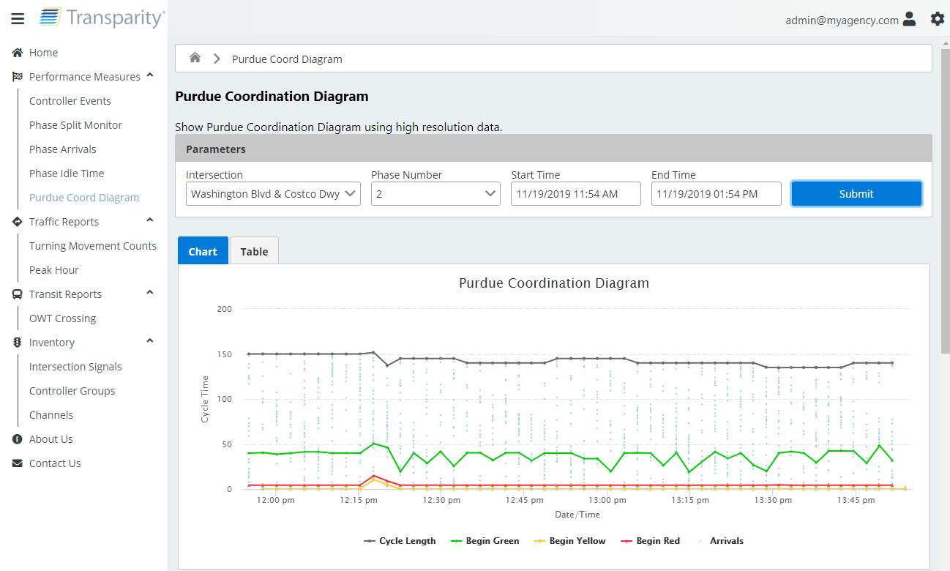

Signal Performance Measures -
Purdue Coordination Diagram
Arrival Performance / Cycle
The Arrival on Green % is calculated for each cycle and summarized for the overall data set
Visual Indication of Offset Efficiency
The user can easily identify issues with offset via the visual representation of the platoon/detector actuations
PHASE SPLIT % VS ARRIVALs on Green
A Measure of Split Efficiency called Platoon Ratio
Activate Notifications

Slide 25
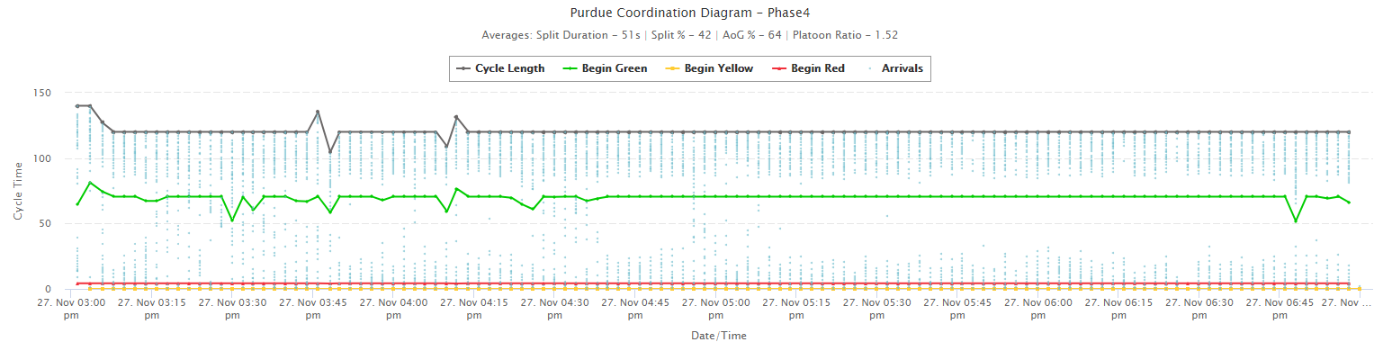

Slide 27
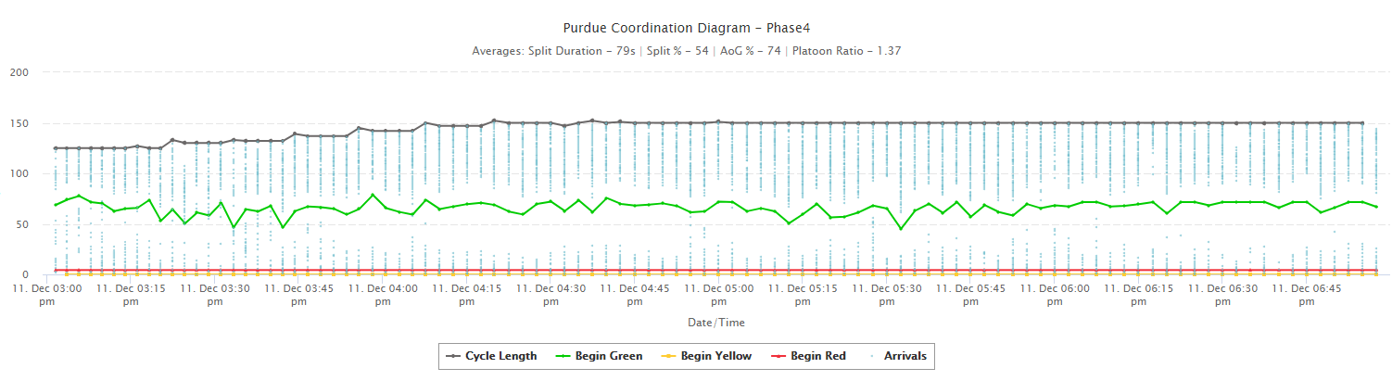

Slide 29

Distribute
Functionality, Real-time Status, & Event Information

Slide 30
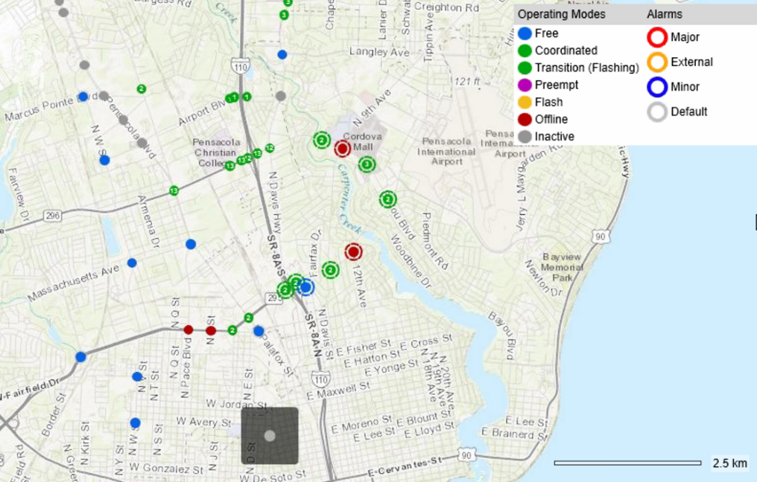



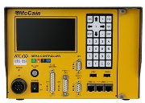
REGIONAL SYSTEM OVERVIEW
Regional Hub
C 2 C Service
C 2 C Service
C 2 C Service
Field Communication Service
Field Communication Service
Field Communication Service
NTCIP
NTCIP
NTCIP
NTCIP
NTCIP
NTCIP
ATC eX 2070
ATC eX 2070
ATC eX 2070
1
2
3
A
1
2
3
A
4
5
6
B
1
2
3
A
4
5
6
B
7
8
9
C
4
5
6
B
7
8
9
C
0
F
E
D
7
8
9
C
0
F
E
D
Model 2070 LX
NEMA
0
F
E
D
Model 2070 LX
Model 2070 LX
NEMA
NEMA
30

Slide 31










INTER-AGENCY SYSTEMS
REGIONAL SYSTEMS
CONNECTED VEHICLE APPLICATIONS
1
2
3
CONNECTED
VEHICLE
APPLICATIONS
EMERGENCY
OPERATIONS
PERFORMANCE
MEASURES
DATABASE
MANAGEMENT
ICMS APPLICATIONS
CENTER-TO-CENTER
SERVICES
CENTER-TO-FIELD
COMMUNICATION
Transparity
Traffic Management System
PARKING
SYSTEM
INTEGRATION
PUBLIC
TRANSPORTATION
EVENT
NOTIFICATION SERVICES
SIGNAL
OPERATIONS
& TIMING
P
1
2
3
4
AVL SYSTEM INTEGRATION
HI-RES DATA
PARKING SYSTEM INTEGRATION
P
P
P

Slide 32

any questions?
www.mccain-inc.com
info@mccain-inc.com
(760) 727-8100

