Slide 1

TRANSPARITY TMS, SPM, and Adaptive
An EMPOWER Series Product Sales Training
Brian Wagner
Project Manager – TMS
3/24/2022

Slide 2

AGENDA
Empower exploratory conversations to match customer needs with readily available solutions.
Transparity TMS Overview
Feature Strengths & Use Cases
Signal timing editor (navigation, audit, compare)
Special functions
Adaptive operations
Signal Performance Measures
Center-to-Center / ICMS
Upcoming enhancements
Cloud-Hosted Transparity

Slide 3
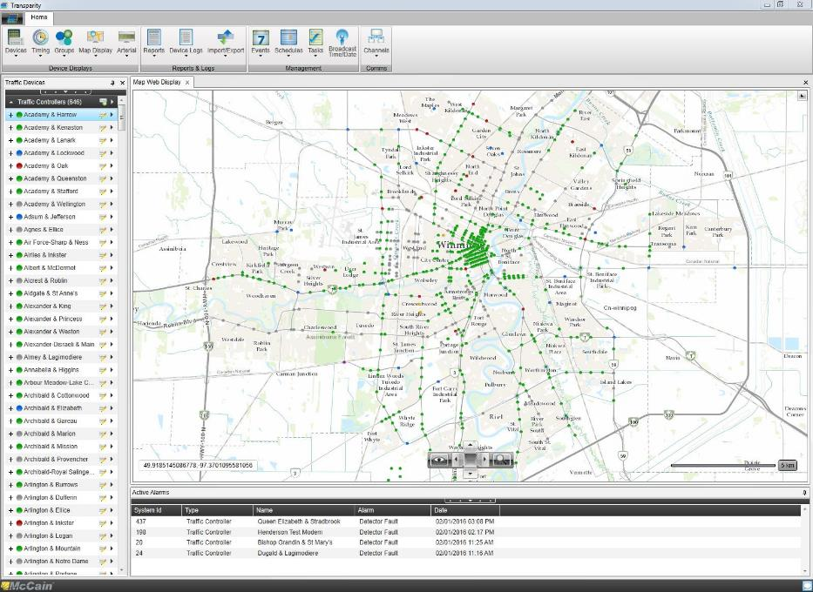
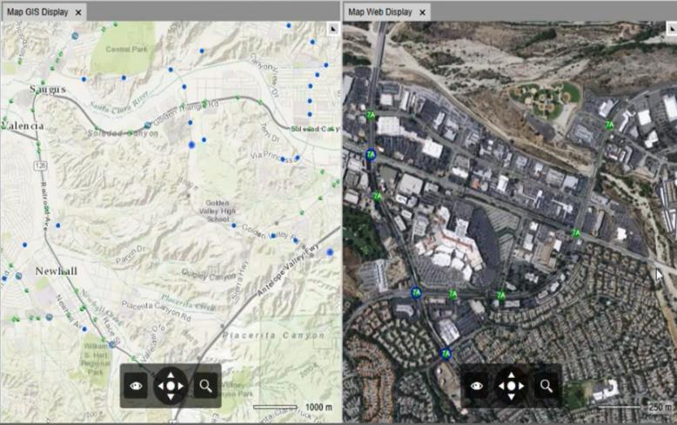
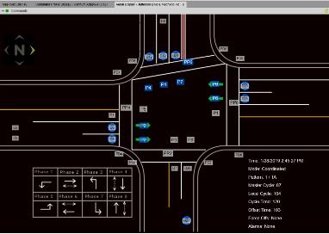
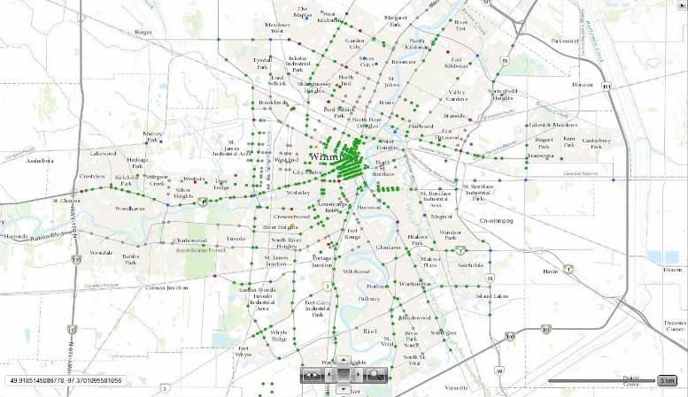
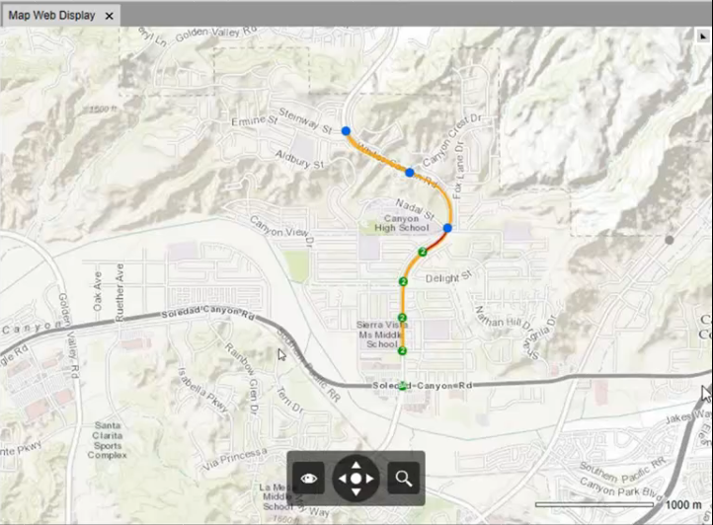
TransparITY TMS – Traffic Controller Management FEATURE OVERVIEW
Monitoring
Alarm status monitoring
Operational status
Real-time signal status
Event logs and reports
Traffic conditions
Control
Timing parameter management
Command operational modes/patterns
Advanced operations
Special Functions Interface
Remote control
Traffic Responsive
Several pending implementations
Often overlooked as a viable solution
Excellent for activating P2P
Traffic Adaptive
10 corridors in Culver City running every day
Notes:
Navigation
Organized in a fashion similar to the Omni eX front panel (Categorization)
Pages
Hides unused phases, overlaps, detectors, and features (managed by Controller configuration)
For example, newly added feature “Red Light Protect” will only appear on relevant intersections
Parameters
Range validation
Controller validation
Side by Side comparison
Colorized differences

Slide 4
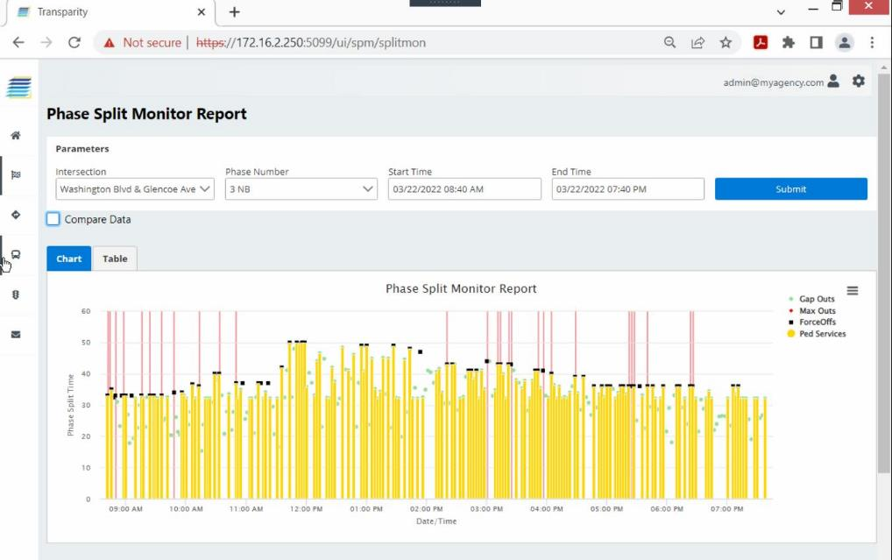
TransparITY TMS – Traffic Controller Management FEATURE OVERVIEW
Analyze
Signal Performance Measures
Review all event data
Supports ALL Hi-Resolution Events
Interactive charts
Enhances user experience
Consolidated phase analysis
Enables decision making
Table views for export
Extensibility
MyCity SPA (coming soon!)
System Integration
ICMS Applications
Proven standards compliant interface
Reduces project risk
An enabler for system upgrades
Center-to-Center
More and more opportunities in regional systems
Notes:
Does Center-to-Center justify its own market training.

Slide 5
Feature Strengths & Use cases
Signal timing editor (navigation, audit, compare)
Special functions
Adaptive operations
Signal Performance Measures

Slide 6
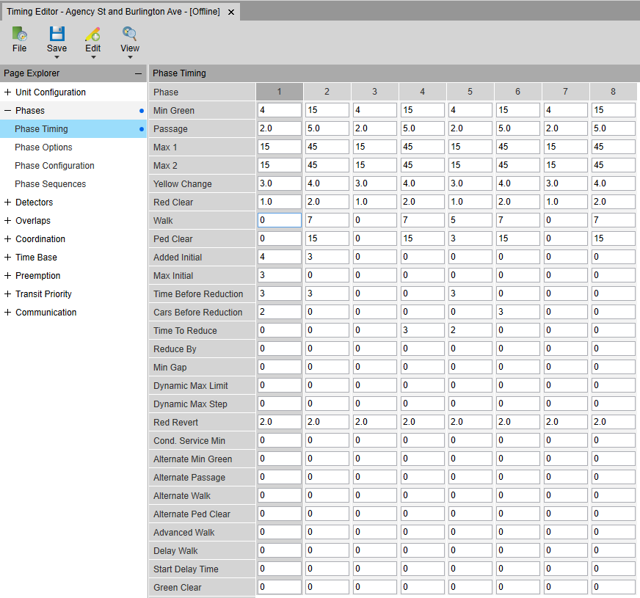
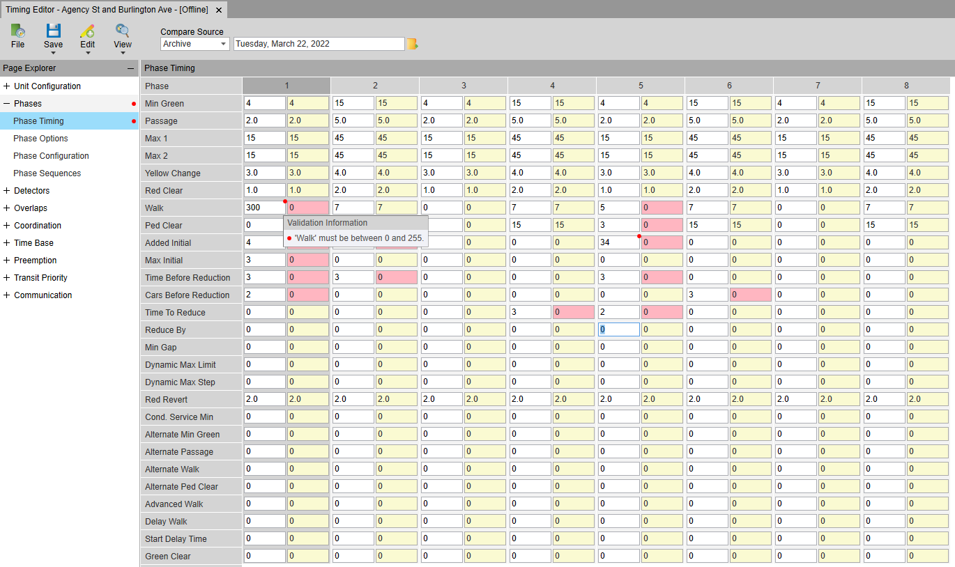
TransparITY TMS – Traffic Controller Management Signal Timing Management
Problem Statement: Remotely changing signal timing parameters is stressful as there are many opportunities for an error (human or technology) that will affect traffic conditions.
Use Case: As a traffic engineer, I need an interface that enables confident remote management of signal timing parameters.
Solution:
Intuitive Navigation
Clear comparison of Controller & Central DB
Timing archives with description of changes
Import / Export for offline controllers
Hide unused parameters
Phases
Detectors
Overlaps
Schedules
Features
Notes:
Navigation
Organized in a fashion similar to the Omni eX front panel (Categorization)
Pages
Hides unused phases, overlaps, detectors, and features (managed by Controller configuration)
For example, newly added feature “Red Light Protect” will only appear on relevant intersections
Parameters
Range validation
Controller validation
Side by Side comparison
Colorized differences

Slide 7
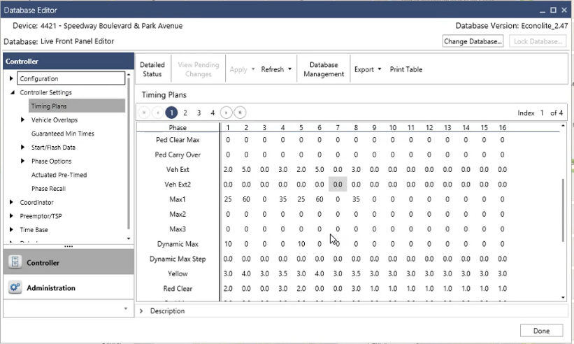
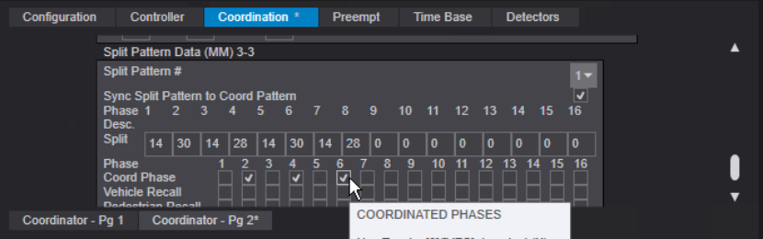
TransparITY TMS – Traffic Controller Management Timing editor – Competitor Examples
Notes:
Navigation
Organized in a fashion similar to the Omni eX front panel (Categorization)
Pages
Hides unused phases, overlaps, detectors, and features (managed by Controller configuration)
For example, newly added feature “Red Light Protect” will only appear on relevant intersections
Parameters
Range validation
Controller validation
Side by Side comparison
Colorized differences

Slide 8
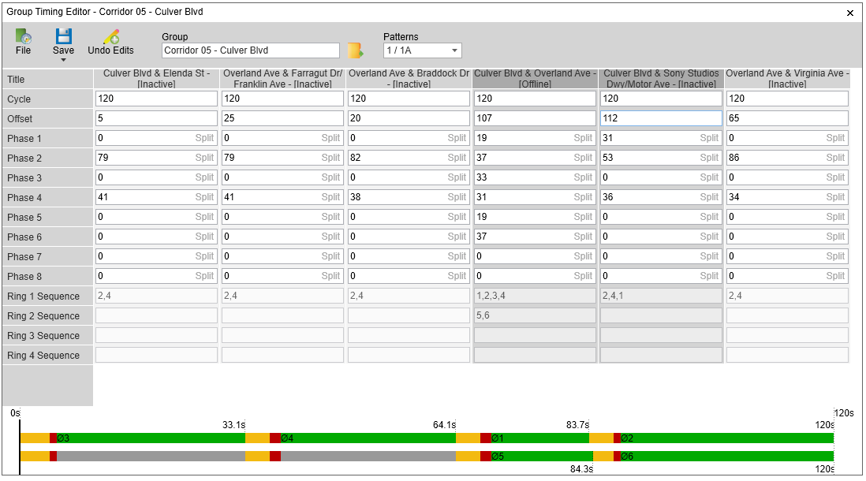
TransparITY TMS – Traffic Controller Management Signal Timing Management
Problem Statement: It’s difficult to manage the coordination parameters of multiple intersections.
Use Case: As a user, I need an interface that allows me view, edit, and/or import optimized timing parameters for a synchronized group of intersections.
Solution: Group Timing Editor
Cycle Length
Offset
Phase Splits
Sequence / Split Diagram
Opens when importing UTDF data from external
optimization tools (i.e. Synchro).

Slide 9
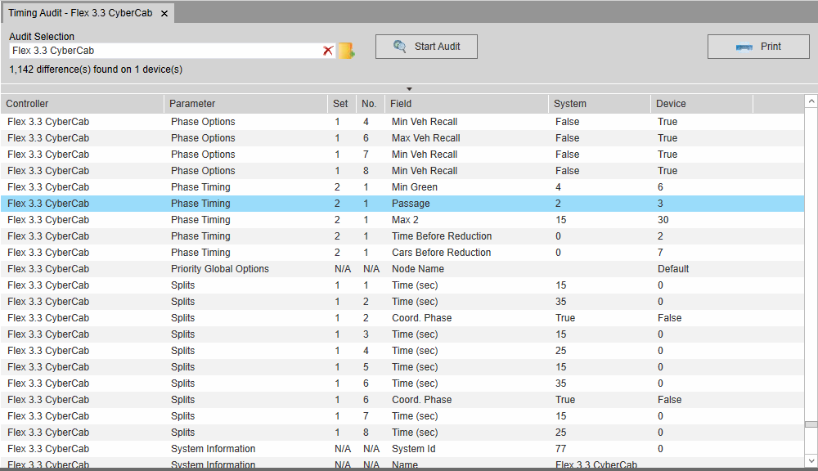
TransparITY TMS – Traffic Controller Management Signal Timing Management
Problem Statement: When the local controller timing doesn’t match the central system, the operation of the intersection and/or reporting to external systems is out of sync with the intended operations>
Use Case: As an engineer, I need to know when changes in the field have taken place and an interface to resolve the discrepancy between local controller timing and the central system database.
Solution: Signal Timing Audit / Comparison
On Demand
Scheduled with notification
Launches Side-by-Side comparison
Visual indication of mismatches
Corrective measure thereafter
Field modifications
Automatic audit with notification

Slide 10
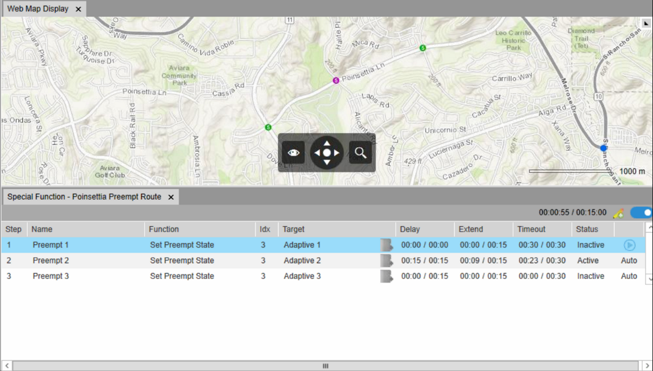
TransparITY TMS – Traffic Controller Management SPECIAL FUNCTIONS
Problem Statement: Special events and abnormal traffic events require active management of signal operations.
Use Case: As a system operator, I need to be able to override standard operations and issue specific NTCIP commands to address specific traffic control measures.
Solution: Special Functions
Remote Pickle
Manual Control Enable
Manual Advance
Remote Preempt Route
Multiple Intersections
Automatic cascade with delay
Virtual Detector
Extend phase duration
Remote StopTime
“Yeah, I know”

Slide 11

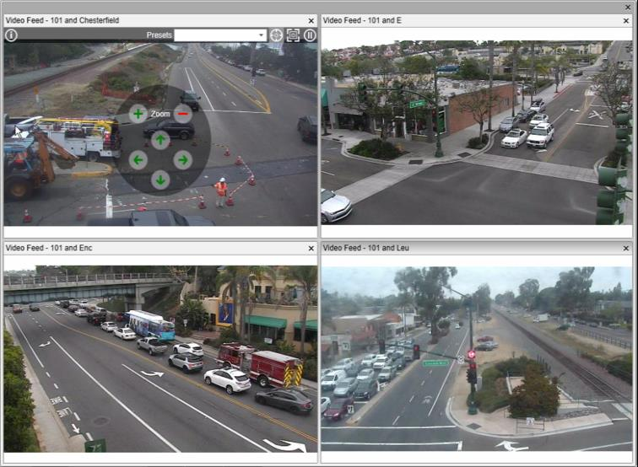
TransparITY TMS – Traffic Controller Management CCTV / Video Detection Feeds
Problem Statement: Visual confirmation of traffic conditions requires support of video from field devices.
Use Case: As a system operator, I need to be able view a live video feed from the intersection(s) that I am actively managing.
Solution: Digital Spectrum Integration
View Live Streams
CCTV
Video Detection
Pan, Tilt, Zoom
Activate Presets
View Camera Info

Slide 12
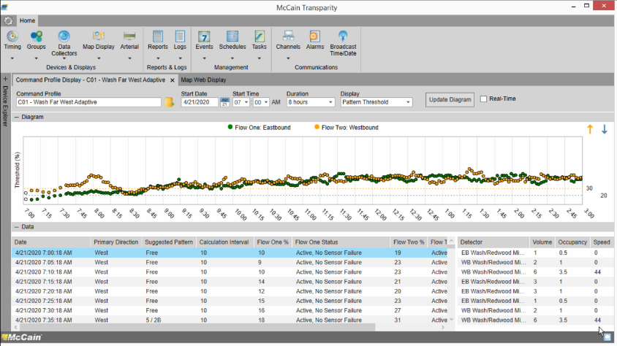
TransparITY TMS – Traffic Controller Management ADAPTIVE SIGNAL CONTROL
Problem Statement: Traditional retiming efforts only address snapshots of peek hour traffic conditions, are expensive, and increase the project management workload of the agency.
Use Case: As a traffic engineer, I need the traffic controllers to automatically assess traffic conditions and re-time signal coordination parameters to meet the prevailing needs. The solution shall allow supporting staff to clearly understand the decision and outcome of the automatic re-timing.
Solution: Transparity Adaptive Signal Control operations.
Evaluates conditions > select operational mode
Free, Peer-to-Peer, Adaptive, TOD coordination
Measure split utilization > trend > request
Determine optimal cycle length
Measure directional volume
Apply equitable favor to heavy direction
Culver City – 10 corridors running adaptive daily

Slide 13
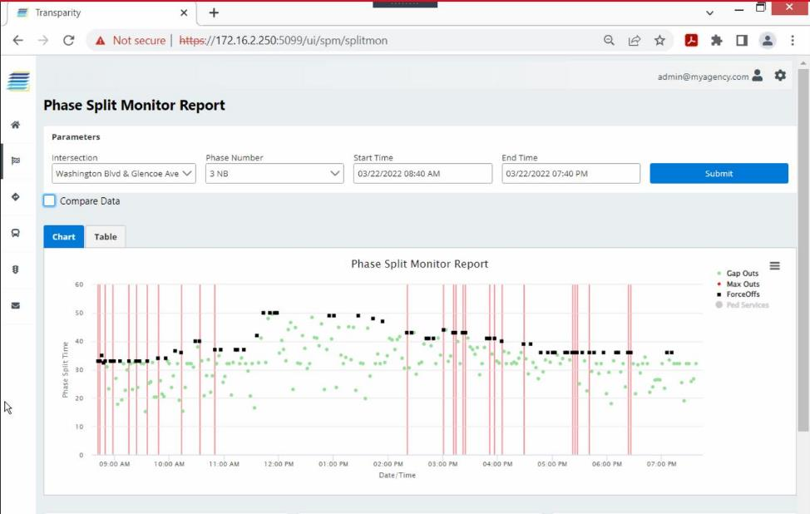
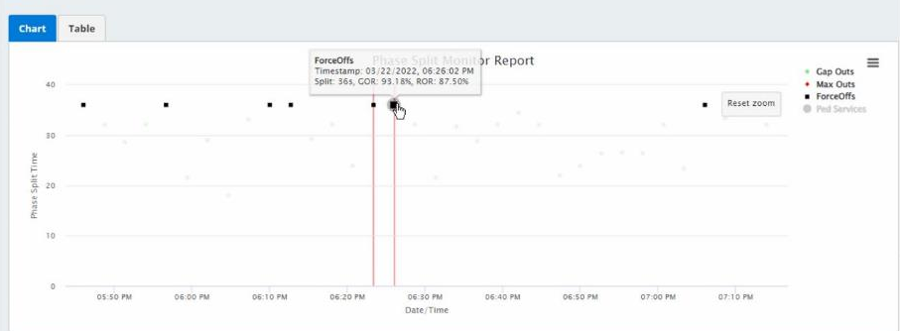
TransparITY TMS – Traffic Controller Management Signal Performance Measures
Problem Statement: Traditional traffic controller data does NOT enable the analysis of signal timing effectiveness.
Use Case: As a traffic engineer, I need the ability to regularly and remotely review the details of signal timing operations and identify the benefits of changes and/or specific operations.
Solution: Transparity SPM Reports
Hi-resolution event data is collected 24hrs/day
Key measures: AoG, Wait Time, Split Failure
Deeper insights than status quo ATSPM reports
Significantly improves operational efficiency
Included as a core feature in Transparity

Slide 14
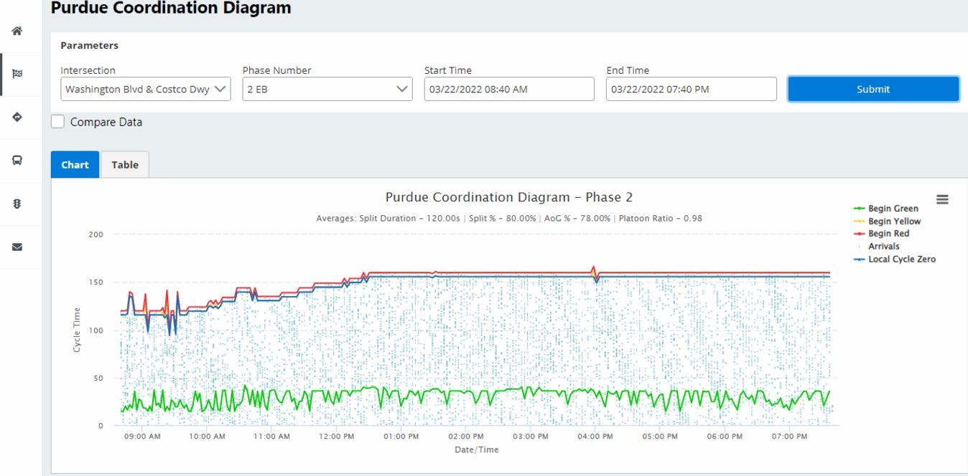
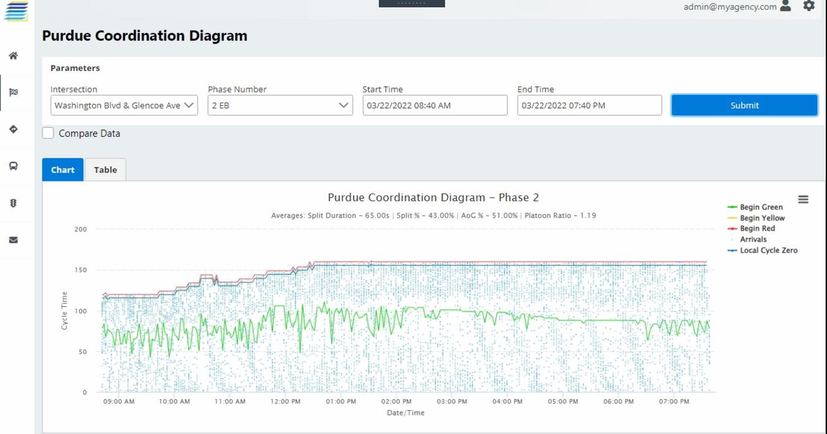
TransparITY TMS – Traffic Controller Management Signal Performance Measures

Slide 15

UPCOMING
Proposed Transparity features
Real-time split monitoring
User change tracking
Additions to Aerial display
MyCity SPA
Additional performance reports
Automatic analysis and notifications
Email, SMS / Text , Push Notifications / Mobile Popups
Performance Dashboards
Floating Car Data
Enables assessment of advanced operations
Value-added feature in product portfolio

Slide 16
Join us for the next empower Series Session
MyCity SPA
Thursday, May 12th
10 am PDT
Visit go.mccain-inc.com/empower-series to register

Slide 17
Questions?
Brian Wagner, Project Manager - TMS
bwagner@mccain-inc.com
(760) 734-5033

